Slide 1
Anatomy & Physiology of Pancreas
Dr Reshmy K.R
Professor
Dept. of Physiology
SKHMC

Slide 2
Duodenum and Pancreas

Slide 3
The Pancreas
The pancreas is both an endocrine gland and
exocrine gland.
An accessory organ, the pancreas is important to the digestive process because it produces a broad spectrum of enzymes
These enzymes break down all categories of foodstuffs, which the pancreas then delivers to the duodenum
This exocrine product is called pancreatic juice

Slide 4
The islets of Langerhan are endocrine and the acinar cells form the exocrine portion.

Slide 5
pancreas is a soft, tadpole-shaped gland that extends across the abdomen
Most the pancreas is retroperitoneal and lies deeper to the greater curvature of stomach
Pancreatic juice drains from the pancreas via the centrally located main pancreatic duct

Slide 7
Pancreas
Anatomy
Endocrine
Pancreatic islets produce insulin and glucagon
Exocrine
Acini produce digestive enzymes
Regions: Head, body, tail
Secretions
Pancreatic juice (exocrine)
Trypsin
Chymotrypsin
Carboxypeptidase
Pancreatic amylase
Pancreatic lipases
Enzymes that reduce DNA and ribonucleic acid

Slide 8
Pancreatic Juice
Approximately 1200 to 1500 ml of clear pancreatic juice is produced daily
It consists mainly of water and contains enzymes and electrolytes
The acinar cells produce the enzyme rich pancreatic juice
The epithelial cells lining the smallest pancreatic ducts release the bicarbonate ions that make it alkaline (pH 8)

Slide 9
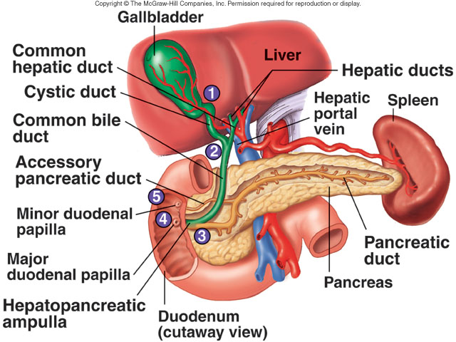
PANCREAS
The pancreas is divided into a head, body, and tail and is connected to the duodenum via the pancreatic duct (duct of Wirsung) and accessory duct (duct of Santorini).
Pancreatic islets (islets of Langerhans) secrete hormones and acini secrete a mixture of fluid and digestive enzymes called pancreatic juice.

Slide 10
duct system of pancrease
The common hepatic duct and the cystic duct fuse to form the bile duct

Slide 11
The Pancreas
Within the pancreas are the acini, clusters of secretory cells surrounding ducts

Slide 12
The Pancreas
The acini cells are full of rough endoplasmic reticulum and exhibit deeply staining zymogen granules containing digestive enzymes

Slide 13
The pancreatic duct generally fuses with the bile duct just as it enters the duodenum
A smaller accessory pancreatic duct empties directly into the main duct

Slide 14
The Pancreas
The pancreas also has an endocrine function
Scattered amidst the acini are the more lightly staining pancreatic islets

Slide 15
The Pancreas
These Islets of Langerhans release insulin and glucagon, hormones that regulate carbohydrate metabolism

Slide 16
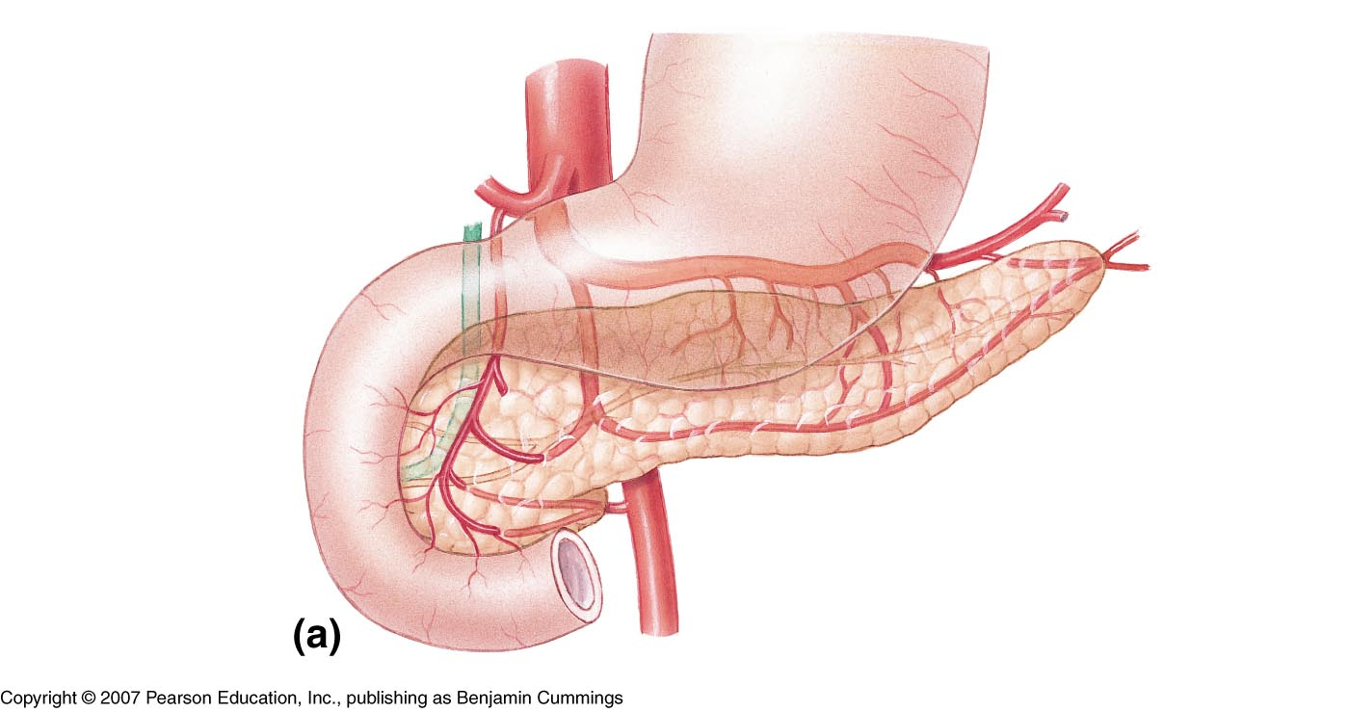
Pancreatic & bile ducts
Common bile duct
Accessory pancreatic duct
Stomach
Head
Pancreatic duct
Tail
Body

Slide 17
Pancreas:
Pancreatic juice consists of a bicarbonate solution containing salts and digestive enzymes.
Bicarbonate helps buffer acidic chyme from the stomach

Slide 18
the pancreatic juice, produced by the acinar cells, moves from the pancreas to the duodenum in the pancreatic duct
Pancreatic juice consists mainly of water, enzymes, and bicarbonate ions.
The pH is alkaline which helps to neutralize the acid chyme.

Slide 19
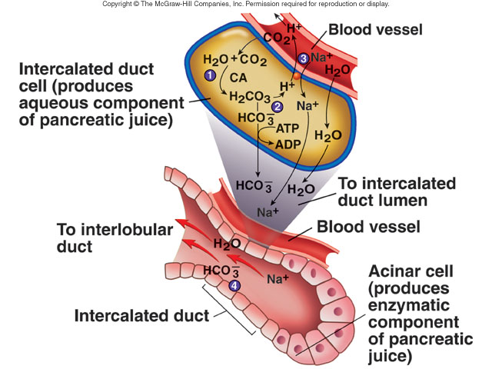
Bicarbonate Ion Production

Slide 20
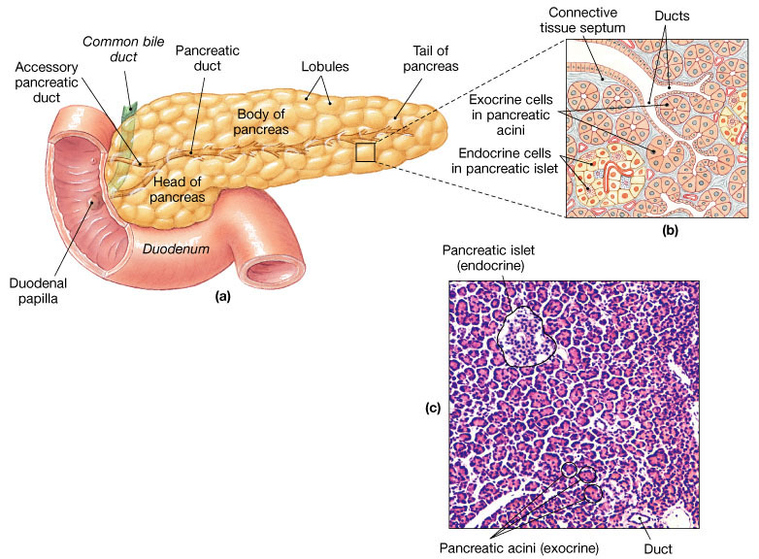
The Pancreas
Pancreatic duct penetrates duodenal wall
Endocrine functions - insulin and glucagons
Exocrine functions
Secretes pancreatic juice secreted into small intestine which breaks down all categories of foodstuff
Acini (clusters of secretory cells) contain zymogen granules with digestive enzymes

Slide 21
Composition of Pancreatic Juice
Produces 1.2L to 1.5L of pancreatic juices daily.
Water solution of enzymes and electrolytes (primarily HCO3–)
Neutralizes acid chyme
Provides optimal environment for pancreatic enzymes
Enzymes are released in inactive form and activated in the duodenum
Examples include
Trypsinogen is activated to trypsin
Procarboxypeptidase is activated to carboxypeptidase
Active enzymes secreted
Amylase, lipases, and nucleases
These enzymes require ions or bile for optimal activity

Slide 22
Pancreas
Pancreatic juice – mixture of enzymes & buffers (sodium bicarbonate) secreted by acinar cells into pancreatic duct & released into duodenum
pancreatic amylase
Starch maltose
pancreatic lipase
Lipids fatty acids + monoglycerol
proteases (trypsin, chymotrypsin, carboxypeptidase)
Proteins & polypeptides small peptides tri & dipeptides
Nuclease – digest RNA & DNA
sodium bicarbonate – neutralizes acidic chyme because enzymes in small intestine need an alkaline pH

Slide 23
Proteolytic enzymes of Pancreatic Juice
Trypsin
proteins proteoses, polypeptides
Chymotrypsin
proteins polypeptides
carboxypeptidase
polypeptides Aminoacids
RNA,DNA trypsin Mononucleotides
Trypsin
Chymotrypsin
Carboxypeptidases

Slide 24
The Pancreas
The high pH enables pancreatic fluid to neutralize the acid chyme entering the duodenum
It also provides the optimal environment for activity of intestinal and pancreatic enzymes
Like pepsin of the stomach, pancreatic protein digesting enzymes are produced and released in active forms, which are then activated in the duodenum

Slide 25
The Pancreas
Within the duodenum trypsinogen is activated to trypsin by enterokinase an intestinal brush border enzyme
Trypsin in turn activates two other pancreatic enzymes
Procarboxypeptidase to carboxypeptidase
Chymotrypsinogen to chymotrypsin
Other pancreatic enzymes (amylase, lipase, and nucleases) are secreted in active form but require ions in the bile for activity

Slide 26
Regulation of Pancreatic Secretion
Secretion of pancreatic juice is regulated both by local hormones and by the parasympathetic nervous system

Slide 27
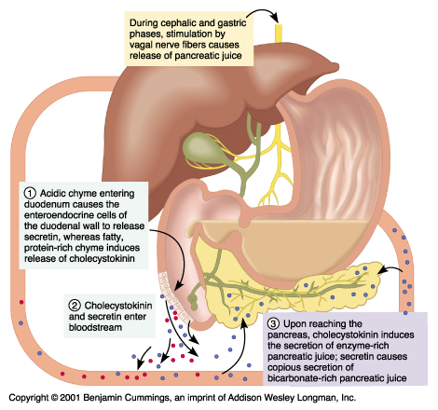
PANCREAS
NEUROLOGICAL CONTROL
The pancreas is regulated
by the autonomic nervous
system. The parasympathetic
Division, using the vagus nerve, is excitatory and
the sympathetic division
inhibits the pancreas.

Slide 28
CHEMICAL DIGESTION
Carbohydrate digestion

Slide 29
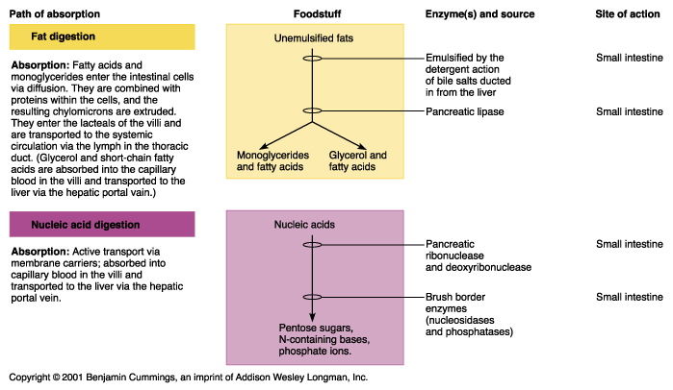
PANCREAS- Fat digestion

Slide 30
PANCREAS -Protein digestion

Slide 31
Neural and Hormonal Control of the Pancreas
secretin:
acidity in intestine causes increased sodium bicarbonate release
GIP:
fatty acids & sugar causes increased insulin release
CCK:
fats and proteins cause increased digestive enzyme release

Slide 32
enzymes of pancreatic juice

Slide 33
Regulation of Pancreatic Secretion
Secretin is released in response to the presence of HCL in the intestine
Cholecystokinin is released in response to the entry of proteins and fats

Slide 34
Regulation of Pancreas Secretion
Both hormones act on the pancreas, but secretin targets the duct cells, prompting their release of watery bicarbonate-rich pancreatic juice, Whereas CCK stimulates the acini to release enzyme-rich pancreatic juice
Vagal stimulation causes release of pancreatic juice primarily during the cephalic and gastric phases of gastric secretion

Slide 35
Regulation of Pancreatic Secretion
Normally, the amount of HCL produced in the stomach is exactly balanced by the amount of bicarbonate (HCO₃) actively secreted by the pancreas
HCO₃ is secreted into the pancreatic juice, and H⁺ enters the blood

Slide 36
Regulation of Pancreatic Secretion
Consequently, the pH of venous blood returning to the heart remains relatively unchanged because alkaline blood draining from the stomach is neutralized by the acidic blood draining the pancreas

Slide 37
Regulation of Pancreatic Secretion
Secretin and CCK are released when fatty or acidic chyme enters the duodenum
CCK and secretin enter the bloodstream
Upon reaching the pancreas:
CCK induces the secretion of enzyme-rich pancreatic juice
Secretin causes secretion of bicarbonate-rich pancreatic juice
Vagal stimulation also causes release of pancreatic juice

Slide 38
Neural regulation -Role of Vagus nerve

Slide 39
The pancreas is regulated by the autonomic nervous system.
Parasympathetic division, using the vagus nerve, is excitatory
Sympathetic division inhibits the pancreas.

Slide 40
Hormonal regulation
secretin and cholecystokinin (CCK).
CCK induces the acinar cells to
secrete the enzymes found in pancreatic juice.
Secretin causes bicarbonate ions

Slide 42
reference
https://columbiasurgery.org/pancreas/pancreas-and-its-functions
https://in.pinterest.com/pin/560768591071953546/
THANK YOU

