Slide 1
Parkinson’s disease
Dr Reshmy K.R
Professor
Dept. of Physiology
SKHMC

Slide 2
Named after James Parkinson who published 'An Essay on the Shaking Palsy' in 1817, which established Parkinson’s as a recognised medical condition.

Slide 3
Basal ganglia
Cerebellum

Slide 4
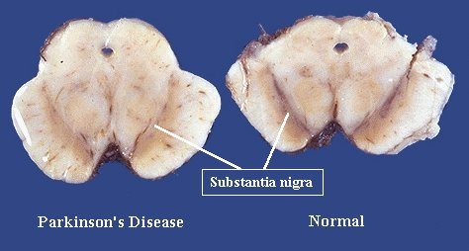
Parkinsonism
A slowly progressive degenerative disease of nervous system associated with destruction of brain cells , which produce dopamine.

Slide 5
Causes
Viral infection of brain like encephalitis
Cerbral Arterioscelrosis
Injury to Basal ganglia
Destruction or removal of dopamine in basal ganglia-Drug induced
Unknown cause- Idiopathic

Slide 6
Symptoms
Rigidity
Poverty of movements
Tremor
Akinesia/Hypokinesia
Gait- Festinant gait
Emotional changes

Slide 7
Movement disorders:
1) Akinetic-rigid syndromes
- Slowed movement.
- Increased tone.
-> IPD, drug-induced parkinsonism, multiple systems atrophy, progressive supranuclear palsy.
2) Dyskinesias
-Added, uncontrollable movements.
-> Essential tremor, chorea, myoclonus, tics.

Slide 8
Parkinsonism
Multiple systems atrophy
Progressive supranuclear palsy
Lewy body dementia
IPD
Vascular parkinsonism
Drug-induced parkinsonism

Slide 9
Annual incidence - 0.2/1000.
Tends to affect ≥ 50 years.
1/20 is under the age of 20 years.
Incidence and prevalence increase with age.
Equal sex incidence.

Slide 10
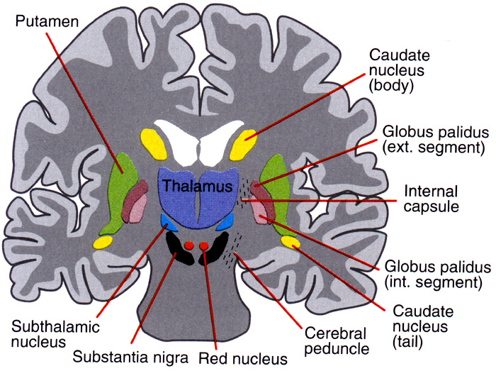
Pathology
Group of nuclei in the brain situated at the base of the forebrain (striatum, globus pallidus, substantia nigra subthalamic nucleus).
Associated with voluntary motor control, eye movements, cognitive and emotional functions.

Slide 11
Pathology
Depletion of pigmented dopaminergic neurons in SN
Reduced dopaminergic output from SN
Inclusion bodies (Lewy bodies) develop in nigral cells
Degeneration in other basal ganglia nuclei
Neurons in subthalamic nucleus become more active than usual in inhibiting activation of the cortex
Bradykinesia

Slide 12
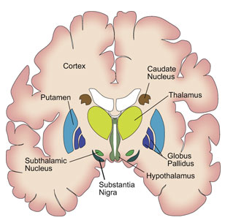
Pathology

Slide 13
Signs & Symptoms
Symptoms develop very slowly, unnoticed for months or years
1.Tremor- Resting tremor, disappears while doing any work
Drum beating tremor
Pill rolling movement- thumb moves rhythmically over the index and middle fingers

Slide 14
2. Slowness of movements
Bradykinesia- takes long time even for simple task
Unable to initiate voluntary activity- Akinesia
Hypertonicity of the muscles

Slide 15
3. Poverty of movements
Absence of associated movements- Statue like body
Face mask like- absence of expressions like blinking, smiling

Slide 16
4. Rigidity
Lead pipe rigidity- due to increased muscle tone due to the removal of inhibitory influence on gamma motor neurons
Affects both flexors and extensors
Limbs are rigid like pillars

Slide 17
Gait
Festinant gait- walks quickly in short steps by bending forward as if he is going to catch up the centre of gravity.

Slide 18
Clinical features
Parkinsonism
Bradykinesia
Rigidity
Resting
Tremor
Postural instability

Slide 19
Clinical features
Resting
Tremor
Pill-rolling at
rest
Arms/legs/
feet
/jaw/tongue
Present:
-At rest
-When
distracted
Diminished:
-On action

Slide 20
Clinical features
Rigidity
Cogwheel
rigidity
(upper limbs)
Increased tone
when opposite
arm moves
actively
Lead pipe
rigidity
(legs)
Flexed posture

Slide 21
Clinical features
Bradykinesia
Difficulty in
initiating
movement
Poor rapid fine
movements
(fingers)
Facial
immobility
Reduced
spontaneous
blinking

Slide 22
Clinical features
Postural instability
Loss of postural reflexes
Retropulsion
Difficulty making turns

Slide 23
Clinical features
Gait:
Stooping
Slow to initiate walking
Rapid small steps
Tendency to run (festinating)
Reduced arm swing
Impaired balance on turning

Slide 24
Clinical features
Speech
-Monotone →tremulous, slurring dysarthria.
-Soft, rapid, indistinct.
Cognitive
-Cognitive impairment (loss of executive functions including planning/decision-making/controlling emotions).
-Depression.

Slide 25
Clinical features
GI symptoms
-Constipation/heartburn/dribbling/ dysphagia/weight loss.
-Greasy skin.
-Micrographia.

Slide 26
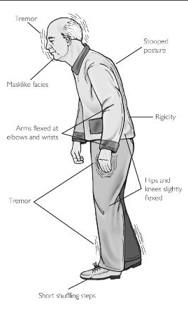
Clinical features

Slide 27
Idiopathic Parkinsonism
Most people with parkinsonism have idiopathic Parkinson’s disease, also known as Parkinson’s. Idiopathic means the cause is unknown.
The most common symptoms of idiopathic Parkinson’s are tremor, rigidity and slowness of movement.

Slide 28
Vascular parkinsonism
Arteriosclerotic parkinsonism affects people with restricted blood supply to the brain.
Sometimes people who have had a mild stroke may develop this form of parkinsonism.
Common symptoms include problems with memory, sleep, mood and movement.

Slide 29
Drug-induced parkinsonism.
Neuroleptic drugs (used to treat schizophrenia and other psychotic disorders), which block the action of the chemical dopamine in the brain.
Affects a small number of people, and most will recover within months – and often within days or weeks – of stopping the drug that’s causing it.

Slide 30
Investigations
<50 years
CT head scan if:
- Pyramidal/cerebellar/autonomic involvement.
- Diagnosis is in doubt.

Slide 31
Differential diagnoses
Multiple systems atrophy
Progressive supranuclear palsy
Lewy body dementia
Drug-induced parkinsonism
Vascular parkinsonism

Slide 32
https://healthvision.in/a-ray-of-hope-in-ayurveda-for-parkinsonism/
Thank you
th

