Slide 1
POLIOMYELITIS
Dr. Reshma Reghu
Assistant Professor
Department of Community medicine

Slide 8
Polio Surveillance
Surveillance is the most important part of the whole polio eradication initiative.
Without surveillance, it would be impossible to pinpoint where and how wild poliovirus is still circulating, or to verify that the virus has been eradicated.
Surveillance identifies new cases and detects importation of wild poliovirus.

Slide 10
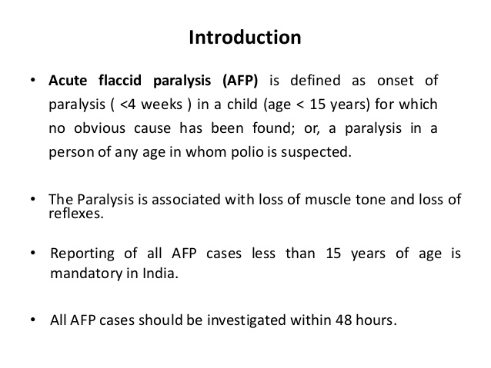

Slide 11
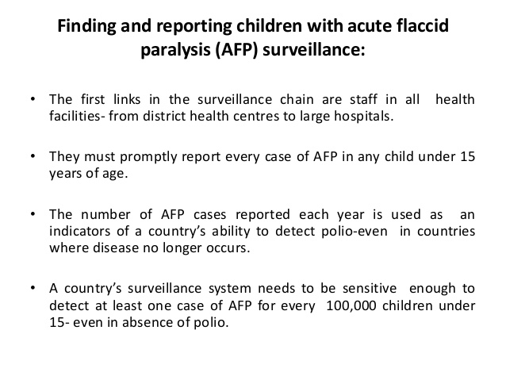

Slide 13
Isolating poliovirus
first isolate the virus from the stool samples
Distinguish wild and VRPV, since OPV consist of virus resembling wild virus
If wild poliovirus, Identify the type of the virus

Slide 14
Mapping the virus
Determine the origin of the strain
Genetic make up and geographical area
Identify the source of importation
Appropriate immunization strategies to prevent the spread of the virus

Slide 18
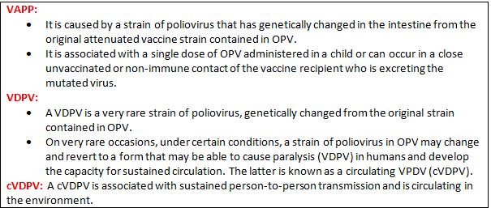

Slide 19
VDPVs are divided into 3 categories
cVDPV
Immunodeficiency associated VDPV
Ambiguous VDPV

Slide 20
The prolonged large outbreak reaffirm the following points
1. The clinical signs and severity of paralysis associated with VDPV and WPV infections are indistinguishable.
2. cVDPVs pose the same public health threat as WPVs and require the same control measures.
3. Surveillance for WPVs and VDPVs should continue to be strengthened.
4. Environmental surveillance to detect VDPVs and WPV infection can serve as an important, sensitive supplement to AFP surveillance in many settings.
5. Persons with prolonged iVDPV infection may transmit poliovirus to others, raising the risk of VDPV circulation in settings of low population immunity to the corresponding poliovirus serotype.
6. Prolonged iVDPV excretion is uncommon among persons with primary immunodeficiencies exposed to OPV.
7. The prevalence of long-term iVDPV excretors may be higher than suggested

Slide 33
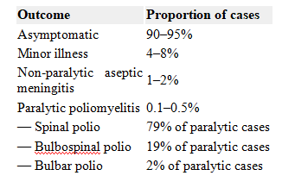

Slide 36
TREATMENT
No specific treatment
Good nursing care from the beginning can minimize or prevent crippling
Physiotherapy is important to regain the strength of weakened muscle and the child have to put on metal callipers

