Slide 1
RABIES
Dr. Reshma Reghu
Assistant Professor
Dept of Community medicine

Slide 5
The virus recovered from naturally occurring cases of rabies is called “ street virus”.
Serial brain to brain passage of street virus in rabbits modifies the virus such that its incubation period is reduced until it becomes constant between 4- 6 days. Virus isolated at this stage is called “fixed virus”.
The fixed virus is used in the preparation of anti- rabies vaccine.

Slide 6
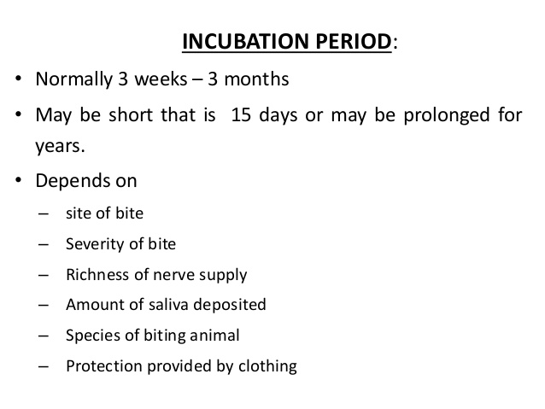

Slide 7
The symptoms are aggravated at swallowing liquids.
At later stage, mere site or sound of water may provoke spasm of muscles of deglutition (Hydrophobia).
The duration of illness is 2 to 3 days, may be prolonged to 5 to 6 days.
The patient may die abruptly during one of the convulsion or may pass on to the stage of paralysis and coma.

Slide 14
Immunization
Cell cultured and embryonated egg vaccines (CCEEVs).
The vaccines based on chick embryo cells and Vero cells have safety and efficacy records.
The shelf life of this vaccine is > 3years provided they are stored at +2C to +8C and protected from sunlight.

Slide 15
