Slide 1
RABIES
Dr.Gopika.R.S
Prof & Head Dept of Pathology
SKHMC

Slide 2
Rhabdovirus - Rabies
genus Lyssavirus
Enveloped, bullet-shaped virions
Slow, progressive zoonotic disease
Primary reservoirs are wild mammals; it can be spread by both wild and domestic mammals by bites, scratches, and inhalation of droplets

Slide 3
Structure of the rabies virus

Slide 4
Pathogenesis
Virus enters through bite
grows at trauma site ,multiplies in muscles, connective tissue
enters nerve endings
advances toward the ganglia, spinal cord and brain
Infection cycle completed when virus replicates in the salivary glands

Slide 5
Pathologic pictures of rabies

Slide 6
Clinical phases of rabies:
IP -1-2months /upto 2 years
Prodromal phase
– fever, nausea, vomiting, headache, fatigue; some experience pain, burning, tingling sensations at site of wound

Slide 7
Furious phase
– agitation, disorientation, seizures, twitching, hydrophobia
Dumb phase –
paralyzed, disoriented, stuporous
Progress to coma phase, resulting in death(resp paralysis)

Slide 8
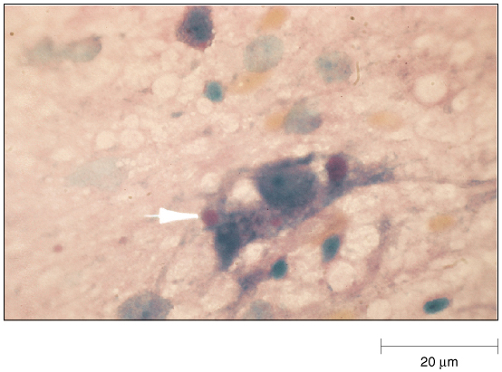
DIAGNOSIS
fluorescent antibody tests.
intracellular inclusions (Negri bodies) in nervous tissue
Positive Fluorescent Antibody Test
Brain tissue showing Negri bodies.

Slide 9
Preventive therapy initiated if signs of rabies appear
Treatment –
passive and active postexposure immunization

Slide 10
https://www.youtube.com/watch?v=TDxU-7gGc34

Slide 11
Viruses that infect the central nervous system
Neurotropic – infect neural cells Neuroinvasive – can enter CNS
(spinal cord or brain) Neurovirulent – can cause disease of
nervous tissue

Slide 12
Mumps –
highly neuroinvasive, but low neurovirulence; most infection leads to infection of CNS, but neurological disease is mild
Rabies –
highly neuroinvasive, high neurovirulence – readily infects periferal NS and spreads to CNS, with 100% lethality.
(Herpes) –
low neuroinvasiveness, high neurovirulence – always infects periferal NS rarely spreads to CNS, severe consequences.

