Slide 1
BRAIN STEM REDNUCLEUS
Dr RESHMY K.R
Professor
Dept.of Physiology
SKHMC

Slide 2
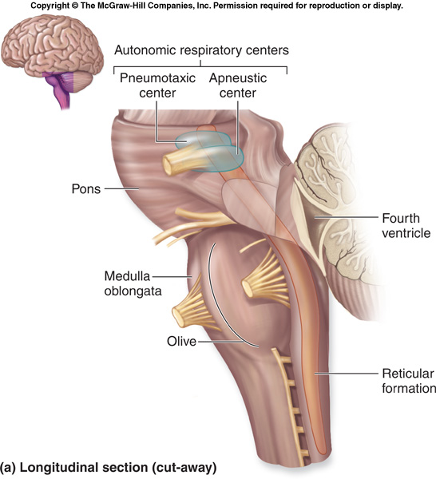

Slide 3
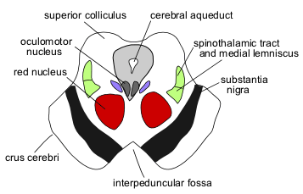
RED NUCLEUS
A large, well defined, elongated cell mass of reddish-gray hue that is located in the mesencephalic tegmentum,
Receives a massive projection from the contralateral half of the cerebellum,
Receives an additional projection from the ipsilateral motor cortex,
Efferent connections are with the contralateral half of the rhombencephalic reticular formation and spinal cord.

Slide 4
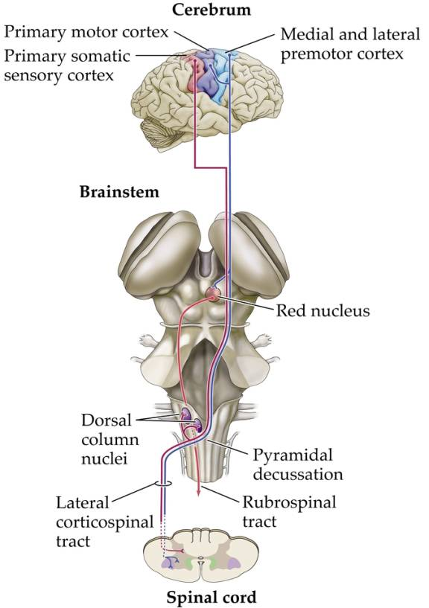

Slide 5
parts
Nu. Magnocellularis- rubrospinal& rubrobulbar tract.
Nu. Parvocellularis- reticulospinal tract

Slide 6
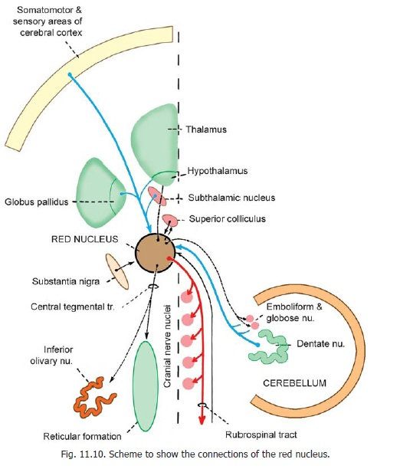
Efferent connections
Rubrospinal& rubrobulbar tracts from magnocellularis nu.
Rubroreticular tract from -parvocellularis
Rubrothalamic tract to lat. Ven. nu. Of thalamus
Rubro- olivary tract
Rubro striatal &Rubropallidal tract
fibres to the nu. Of 3rd ,4th ,6th,cranial nerves.

Slide 7
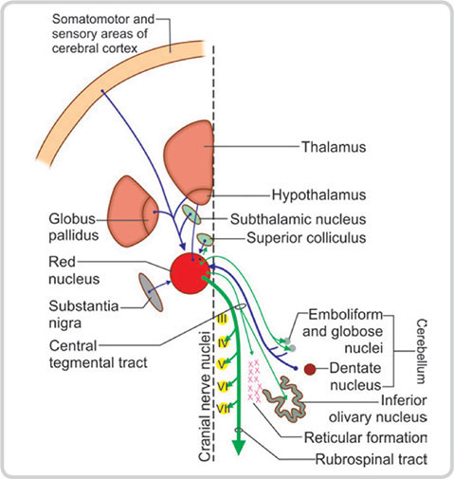
Afferent connections
Corticorubral from –motor cortex- frontal lobe- & from area 6 to the Nu. Parvocellularis
Cerebellorubral –from Dentate Nu. of opposite cerebellar hem. through the sup . Cerebeller peduncle to the magnocellularis
Pallidorubral - from other parts of basal ganglia - globus pallidus & subthalamic nuc. to magnocellularis.

Slide 8
Functions
Control of muscle tone- cerebellum, vestibular apparatus and skeletal muscle - facilitating the muscle tone
Con. of complex muscular mov-- integration of various impulses received from many important areas of bin
Con of righting reflex -except optical righting reflex
Con. of mov. of eye ball- with the efferent connection with nuclei of 3rd, 4th and 6 th Cranial nerves, red nucleus
Con. of skilled mov- by its connections with spinal cord and cerebral cortex.

Slide 9
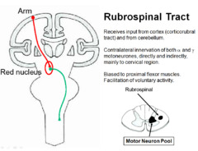
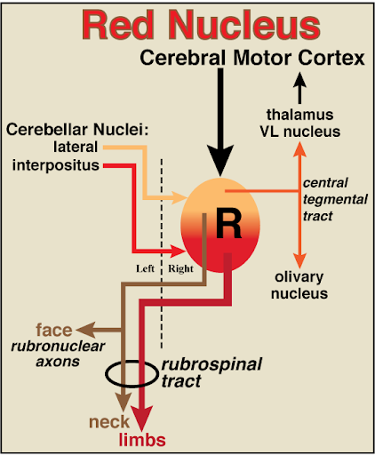

Slide 10
https://en.wikipedia.org/wiki/Red_nucleus
http://vanat.cvm.umn.edu/brain18/pages/redNucleus.html
THANK YOU

