Slide 1
Receptors
Dr RESHMY K.R
Professor
Dept. of Physiology
SKHMC

Slide 2
Definition
Sensory nerve endings that terminate in periphery as bare unmyelinated endings
Capsulated structures
Biological transducers
Convert various forms of energy into action potentials

Slide 3
classifiation
Exteroceptors Cutaneous receptors/Mechanoreceptors
Chemoreceptors
Telereceptors
Interoceptors Visceroceptors
Proprioceptors

Slide 4
Exteroceptors
Cutaneous receptors
Chemoreceptors
Tele receptors
Taste
Smell
Hearing
Vision
taste buds
olfactory receptors
hair cells in organ of corti
rods, cones
Thermoreceptors
Touch-
Meissner's corpuscle,Merkel's disk
Pressure-
pacinian corpuscle
Cold -
Krause end bulb
Warmth -Ruffini end organ
Pain -free nerve endings- Nociceptors

Slide 5
Sensory Receptors:
Teleceptors: (distance receivers), detect events at distance e.g. rods & cones → light; sound: hair cells
Exteroceptors: concerned with information of the ext. environment e.g. skin: pain, touch, temperature
Interoreceptors: concerned with internal environment, e.g. chemoreceptors, baroreceptors, osmoreceptors
Proprioceptors: provide information about body position in space, e.g. receptors in muscle, tendons & joints: muscle spindles, Goli tendon organs
Nociceptors: these are pain receptors

Slide 7
Mechanoreceptors- Activated by mechanical stimuli or deformation of the receptor.
Chemoreceptors- Respond to changing of the chemical concentrations of the body
Thermoceptors- detect hot & old
Nociceptors- Any stimuli that can cause tissue damage, sensation of pain
Photoreceptors- Respond to light

Slide 8
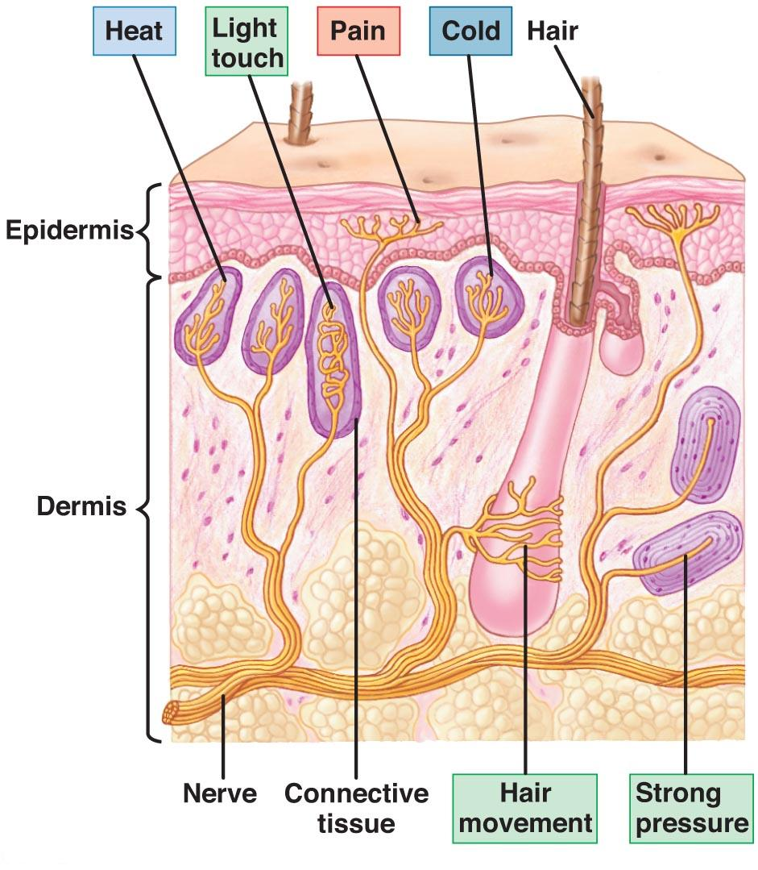
mechanoreceptors/cutaneous receptors

Slide 9
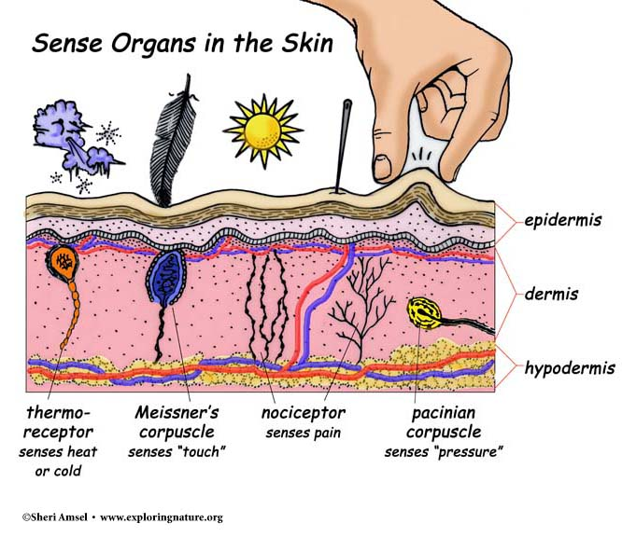

Slide 10
Interoceptors
Visceroceptors
Stretch receptors
Baroreceptors
Chemoreceptors
Osmoreceptors
Propriceptors
Muscle spindle
Golgi tendon organ
Pacinian corpuscles
Free nerve endings
Hair cells of Organ of Corti

Slide 11
PROPERTIES OF RECEPTORS
1. Specificity of response- Muller's Law
2. Adaptation- sensory adaptation
3. Response to increase in strength of stimulus- Weber -Fechner's Law
4. Sensory Tansduction
5. Receptor Potential
6. Law of Projection

Slide 12
Receptor potential
Pressure stimulus
Compression of pacinian corpuscles
Change in shape of pacinian corpuscles
Deformation of center core fiber
Opening of mechanically gated sodium channel
Entrance of sodium ions into the core fiber
Development of receptor potential
Development of local circuit of current flow
Spread of circuit of current flow to the 1stnode of Ranvier
Opening of voltage gated Na channels in the 1stnode of Ranvier
Entrance of Na ions
Generation of A.P in the nerve fiber

Slide 13
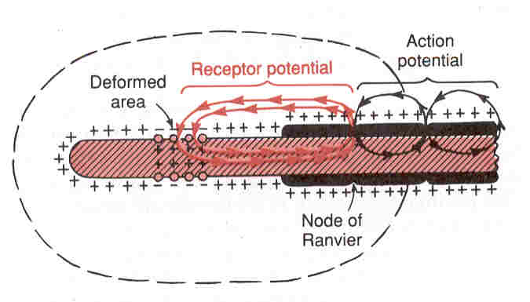

Slide 14
RECEPTOR POTENTIAL & ACTION POTENTIAL

Slide 15
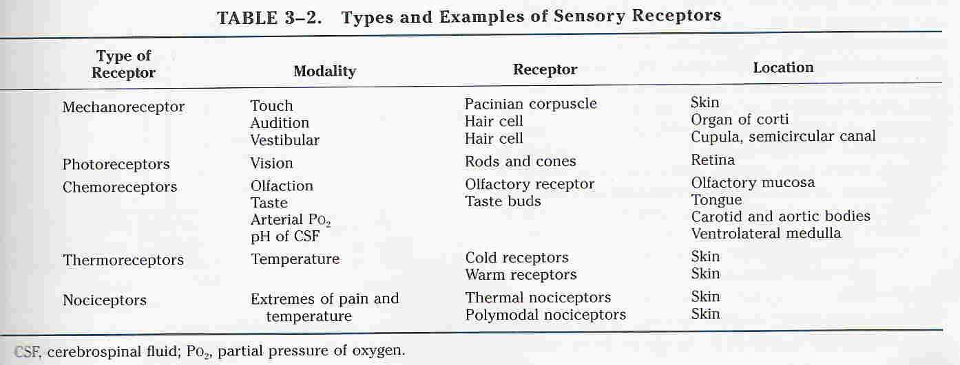
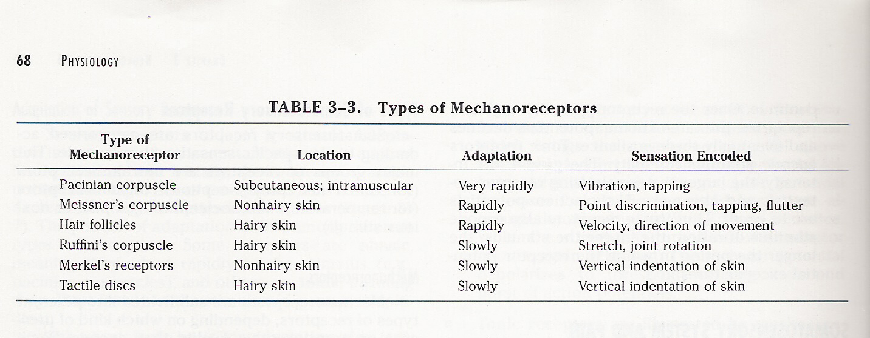

Slide 16
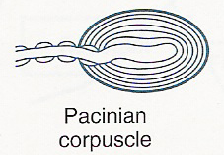
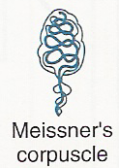
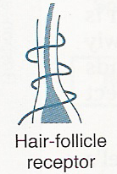
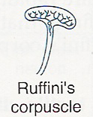
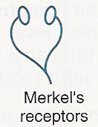

Slide 17
https://www.exploringnature.org/db/view/Touch-and-the-Sensory-Receptors-of-the-Skin
THANK YOU

