Slide 1
Rubella
Dr. Reshma Reghu
Assistant Professor
Dept of Community medicine

Slide 2
Introduction
Rubella or german measles
It is an acute childhood infection, usually mild, of short duration (approximately 3 days) and accompanied by low-grade fever, lymphadenopathy and a maculo-papular rash.
Infection in early pregnancy may result in serious congenital defects, including death of the foetus.
The disease is worldwide in distribution and tends to occur in epidemics, in non-immunized populations, every 6 to 8 years

Slide 3
History
1941 when Norman Gregg, an ophthalmologist reported an epidemic of congenital cataracts associated with other congenital defects in children born to mothers who had rubella during their pregnancies.
This discovery changed the concept that rubella is not merely a benign disease of childhood but also one with teratogenic potential.
In 1962, the virus was isolated; in 1967, an attenuated vaccine was developed.

Slide 4
Epidemiological determinants
Agent factors
Host factors
Environmental factors

Slide 7
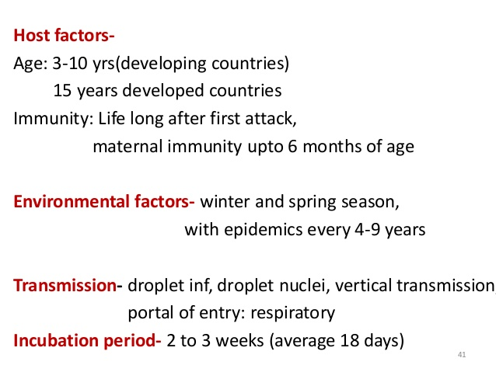

Slide 8
CLINICAL FEATURES
A large percentage of infections are asymptomatic (50- 65%)
PRODROMAL STAGE:
Mild
Coryza, sore throat, low grade fever
LYMPHADENOPATHY:
Post auricular and post- cervical lymphadenopathy appears as early as 7 days before the appearance of rashes.
The glands found enlarged for 10 to 14 days after the rash.

Slide 9
RASH
First indication of the disease in children.
Appears first on face, within 24 hours of onset of prodromal symptoms.
Minute, pinkish, discrete, macular in appearance. Not confluent as in measles.
Rashes spread to the trunk & extremities.
Rashes spread much faster and clears more rapidly
It disappears by the third day.
Conjunctivitis may appear

Slide 10
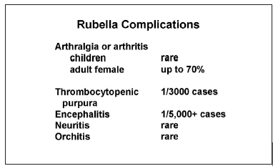

Slide 11
Diagnosis
Virus isolation and serology
Haemagglutination inhibition test (HI)- standard test for Rubella
Detection of Ig G

Slide 12
CONGENITAL RUBELLA
Refers to infants born with defects secondary to intra uterine infection or who manifest the symptoms after birth.
Chronic persistance of virus in the new born
Virus is detectable in pharyngeal secretions, multiple organs, csf, urine and rectal swabs.
Viral excretion last for 12- 18 months after birth.
Rubella infection inhibits cell division results in congenital malformations and low birth weight

Slide 14
The first trimester is the most disastrous time for foetus as the organs are developing.
Infection during this period results in abnormalities- 85%
Infection during second trimester- 16 %
Birth defects are common if maternal infection occurs after 20 weeks
Inapparent maternal infection result in foetal death and spontaneous abortion.

