Slide 1
shock
DR MANOJ RADHAKRISHNAN
DEPT OF PATHOLOGY AND MICROBIOLOGY
SKHMC

Slide 2
what is shock ?
Is a final common pathway for a number of serious or potentially lethal clinical events- e g
severe hemorrhage,
Extensive trauma or burns
large myocardial infarction
Massive pulmonary embolism
Microbial sepsis

Slide 3
Definition of shock
Systemic hypoperfusion caused either by
reduced cardiac output, or by
reduced effective circulatory blood volume.
End results are,
Hypotension
Impaired tissue perfusion
Cellular hypoxia

Slide 4
3 categories of shock
Cardiogenic shock: results from failure of the cardiac pump.due to myocardial damage(infarction), ventricular arrythmias, extrinsic compression(cardiac tamponade), or outflow obstruction.(pulmonary embolism)
Hypovolemic shock: results from loss of blood or plasma volume. This maybe caused by hemorrhage , fluid loss from severe burns, or trauma
Septic shock: most commonly occurs in gram negative infections(endotoxic shock), due to host responses.

Slide 5
Cardiogenic shock
Causes : Myocardial Infarction, Ventricular rupture, Arrhythmia, cardiac tamponade, pulmonary embolism.
Principal mechanism : Failure of myocardial pump, resulting from
intrinsic myocardial damage
Extrinsic pressure
Obstruction to outflow

Slide 6
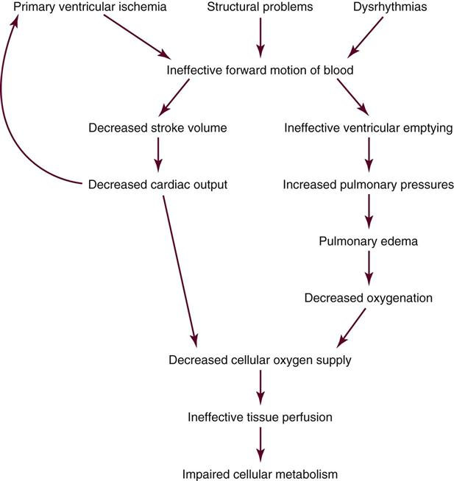
Cardiogenic shock-mechanisms

Slide 7
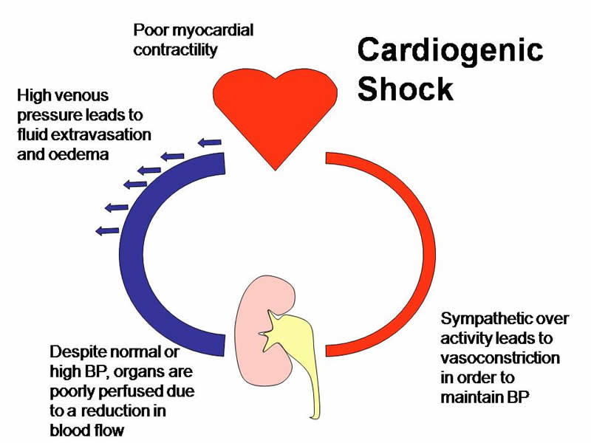
Patho-physiology of cardiogenic shock

Slide 8
Hypovolemic shock
Causes : hemorrhage, fluid loss ( vomiting , diarrhoea, burns, or trauma)
Principal mechanism : Inadequate blood or plasma volume.

Slide 9
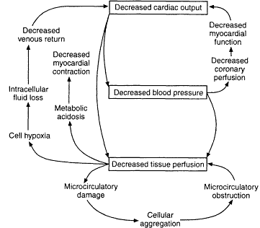
Hypovolemic shock-mechanisms

Slide 11
Septic shock
Causes: overwhelming microbial infections, endotoxic shock, gram positive septicemia, fungal sepsis, superantigens(e.g toxic shock syndrome)
Principal mechanism :
Peripheral vasodilatation and pooling of blood ; endothelial activation/ Injury; leucocyte –induced damage; disseminated intravascular caugulation; activation of cytokine cascades.

Slide 14
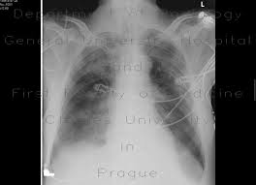
Shock lung or ARDS –Lung ,fluffy, cottony opacities-CXR

Slide 16
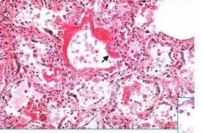
A.R.D.S Lung

Slide 17
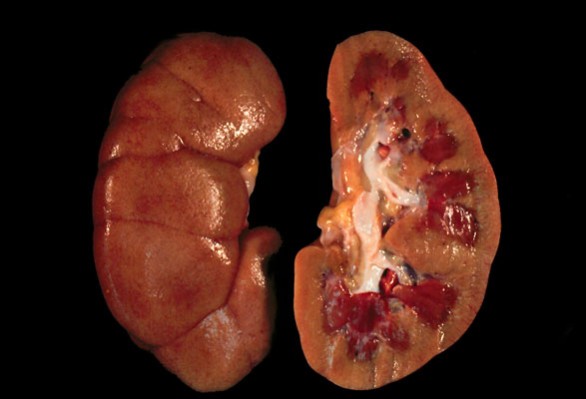
Shock Kidney

