Slide 1
DR.LAL.M.P. Prof. & Head. Dept of surgery
SINUSITIS

Slide 2
SINUSITIS
Mucosal inflammation of the paranasal sinuses. Usually maxillary sinus is involved.
TYPES
ACUTE CHRONIC

Slide 3
ACUTE SINUSITIS
Acute inflammation of sinus mucosa commonly follows an attack of acute rhinitis as in common cold or influenza when the bacteria invade as secondary organism.
Maxillary sinus inflammation may follow dental infections.
Sinus may get infected after trauma or through a blood- borne infection.

Slide 4
Predisposing factors
Adenoids
Infected tonsils
Deflected nasal septum
Nasal polypi
Benign tumours of the nose.
Chronic suppurative lung disease.

Slide 5
CLINICAL FEATURES
SYSTEMIC EFFECTS – malaise , body ache ,
and shivering.
In maxillary sinusitis, the pain is felt in cheek
below the eyes, it may be referred to teeth or along the distribution of superior orbital nerve. Pain is aggravated on stooping or coughing.

Slide 6
CLINICAL FEATURES - Continued
In ethmoiditis ,pain is localised over the nasal bridge, inner canthes & behind the eye.
In frontal sinusitis, pain is localised over forehead & pain is severe in morning & gradually subsides towards noon.
In sphenoidal infection ,pain is referred to vertex or occiput
Other symptoms -nasal blockage & mucopurulent nasal discharge.

Slide 7
SIGNS
IN FULMINANT CASES- redness & oedema of soft tissues of face over the sinus involved.
Tenderness on applying pressure over the sinus.
On anterior & posterior rhinos copy – generalised congestion of nasal mucosa & presence of mucopus. localised oedematous mucosa in the neighbourhood of ostium of the sinus

Slide 8
CHRONIC SINUSITIS
Chronic sinusitis is usually the result of incompletely resolved acute sinusitis.
Maxillary sinus is mostly involved.

Slide 9
CLINICAL FEATURES
Nasal obstruction
Nasal discharge
Abnormalities of smell
Epistaxis
Headache
Tiredness ,fever, dryness of throat and repeated sore throat may occur.

Slide 10
INVESTIGATION
X –ray examination of paranasal sinuses ,occipitomental view(water’s view ) is helpful .
The sinuses appear as hazy and may show a fluid level.

Slide 11
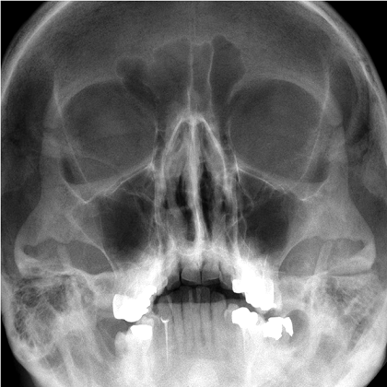
PARANASAL SINUS(WATER’S VIEW

Slide 12
MANAGEMENT
Bed rest
Steam inhalation
If the symptoms do not subside, particularly in frontal sinusitis with increasing cellulitis,then drainage of the frontal sinus is done through the floor of frontal sinus above the inner canthes.This procedure is known as trephining of the frontal sinus.

Slide 13
TREATMENT OF CHRONIC SINUSITIS
Antrum puncture
Intranasal Antrostomy (INA)
Caldwell-Luc Operation
Functional Endoscopic Sinus Surgery(FESS)

Slide 14
COMPLICATIONS OF SINUSITIS
Osteomyelitis
Meningitis
Cerebral abscess

Slide 15
HOMOEOPATHIC THERAPEUTICS
SILICEA
KALI BICH
PULSATILLA
STICTA
HEPAR SULPH
MERC SOL
BELLADONNA
THUJA
KALI IOD
PHOSPHORUS

