Slide 1
SPLEEN
By
Dr.Berlina Terrence Mary
Assistant Professor
Department of Anatomy

Slide 2
Location
The spleen is a wedge-shaped organ lying mainly in the left hypochondrium, and partly in the epigastrium. It is wedged in between the fundus of the stomach and the diaphragm.
Dimensions
• On an average the spleen is 1 inch or 2.5 cm thick
• 3 inches or 7.5 cm broad
• 5 inches or 12.5 cm long
• 7 ounces in weight and is related to 9th to 11th ribs.
• The odd numbers are 1, 3, 5 are 7, 9, 11. Normally, the spleen is not palpable.

Slide 3
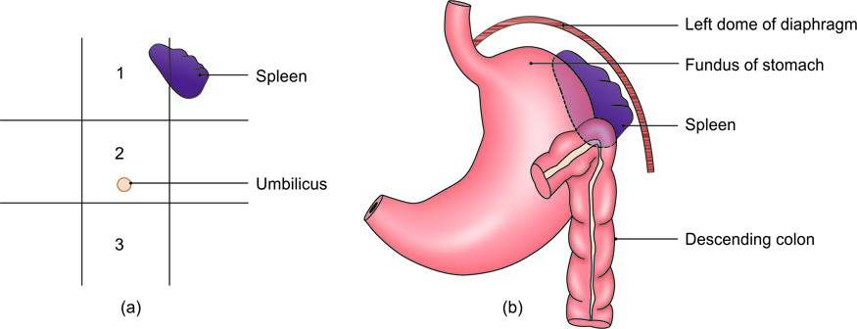
Location of the spleen: (a) In relation to the nine regions of the abdomen: (1) Epigastrium; (2) umbilical region; and (3) hypogastrium, and (b) in relation to the fundus of the stomach and the diaphragm

Slide 4
External Features
Two Ends
• The anterior or lateral end
• The posterior or medial end
Three Borders
• The superior border
• The inferior border
• The intermediate border

Slide 5
Two Surfaces
• The diaphragmatic surface
• The visceral surfac
Two Angles
Anterobasal angle:
It is the most forward projecting part of spleen.
Posterobasal angle:
Hilum
Hilum lies between superior and intermediate borders. It is pierced by branches and tributaries of splenic vessels.

Slide 6
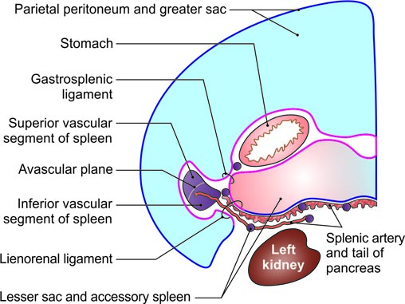
Peritoneal ligaments attached to the spleen, and common sites of accessory spleen

Slide 7
Visceral relations of the spleen

Slide 8
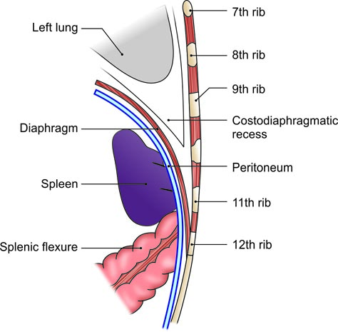
Relations of diaphragmatic surface

Slide 9
Arterial Supply
The spleen is supplied by the splenic artery which is the largest branch of the coeliac trunk.
Functions of the Spleen
1. Phagocytosis:
2. Haemopoiesis:
3. Immune responses:
4. Storage of RBCs:

Slide 10
CLINICAL ANATOMY
• Palpation of the spleen: A normal spleen is not palpable. An enlarged spleen can be felt under the left costal margin during inspiration. Palpation is assisted by turning the patient to his right side. Note that the spleen becomes palpable only after it has enlarged to about twice its normal size. Malaria is the commonest cause of splenomegaly.
• Splenomegaly: Enlargement of the spleen is called splenomegaly. Sometimes the spleen becomes very large. It then projects towards the right iliac fossa in the direction of the axis of the tenth rib. The notches of enlarged spleen are easily palpable.

