Slide 1
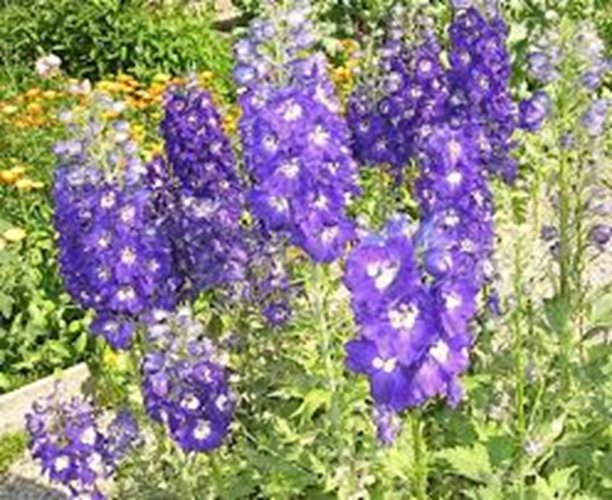
STAPHISAGRIA
Dr.P.R.SAIJI
ASSOCIATE PROFESSOR
DEPT OF MATERIA MEDICA

Slide 2
DESCRIPTION Natural Order: Ranunculaceae. Synonyms: Delphinium Staphisagria, Stavesacre. Habitat: southern Europe.

Slide 3
PREPARATIONS Homoeo., Mother tincture of the ripe seeds; and dilutions. U. S. P., Staphisagria, Fluidextractum Staphisagria.

Slide 4
DOSAGE Of the mother tincture, 1 to 5 drops; of the fluidextract, mj. Homoeo., 3x.

Slide 5
PHYSIOLOGICAL ACTION - This agent is an emetic, cathartic and parasiticide. - Locally, it causes tingling, burning and inflammation; internally, it causes tingling, burning and inflammation; internally, it lowers the heart's action and decreases the number of respirations.

Slide 6
Doctrine of signature Hairy tree so person is also sensitive. Flowers are deep coloured attract insects. They also try to attract by their art, creation. Seeds are Angiospermic (numerous seeds enclose in a seed vessel). They also want to show that they are multitalented. Plants found in cold and temperate region, patient cannot tolerate cold.

Slide 7
THERAPEUTICS - This remedy is indicated when the mind has been dwelling too much upon sexual subjects, or there has been sexual excess or onanism. - The patient is depressed and gloomy. - He is shy and feels sad and despondent. - It has an influence over the nervous system, and assists him to overcome the practice.

Slide 8
- It is of service in females, when there is a sensation as of some insect crawling on the external genital organs. - The parts are sensitive. - It is of service in the relief of suppressed anger, peevishness and over-sensitiveness. - He is worn out and exhausted.

Slide 9
- The nose is peaked, the face is pale, and the eyes are sunken and surrounded by dark rings. - It is beneficial when there is itching of the skin, when the scratchy changes its position. - It is beneficial when the child's teeth turn black and crumble as soon as they appear.

Slide 10
* Nervous affections with marked irritability, diseases of the genito-urinary tract and skin, most frequently give symptoms calling for this drug. * Acts on teeth and alveolar periosteum. * Ill effects of anger and insults. * Sexual sins and excesses. Very sensitive. * Lacerated tissues. * Pain and nervousness after extraction of teeth. Sphincters lacerated or stretched.

Slide 11
MIND - Impetuous, violent outbursts of passion, hypochondriacal, sad. - Very sensitive as to what others say about her. - Dwells on sexual matters; prefers solitude. - Peevish. - Child cries for many things, and refuses them when offered.

Slide 12
Great indignation about things done by others or by himself; grieves about consequences. Indifferent, low-spirited, dullness of mind after onanism.

Slide 13
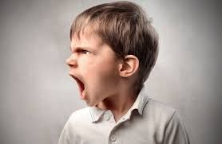
- Peevish. - Child cries for many things, and refuses them when offered.

Slide 14
HEAD - Stupefying headache; passes off with yawning. - Brain feels squeezed. - Sensation of a ball of lead in forehead. - Itching eruption above and behind ears.

Slide 15
EYES - Heat in eyeballs, dims spectacles. - Recurrent styes. Chalazae. Eyes sunken, with blue rings. - Margin of lids itch. Affections of angles of eye, particularly the inner. - Lacerated or incised wounds of cornea. - Bursting pain in eyeballs of syphilitic iritis.

Slide 16
THROAT - Stitches flying to the ear on swallowing, especially left.

Slide 17
MOUTH - Toothache during menses. - Teeth black and crumbling. - Salivation, spongy gums, bleed easily. - Submaxillary glands swollen. - After eating feels sleepy. pyorrhoea.

Slide 18
STOMACH - Flabby and weak. Desire for stimulants. - Stomach feels relaxed. Craving for tobacco. - Canine hunger, even when stomach is full. - Nausea after abdominal operations.

Slide 19
ABDOMEN - Colic after anger. Hot flatus. Colic, with pelvic tenesmus. - Swollen abdomen in children, with much flatus. - Severe pain following an abdominal operation. - Incarcerated flatus. - Diarrhoea after drinking cold water, with tenesmus. - Constipation (2 drops tincture night and morning), haemorrhoids, with enlarged prostate.

Slide 20
MALE - Especially after self-abuse; persistent dwelling on sexual subjects. - Spermatorrhoea, with sunken features; guilty look; emissions, with backache and weakness and sexual neurasthenia. - Dyspnoea after coition.

Slide 21
FEMALE - Parts very sensitive, worse sitting down. - Irritable bladder in young married women. - Leucorrhoea. - Prolapsus, with sinking in the abdomen; aching around the hips.

Slide 22
URINARY - Cystocele (locally and internally). Cystitis in lying-in patients. - Ineffectual urging to urinate in newly married women. - Pressure upon bladder; feels as if it did not empty. - Sensation as if a drop of urine were rolling continuously along the channel.

Slide 23
- Burning in urethra during micturition. - Prostatic troubles; frequent urination, burning in urethra when not urinating. Urging and pain after urinating. - Pain after lithotomy.

Slide 24
SKIN - Eczema of head, ears, face, and body; thick scabs, dry, and itch violently; scratching changes location of itching. - Fig-warts pedunculated. Arthritic nodes. - Inflammation of phalanges. Night-sweats.

Slide 25
EXTREMITIES - Muscles, especially of calves, feel bruised. - Backache; worse in morning before rising. - Extremities feel beaten and painful. - Joints stiff. Crural neuralgia. - Dull aching of nates extending to hip-joint and small of back.

Slide 26
MODALITIES Worse: anger, indignation, grief, tobacco, mortification, loss of fluids, onanism, sexual excesses; least touch on affected parts. Better: after breakfast, warmth, rest at night.

Slide 27
Relationship - Inimical : Ranunc. bulb. - Complementary : Caust.; Colocy. - Compare : Ferrum pyrophos. (tarsal cysts); Colocy.; Caust.; Ign.; Phos. ac.; Calad. - Antidote: Camph.

Slide 28
DOSE - Third to thirtieth potency.

