Slide 1
streptococcus
Dr.R.S.Gopika M.D. (Hom.)
Professor & HoD
Dept. of Pathology
SKHMC

Slide 2
streptococcus
Gram-positive,
nonmotile,
catalase-negative,
facultatively
anaerobic cocci that occur in chains or pairs.

Slide 3
CLASSIFICATION
They are classified based
on their hemolytic capacity (α, ß, γ-hemolysis)

Slide 4
groups
Alpha -Colonies on blood agar are surrounded by a green zone- caused by H₂O₂, which converts hemoglobin into methemoglobin.
Beta- Colonies on blood agar are surrounded by a large, yellowish hemolytic zone in which no more intact erythrocytes are present and the
hemoglobin is decomposed
Gamma means there is no lysis.

Slide 5
LANCEFIELD CLASSIFICATION
Based on the antigenicity of a C-carbohydrate occurring in their cell walls (Lancefield antigen).
20 serological types
Group A-V

Slide 6
Group A streptococcus
S. pyogenes
Gram-positive cocci with a diameter of 1µm
chains
Colonies on blood agar show ß hemolysis
caused by streptolysins

Slide 7
CULTURE
37ºC
Grow in media containing carbohydrate or enriched with blood or serum.
NB – granular turbidity.

Slide 8
Blood agar
Small, .5- Imm ,
circular ,
semi transparent,
low convex,
clear haemolysis.

Slide 9
Selective media
Mannitol salt agar or MSA
Crystal voilet blood agar

Slide 10
Resistance
Heat – 54ºC- 30sec

Slide 11
Virulence factors
Capsule
Cell wall Ag
Carbohydrate
Cytoplasmic mem Ag
Peptidoglycans

Slide 12
Capsule - hyaluronic acid – antiphagocytic
Cellwall Ag –
M proteins –inhibit phagocytosis, attachment
T,R protein – react with myocardium
Carbohydrate - react with myocardium ,cardiac valves, toxic to connective tissue.
Cytoplasmic mem Ag – Agenic relation with
vascular intima.
Peptidoglycans – exotoxins

Slide 13
Extracellular toxins and enzymes
Haemolysin-
Streptolysin O, streptolysin S.-
Destroy the membranes of erythrocytes and other cells. Streptolysin O acts as an antigen.
Past infections can be detected by measuring the antibodies to this toxin (ASO).
Pyrogenic streptococcal exotoxins (PSE) A, B, C.
Responsible for fever, scarlet fever exanthem and enanthem, sepsis, and septic shock.
The pyrogenic exotoxins are superantigens and induce production of large amounts of cytokines

Slide 14
Cont…
Streptokinase.
Dissolves fibrin; facilitates spread of streptococci in tissues.
Hyaluronidase.
Breaks down a substance that cements tissues together.
DNases.
Breakdown of DNA, producing runny pus

Slide 15
Pathogenesis and clinical pictures
Streptococcal diseases can be classified
as either
acute non invasive infections,
invasive infections or
sequelae to them.
opportunistic pathogen.
It is part of the normal flora of the respiratory tract in many people.

Slide 16
Pathogenesis
diseases range from
mild - like strep throat and impetigo,
to severe,- like necrotizing fasciitis, and streptococcal toxic shock syndrome.

Slide 17
Most Common:
strep throat -strep pharyngitis – pharynx
impetigo, cellulitis, and erysipelas – infections of the skin which can be complicated by necrotizing fasciitis – skin, fascia and muscle

Slide 18
Less Common:
Bacteremia can be associated with these infections
septic arthritis – joints
osteomyelitis – bones
vaginitis – in young girls
Meningitis – meninges
Sinusitis – sinuses
Pneumonia – pulmonary alveolus

Slide 19
Erysipelas
Acute infection and inflammation of the dermal layer of skin.
Painful red patches which enlarge and thicken

Slide 20
Diseases--The non-invasive infections
most common bacterial cause of sore throat.
A painful, red throat with white patches on tonsils is characteristic of pharyngitis/ strep throat.
It is usually accompanied by swollen lymph nodes, fever, and headache.
Rarely accompanied by nausea, vomiting, and abdominal pain.

Slide 21
Strep Throat
Most common of all Strep diseases
Spread by saliva or nasal secretions
Incubation period 2-4 days
Sore throat, slight fever (101ºF)
Rash appears and characteristic is the strawberry colored tongue

Slide 22
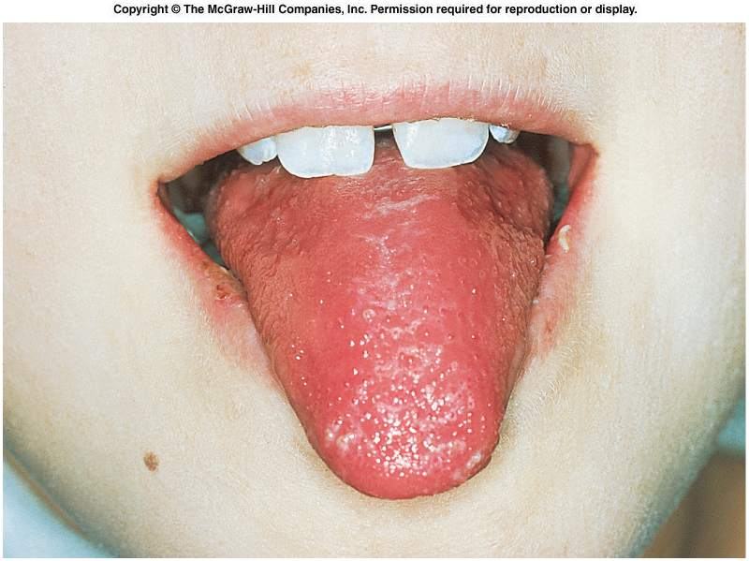
Strawberry Tongue

Slide 23
Scarlet fever
If left untreated strep throat can lead to further complications, including scarlet fever.
Scarlet fever
is characterized by a red rash on the chest that may spread to the rest of the body.
The rash has a sandpaper-like texture and appears as tiny red pinpoints.
It is caused by the exotoxins
seen in children under ten.

Slide 24
Impetigo
Impetigo starts as a red sore and form crusty sores after a few days.
The sores most commonly occur on the face, but can also be found on the extremities.
They usually itch, but are extremely contagious though direct contact.

Slide 25
Cellulitus
begins when Streptococcus pyogenes infects the site of a minor injury, such as a bruise, burn, or wound.
It causes the skin to turn red, widespread pain, swelling, and tenderness of the infected area.
Other symptoms - fever and chills, swollen glands, blistering of the skin, and malaise

Slide 26
The invasive infections
more severe and less common.
This occurs when the bacteria is able to infect areas where bacteria are not usually found, such as blood and organs.
necrotizing fasciitis (NF),
streptococcal toxic shock syndrome (STSS),
pneumonia,
bacteremia.

Slide 27
Necrotizing fasciitis
is a rare, very serious infection -"flesh eating bacteria“/ Haemolytic Sterp gangrene
The bacteria enters the body through a minor trauma or surgical wound in immuno compromised persons
Causes infection just below the skin that spreads to deeper tissues.
acute onset, rapid
Early - Severe pain ,minimal erythema, fever ,chill, toxic apperance
Late – skin dusky ,mottled erythema, anesthetized, extensive necrosis of subcutaneous tissue, fascia & muscles

Slide 28
Streptococcal Bacteremia
Occurs secondary to NF ,rarely with pharygitis, cellulitis or pneumonia
it leads to endocarditis ,septic arthritis, OM, viseral abcesses,TSS.

Slide 29
Streptococcal toxic shock syndrome
Due to pyrogenic exotoxins
Symptoms –
pain, swelling, and redness of infected area, fever, dizziness, difficulty breathing, dangerously low blood pressure, and a weak, rapid pulse.
Shock & multi system failure

Slide 30
Sequelae
Streprtococcal Ag show molecular mimicry with human Ag
So Ab produced against previous Strep infection cross react with human tissues to produce lesions

Slide 31
Sequelae
Rheumatic fever
Post-streptococcal glomerulonephritis
PANDAS
Guttate psoriasis
Reactive arthritis

Slide 32
PANDAS
Pediatric Autoimmune Neuropsychiatric Disorders Associated With Streptococcal Infections.
Children
rapid onset of obsessive-compulsive disorder (OCD) and/or tic disorders

Slide 33
The proposed link between infection and these disorders
initial autoimmune reaction to a GABHS infection
produces antibodies
Ab interfere with basal ganglia function
symptom exacerbations.

Slide 34
Guttate psoriasis
Guttate psoriasis is characterized by the acute onset of small, 1-10 mm diameter, erythematous, scaly, teardrop-shaped spots with a silvery scale ,appear on the arms, legs, and middle of the body.
appears after an infection- strep throat

Slide 35
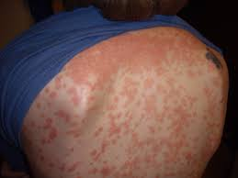
Guttate psoriasis

Slide 36
POST STREPTOCOCCAL REACTIVE ARTHRITIS
is a reactive arthritis characterized by a pharyngeal streptococcal infection
Relatively shorter latent period ( 7 to 10) days
May be persistent or relapsing
Slower response to aspirin
Not associated with other major manifestations
Symmetric invlnt. of large , small joints & axial skeleton

Slide 37
Rheumatic fever (RF)
is an acute, immunologically mediated, multisystem inflammatory disease involving heart, joints, CNS, skin and other tissues that occurs a few weeks after an episode of group A β-hemolytic streptococcal pharyngitis.
ARF usually occurs between 5 and 15 years of age, it can also occasionally occur in adulthood.

Slide 38
Pathogenesis
Autoimmune theory-
strep Ab cross react with human Ag
Cytotoxicity theory
sterp toxins & enzymes are directly cytotoxic to human cardiac cells

Slide 39
Ag cross reaction
Strep Ag Human Ag
Cell wall M protein myocardium
Cell wall C carbohydrate cardiac valves
Cytoplasmic mem glomerular
vascular intima
Peptidoglycan skin Ag
Hyaluronic acid synovial

Slide 40
ARF Pathogenesis:
β-hemolytic streptococci pharygitis
Formation of antistreptococcal antibodies which cross reacts with endogenous tissue antigens in heart
In joints and other tissues(Antibody against Streptococcal hyaluronic acid cross reacts with connective tissue proteoglycans)

Slide 41
2 weeks Post-infection:RF
Joints: Acute febrile polyarthritis
Heart: Pancarditis
Eye: Uveitis
Kidney: Acute glomerulonephritis
Brain: Sydenham chorea (rare)

Slide 42
Jone’s Criteria:
A. Major:
Subcutaneous nodules
Pancraditis
Migratory polyArthritis
Sydenham Chorea
Erythema Marginatum of Skin
B. Minor:
Leukocytosis
ESR raised
Arthralgia
Fever

Slide 43
Migratory polyarthritis
Typically involves larger joints – knee, ankle, wrist, & elbow
Involved joints - hot, red, swollen, and tender
Migratory in nature- a severely infla: joint can become normal within 1-3 days without treatment.
Not deforming
Exudative with normal glucose & neutrophil predominance
response to small doses of salicylate

Slide 44
SUBCUTANEOUS NODULES
Rare ,Freely mobile, painless 0.5 - 2 cm
Occur in crops over bony prominences or extensor tendons
Common locations - elbow,wrist knee,ankle & achilles tendon
Fully developed nodules consist of a central zone of fibrinoid necrosis surrounded by a peripheral cellular reaction consisting of histiocytes and fibroblasts
Self limiting –days to 1 month

Slide 45
ERYTHEMA MARGINATUM
Erythematous, macular lesions with pale centers that are not pruritic
Multiple lesions primarily on the trunk or proximal extremities, rarely on distal extremities that recurs over weeks to months & never on face
It occurs early in course of RF

Slide 46
Uveitis
Uveitis is swelling of the middle layer of the eye, the uvea.
severe redness in the eye
pain
dark floating spots in your vision, called floaters
light sensitivity
blurred vision

Slide 47
Sydenham chorea/ St.Vitus dance
Mc in females.
rare > 20 yrs
A neurological disorder-can occur months after an initial attack, causing jerky involuntary movements, muscle weakness, slurred speech, and personality changes
Exacerbated by stress and disappears with sleep.

Slide 48
Diagnosis:
Either of the following
Essential criteria (serologic evidence of a previous streptococcal infection) + 2 or more Major Criteria
1 Major Criteria + 2 Minor Criteria

Slide 49
Difference between PSRA & ARF
PSRA begins sooner (approximately 10 days) after streptococcal infection .
arf(approximately 21 days).

Slide 50
Rheumatic heart disease (RHD)
is a consequence of acute rheumatic fever
The risk of RHD is greater with repeated episodes of ARF.
RHD is particularly associated with damage to the valves of the heart.
Rheumatic fever is said to “lick the knee but bite the heart”.

Slide 51
Morphology:
RHD is a sequelae of ARF
A. Acute Rheumaic Heart Disease:
1. Aschoff bodies or Rheumatic granuloma
2. Pancarditis
B. Chronic Rheumaic Heart Disease:

Slide 52
ARHD- Aschoff bodies or Rheumatic granuloma:
Inflammatory myocardial lesions-
Fibrinoid necrosis demarcated by:
Antischkow cells (Specialized histiocytes resembling Epithelioid cells which appears catterpillar like in cross section and owl’s eye in longitudinal section)
Lymphoplasmacytic infiltrate
Rarely Aschoff cells (Inflammatory Giant cells)

Slide 53
Pancarditis:
Diffuse inflammation and Aschoff Bodies in any of the 3 layers of heart
Pericardium:
“Bread and Butter” Pericarditis (Fibrinous or Serofibrinous)
Myocardium:
Myocarditis (Scattered Aschoff bodies within interstitial connective tissue)
Endocardium:
Fibrinoid necrosis along the lines of closure of valves forming 1 to 2 mm vegetations (verrucae);
Macculum plaques usually in left atrium

Slide 54
Chronic Rheumatic Heart Disease:
Organization of Acute Inflammation and Subsequent Fibrosis:
Valve leaflet thickening
Commisural fusion and shortening
Thickening and fusion of chordae tendinae
“Fish mouth” or “Button hole” Stenoses: Fibrous bridging across the valvular commisures and calcification
Microscopical Examination:
Diffuse fibrosis and neovascularization
Aschoff bodies replaced by fibrous scar

Slide 55
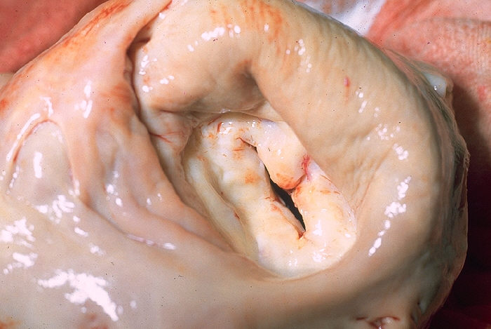
Button hole Stenoses

Slide 56
Functional Consequences:
Valvular stenosis and regurgitation
Stenosis > Regurgitation
Mitral valve alone: 70%
Long-standing congestive pulmonary changes: Leads to Right ventricular hypertrophy

Slide 57
Symptoms of RHD
Heart -palpitations
Chest pain
Breathlessness on exertion
Orthopnoea
paroxysmal nocturnal dyspnoea
oedema
Fainting
Stroke
Fever associated with infection of damaged heart valves.

Slide 58
HEART VALVES:
vegetaions in ARHD
Fibrosis in CRHD
damaged heart valve
cannot open or shut properly
interferes with flow of blood through the heart.
heart failure

Slide 59
HEART VALVES: Complications
heart failure
The strain causes the heart to enlarge.
infection of damaged heart valves (infective endocarditis)
Clots formation in the enlarged heart & damaged valves.
Stroke. -clots then break off (embolise) and cause blockage in blood vessels in the brain .

Slide 60
Post Streptococcal Glomerulo nephritis
Acute inflammation of renal glomerular parenchyma due to deposition of immune complexes characterized by sudden onset of Oliguria, Hematuria ,Hypertension Edema
occurs 7 – 14 days after pharyngitis 2 wks – 6 wks after skin infection with group A β‐hemolytic streptococci
type III hypersensitivity reaction

Slide 61
PATHOGENESIS
Trapping of circulating Ig complexes in glomeruli
Molecular mimicry b/w strept Ag and renal Ag
In situ immune complex formation against anti strep antibodies and glomeruli
Direct complement activation

Slide 62
PATHOLOGY
GROSS
Kidney symmetrically enlarged
LIGHT MICROSCOPY
Glomeruli enlarged and ischaemic
Capillary loops narrowed
Diffuse proliferation of mesangial cells
Polymorphonuclear leukocyte infiltration

Slide 63
Laboratory investigation
?

Slide 64
Group B β-Hemolytic Streptococcus
Staphylococcus agalactiae
Colonize the urogenital tract of pregnant women

Slide 65
invasive diseases
Cause invasive diseases in newborns
Early-onset infection
Late-onset disease
Early-onset infection
Occurs in neonates who are less than 7 days old
Vertical transmission of the organism from the mother
Manifests in the form of pneumonia or meningitis with bacteremia
Associated with a high mortality rate

Slide 66
Late-onset infection
Occurs between 1 week and 3 months after birth
Usually occurs in the meningitis form
Mortality rate is not as high as early-onset
In adults
Occurs in immunosuppressed patients or those with underlying diseases
Often found in a previously healthy adult who just experienced childbirth

Slide 67
Laboratory Diagnosis: Group B β-Hemolytic Streptococcus
Colony morphology
Grayish-white, mucoid, creamy, narrow zone of b-hemolysis
Presumptive Identification tests
Catalase-negative

Slide 68
Enterococcus
Members of the gut flora
Associated infections
Bacteremia
Urinary tract infections
Wound infections
Endocarditis

Slide 69
Peptostreptococci
Normal flora of skin, mouth, intestine & vagina
Puerperal sepsis, skin & soft tissue infections & brain abcesses
Necrotizing lesions- necrotizing fascitis,
necrotizing pneumonitis.
Meleneys gangrene- rare infection of superfical fascia.

