Slide 1
Synapse
Dr. Deepa GS
Associate Professor
Dept. of Physiology & Biochemistry
SKHMC

Slide 2
SYNAPSE
The synapse is the junction point from one neuron to the next
Introduced by Sherrington C.S
Contact without continuity

Slide 3
Synapse
Each impulse
(1) may be blocked in its transmission from one
neuron to the next
(2) may be changed from a single impulse into
repetitive impulses
(3) may be integrated with impulses from other
neurons to cause highly intricate patterns of
impulses in successive neurons

Slide 4
Synapses in anterior motor neuron

Slide 5
Synapse
10,000 to 200,000 minute synaptic knobs called presynaptic terminals (terminal button, end foot , synaptic knob) lie on the surfaces of the dendrites and soma of the motor neuron
About 80 to95 per cent of them on the dendrites
5 to 20per cent on the soma.
These presynaptic terminals are the ends of nerve fibrils that originate from many other neurons

Slide 6
Synapse
Many of these presynaptic terminals are excitatory
Other presynaptic terminals are inhibitory
No of synapses in nervous system can increase or decrease with use and experience

Slide 7
https://depositphotos.com/vector-images/synapse.html

Slide 8
Synapse-Structure
Presynaptic terminals
Mitochondria
Vesicles with neurotransmitter
Few lysosomes
Vesicles
Round-excitatory transmitter
Flat-inhibitory transmitter
Small dense core-catecholamines
Large dense core-neoropeptides

Slide 9
Synapse-Structure
Post synaptic membrane
Receptor proteins(2 parts)
Binding component
Ionophore component
Opens ion channels-Na⁺ , K⁺, Ca2⁺, Cl⁻
Second messenger activator

Slide 10
Second messenger system
https://doctorlib.info/physiology/textbook-medical-physiology/45.htm

Slide 11
Types of synapse
Anatomical classification
Axodendritic-80-90%
Location:
Motor neurons in spinal cord
Excitatory synapse in cerebral cortex
Climbing fibers of cerebellum

Slide 12
Types of synapse
Axosomatic-less common
Loctaion:
motor neuron in spinal cord
Basket cells of cerebellum
Autonomic ganglia

Slide 13
Types of synapse
Axoaxonal-least common
Location:spinal cord
Dendrodendritic
Location:synapse between mitral and granule cell in the olfactory bulb

Slide 14
Types of Synapse
https://www.memorangapp.com/flashcards/258233/Three+types+of+synaptic+transmi+and+more/

Slide 15
Types of synapse

Slide 16
Functional classification

Slide 17
Functional classification
Electrical synapse
Rare ,seen in
cardiac muscle
smooth muscle fibres of intestine epithelial cells of lens in eyes

Slide 18
Chemical synapse
Signals are transmitted by the release of chemical transmitter
More than 40 important transmitter substances have been discovered thus far.
Some of the best known are acetylcholine, norepinephrine,epinephrine, histamine, gamma-aminobutyric acid (GABA), glycine, serotonin, and glutamate.

Slide 19
Chemical synapse
https://depositphotos.com/vector-images/synapse.html

Slide 20
Functions of synapse
Transmission or conduction of impulse
Block or inhibition of impulse
Change an impulse to repetitive impulse
Modification of impulse
Integration of one impulse with another

Slide 21
Synaptic transmission

Slide 22
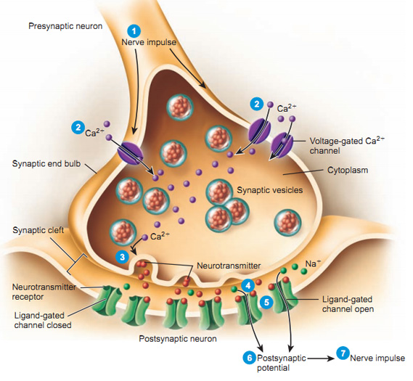
Synaptic transmission
https://teaching.ncl.ac.uk/bms/wiki/index.php/Synaptic_transmission

Slide 23
Synaptic inhibition
Types
Post synaptic or direct inhibition
Presynaptic or indirect inhibition
Renshaw cell inhibition

Slide 24
Functions of synapse-Inhibition
Post synaptic/Direct inhibition
Occurs due to release of an inhibitory neurotransmitter which produce IPSP in postsynaptic terminal
(GABA , glycine , dopamine)
Eg:reciprocal inhibiton

Slide 25
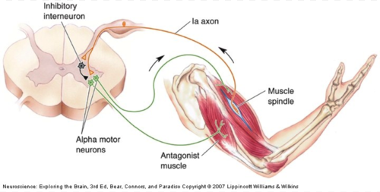
Post synaptic inhibition
https://quizlet.com/95919749/care-prevention-ch-4-flash-cards/

Slide 26
Presynaptic or indirect inhibition
Inhibition at the level of presynaptic terminal mediated by axoaxonal synapses
Ca²⁺ entering the presynaptic terminal is reduced
Eg: pain control system

Slide 27
Presynaptic inhibition

Slide 28
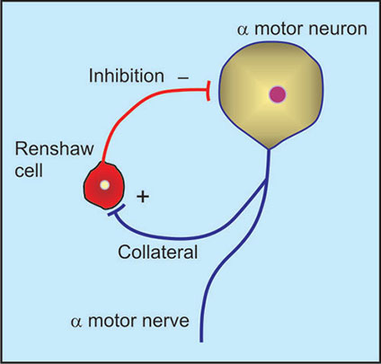
Renshaw cell or negative feed back inhibition
https://www.jaypeedigital.com/book/9789350250761/chapter/ch86

Slide 29
Feedforward inhibition
Occurs in cerebellum
Stellate cells and basket cells which are activated by granule cells inhibit purkinjee cells by releasing GABA

Slide 30
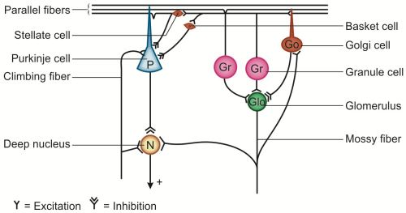
Feed forward inhibition
https://www.jaypeedigital.com/book/9789351529293/chapter/ch82

Slide 31
Significance of inhibition
Limits the number of impulses going to muscles and enable muscles to act appropriately
Strychinine poisoning -inhibitory function impaired
Parkinsonism-inhibitory system impaired

Slide 32
Properties of synapse
One way conduction-Bell megendie law
Impulses pass only from presynaptic neuron to post synaptic neuron
Reason:
Neurotransmitters are present only in the presynaptic membrane
Receptors for neurotransmitter is present only in the post synaptic membrane

Slide 33
Properties of synapse
Synaptic delay-
When an impulse reaches a presynaptic terminal there is an interval of 0.5ms before a response is obtained in post synaptic membrane

Slide 34
Properties of synapse
Fatigue-
If synapses are stimulated repeatedly and rapidly for some time the number of discharges produced by post synaptic neuron is at first great but progressively becomes less and finally stops
Causes:
Deplation of neurotransmitter
Gradual inactivation of Ca2+ channels in presynaptic membrane
Inactivation of post synaptic receptors

Slide 35
Properties of synapse
Summation
Spatial summation
When strength of stimuli is increased,several synaptic knobs are stimulated at the same time and spatial summation of EPSP occurs.The post synaptic potential reaches firing level producing an action potential
If the stimuli of same strength are repeated at very short intervals so that new EPSP s are produced previous EPSPs

Slide 36
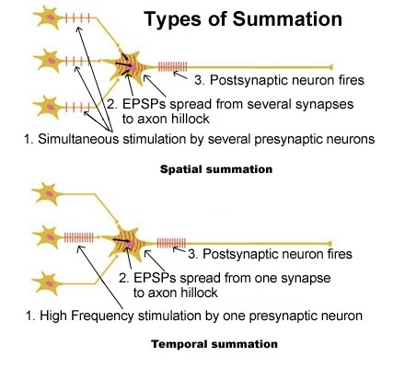
Properties of synapse
Temporal summation
If the stimuli of same strength are repeated at very short intervals it leads to temporal summation of EPSPs producing action potential
n
https://teaching.ncl.ac.uk/bms/wiki/index.php/Summatio

Slide 39
Properties of synapse
Electrical property
IPSP
EPSP
EPSP by single terminal-0.5-1mv
EPSP required to reach threshold for excitation-10-20mv
Potential developed remains for 15milliseconds

Slide 40
Facilitation
If summated potential is excitatory but not risen high enough to reach the threshold for firing by the postsynaptic neuron then the neuron is said to be facilitated

Slide 41
Reference:
Text book of Medical Physiology:Geetha N 2nd edition
Essentials of medical Physilology:K.sembulinhgam Prema sembulingam,Eigth edition
Text book of Physiology:Prof.A.K.Jain,Fourth edition
Guyton and Hall Text Book of Medical Physiology,Arthur C. Guyton,Jhon E.Hall,Revised edition

Slide 42
THANK YOU

