Slide 1
SPEECH
By,
Dr.Mahadevi A.L
Dept of Physiology
SKHMC

Slide 2
SPEECH
Speech and language are the skills we use to communicate with others. We form these skills during the first years of life.
Speech is making the sounds that become words—the physical act of talking.
Language is our system of using words to communicate. It includes using words and gestures to say what we mean, and understanding what others say.

Slide 3
Speech is the verbal means of communicating. Speech consists of the following:
Articulation: How speech sounds are made
Voice: The use of the vocal folds and breathing to produce sound (e.g., hoarseness, breathiness, projection)
Fluency and prosody: The rhythm, intonation, stress, and related attributes of speech
When someone has trouble understanding other people (receptive language) or explaining thoughts, ideas and feelings (expressive language), that is a language disorder.
When someone cannot produce speech sounds correctly or fluently or has voice problems, that is a speech disorder.

Slide 4
Speech is defined as the expression of thoughts by production of articulate sound.
It is one of the highest function of brain.
When a sound produced verbally it is called the speech.
If it is expressed by visual symbols, it is known as Writing.
If visual symbols or written words are expressed verbally, that becomes Reading.

Slide 5
Language is generally divided in to two categories: receptive and expressive.
Receptive language is essentially understanding the expressions and words of others. Children begin to develop this skill first.
Expressive language is the child’s ability to express themselves. As children improve their language skills, they tend to understand more than they can say.
In other words, their receptive language is almost always better than their expressive language.
It should be noted that children born prematurely are often late to speak.

Slide 6
MECHANISM OF SPEECH
Speech depends upon coordinated activities of central and peripheral speech apparatus.
Central speech apparatus consists of higher centres, i.e. cortical and subcortical centers
Peripheral speech apparatus includes larynx or sound box, pharynx, mouth, nasal cavities, tongue, and lips.
All the structures of peripheral speech apparatus function in coordination with respiratory system, with the influences of motor impulses from respective motor areas of the cerebral cortex.

Slide 7
DEVELOPMENT OF SPEECH
First stage
First stage in the development of speech is the association of certain words with visual, tactile, auditory and other sensations, aroused by objects in the external word.
Association of words with other sensations is stored as memory.
Second stage
New neuronal circuits are established during the development of speech.
When a definite meaning has been attached to certain words, pathway between the auditory area (Heschl area 41) and motor area for the muscles of articulation, which helps in speech ( broca area 44) is established.
The child attempts to formulae and pronounce the learnt words

Slide 8
Role of cortical areas in the development of speech
Development of speech involves integration of three important areas of cerebral cortex
1. Wernicke area
2. Broca area
3.Motor area
Role of wernicke area- speech understanding
Understanding of speech begins in wernike area that situated in upper part of temporal lobe.
It sends fibres to broca area through a tract called arcuate fasciculus.
Wernickes area is responsible for understanding the visual and auditory information required for the production of words .
After understanding the words ,it sends the information to broca area

Slide 9
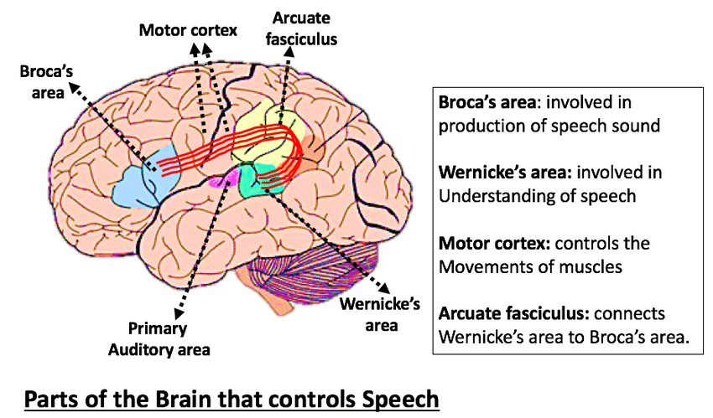

Slide 11
Role of broca area –speech synthesis
Speech is synthesized in the broca area
It is situated adjacent to the motor area, responsible for the movements of tongue, lips and larynx, which are necessary for speech.
By receiving information required for production of words from wernickes area, the broca area develops the pattern of motor activities required to verbalize the words.
The pattern of motor activities sent to motor area.

Slide 12
Role of motor area –activation of peripheral speech apparatus
By receiving the pattern of activities from broca area, motor area activates the peripheral speech apparatus.
It results in initiation of movements of tongue, lips and larynx required for speech.
Later when the child is taught to read, auditory speech is associated with visual symbols (area 18).
Then there is an association of auditory and visual areas with the motor area for the muscles of hand .
Now the child is able to express auditory and visual impressions in the form of written words.

Slide 13
NERVOUS CONTROL OF SPEECH
Speech is an integrated and a well coordinated motor phenomenon.
So, many part of the cortical and subcortical areas are involved in the mechanism of speech.
Subcortical areas concerned with speech are controlled by cortical areas of dominant hemisphere.
In about 95% of human beings , the left cerebral hemisphere is functionally dominant and those persons are right handed.
Following are the motor and sensory cortical areas concerned with speech.

Slide 14
A. Motor areas:
1.broca area
2.upper frontal motor area
Broca area
It is also called speech center, motor speech area or lower frontal area
It includes area 44 &45
These areas are situated in lower part of lateral surface of prefrontal cortex.
It controls the movements of structures( tongue, lips, and larynx) involved in vocalization.
Upper frontal motor area
It is situated in paracentral gyrus over the medial surface of the cerebral hemisphere.
It controls the coordinated movements involved in writing.

Slide 15
Sensory areas
Secondary auditory area
Secondary visual area
Secondary auditory area
Auditopsychic area includes area 22.
It is situated in the superior temporal gyrus. it is concerned with the interpretation of auditory sensation and storage of memories of spoken words.
Secondary visual area
Visuopsychic area includes area 18. it is present in the angular gyrus of the parietal cortex
This area is concerned with the interpretation of visual sensation and storage of memories of the visual symbols.

Slide 16
Wernicke area
It is situated in the upper part of the temporal lobe
This is responsible for the interpretation of auditory sensation. It also plays an important role in speech
It is responsible for understanding the auditory information about any words and sending the information to broca area

Slide 18
APPLIED PHYSIOLOGY-DISORDERS OF SPEECH
Speech disorder is a communication disorder characterised by disrupted speech
It is of 4 types
1.Anarthria or Dysarthria
2. Dysphonia
3. Stammering.
4. Aphasia

Slide 19
Anarthria or dysarthria
The term dysarthria refers to disrupted articulation.
Anarthria means inability to speak
Dysarthria or anarthria is defined as the difficulty or inability to speak because of paralysis or ataxia of muscles involved in articulation.
Psychic effect of speech is not affected
The spoken and written words are understood.
Causes:
Damage of brain or nerves that control the muscles involved in speech
Stroke
Brain injury
Degenerative diseases like parkinson disease and hunghintons disease

Slide 20
Dysphonia
It is a voice disorder
It is characterized by hoarseness and a sore or a dry throat
Hoarseness means the difficulty in producing sound while trying to speak or change in the pitch or loudness of voice.
The voice may be weak, breathy, scratchy or husky.
Causes:
Trauma of vocal cords
Paralysis of vocal cords
Lumps or nodules on vocal cords
Inflammation of larynx
Hypothyroidism
Stress( psychological dysphonia)

Slide 21
Stammering
Shuttering is a speech disorder characterized by hesitations and involuntary repetitions of certain syllables or words .
It is a speech disorder in which normal flow of speech is disturbed by repetitions, prolongations, or abnormal block or stoppage of sounds or syllables .
It is due to the neurological incordination of speech and it is common in children
It is associated with some unusual facial and body movements.
Exact cause is unknown.

Slide 22
Aphasia
Aphasia is the loss or impairment of speech due to brain damage.
It is an acquired disorder
It is not due to paralysis of muscles of articulation ,it is due to damage of speech centers.
Damage of speech centers impairs the expression and understanding of spoken words.
It also affect reading and writing
Speech function is localized to left hemisphere in most of the people
It may be associated with other speech disorders due to brain damage.

Slide 23
Causes
Usually it occurs due to damage of one or more speech centers, which are situated in cerebral cortex.
Damage of speech centers occur due to
Stroke
Head injury
Severe blow to head
Cerebral tumours
Brain infections
Degenerative diseases
Usually in conditions like head injury, aphasia occurs suddenly, and in conditions like infections or cerebral tumours, it develops slowly.
In children traumatic aphasia can develop by exposure to a horrifying event ,without any brain damage.

Slide 24
Types of aphasia
5 types
1. Broca aphasia
2. Wernicke aphasia
3. Global aphasia
4. Nominal aphasia
5. Other types of aphasia- motor, sensory, agraphia

Slide 25
Broca aphasia
Non fluent speech problem
it occurs due to lesion in the left frontal lobe of cerebral cortex
It also known as expressive or anterior aphasia
Affected person do not complete the sentences, because of their inability to construct the sentences
They talk in short phrases by omitting small words such as and, is , for etc.
They make great effort even to initiate speech
Persons with this aphasia are able to understand spoken or written words
They are affected by weakness or paralysis of right arm or leg
It is due to damage of frontal lobe ,which is also responsible for motor activities

Slide 26
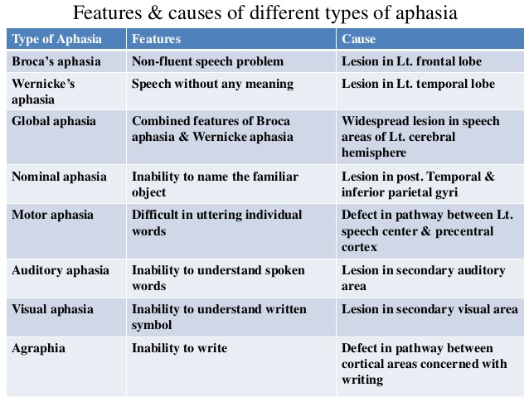

Slide 27
Global Aphasia
It is characterized by combined features of both Wernicke’s and Broca’s areas.
It is due to widespread lesion in speech areas caused by infarction of left cerebral hemisphere.
Common type
In this case, all aspects of speech and language are affected.
Patients can say a few words at most and understand only a few words and phrases.
They usually cannot carry out commands or name objects. They cannot read or write or repeat words said to them.
So they have severe communication problems.

Slide 28
Wernicke’s Aphasia
Speech is produced without effort, and sentences are of normal length. However, the person’s speech is devoid of meaning.
Also called receptive or posterior aphasia.
Damage to the posterior superior areas of the language dominant temporal lobe.
Characterized by fluent speech
Affected person speaks long sentences but without any meaning
They use incorrect or nonexistent words and cannot speak senisibly
This type is known as jargon speech
Unable to understand other speech, they are unaware of their own mistakes while speaking
Not associated with paralysis or weakness of muscles because the injury does not involve the center concerned with movements.

Slide 29
Nominal aphasia
Characterised by inability in naming the familiar objects
Anomic or amnesic aphasia
Lesion in the posterior temporal and inferior parietal gyri
Other types
Motor-
defect in the pathway b/w left speech area and excitomotor or precentral cortex
Also called verbal aphasia or dyspraxia or apraxia of speech
Characterised by difficulty in uttering the words due to lack of coordination b/w central and peripheral speech apparatus.
They are pronounce only few monosyllables such as yes or no.

Slide 30
Sensory-inability to understand words or symbols
Auditory- inability to understand the spoken words, also called word deafness, lesion in secondary auditory area
Visual- inability to understand written symbols, also called word blind ness or dyslexia, lesion in secondary visual area
Agraphia
Inability to write
No defect in the muscles of the hand concerned with writing
Subject can read and speak
Defect in the connection b/w the cortical area concerned with writing
It differs from dysgraphia, which is characterised by distorted writing or writing incorrect letters

Slide 31
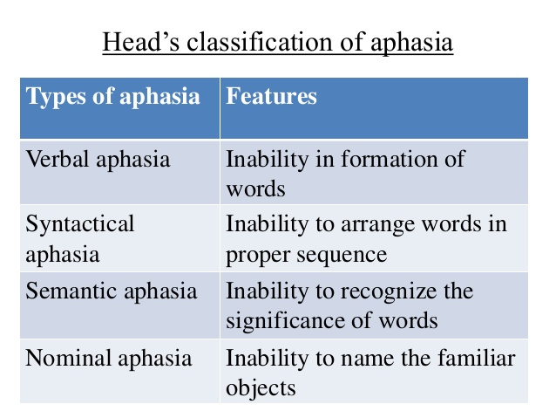

Slide 32
Thank u

