Slide 1
THROMBOSIS
Dr. R. S. Gopika M.D. (Hom)
Prof. & HoD
Department of Pathology

Slide 2
Thrombosis
Thrombosis is the formation of a blood clot within the vascular system during life.
The blood clot is adherent to the vessel wall.
A thrombus is always a potential source of further complications.
The process of thrombosis depends on the interaction of the endothelial cells, platelets, and the coagulation proteins.

Slide 3
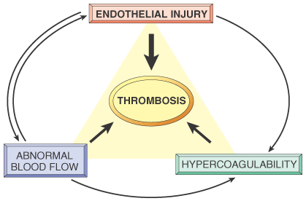
Factors promoting thrombus formation /thrombogenesis
Virchow’s triad
Endothelial/endocardial injury
Changes in blood flow
Changes in the composition of blood (hypercoagulability)

Slide 4
Endothelial injury:
Causes:
atherosclerosis (the single most important cause),
myocardial infarction,
cardiac surgery,
inflammatory or immunologic injuries to the heart valves or blood vessels.

Slide 5
Mechanisms:
a. Adhesion of platelets to exposed collagen at the site of endothelial damage.
b. Secretion of ADP and thromboxane A2 by the adherent platelets.
c. ADP and thromboxane induce platelet aggregation
d. Activation of blood coagulation by:
(i) The intrinsic pathway, initiated by collagen activation of FactorⅫ
(ii) The extrinsic coagulation pathway, initiated by tissue factor, derived from damaged endothelium

Slide 6
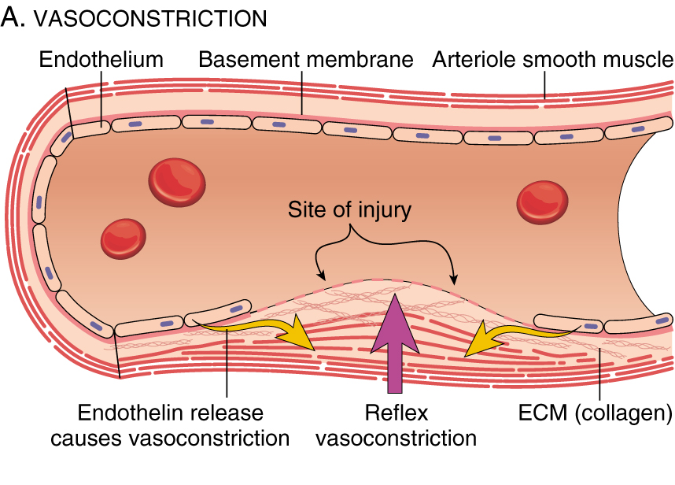

Slide 7
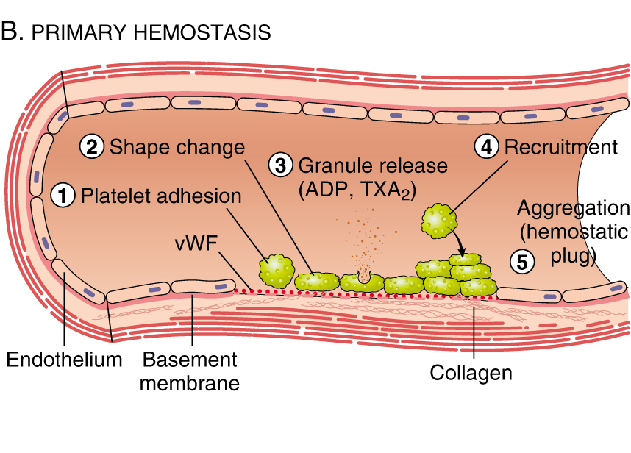

Slide 8
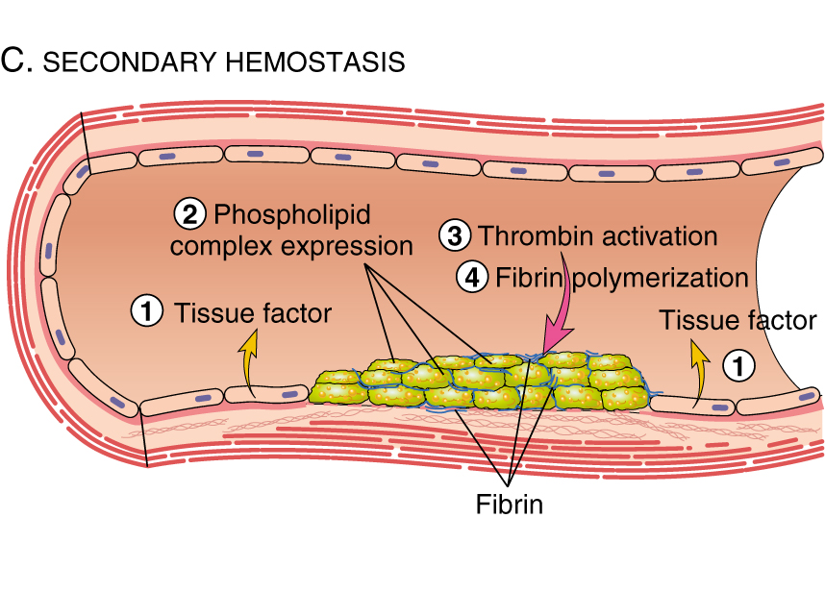

Slide 9
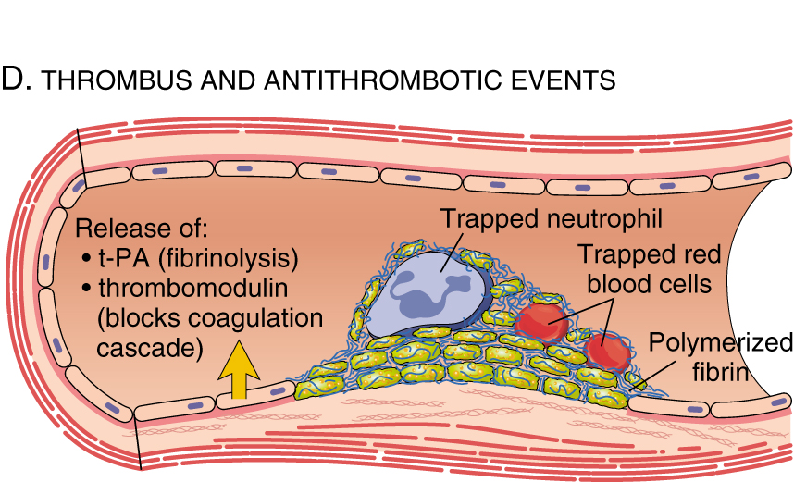

Slide 10
(2) Changes in blood flow:
① Stasis
② Turbulence /Disruption of laminar flow.

Slide 11
Turbulence and stasis
disrupt laminar flow - bring platelets into contact with the endothelium
prevent dilution of activated clotting factors by fresh flowing blood
retard the inflow of clotting factor inhibitors and permit the build-up of thrombi
promote endothelial cell activation, predisposing to local thrombosis, leukocyte adhesion and a variety of other endothelial cell effects.

Slide 12
Causes
Ulcerated atherosclerotic plaques
Aneurysms
Chronic dilation of the left atrium (associated with atrial fibrillation)
Bifurcation of arteries (turbulence)

Slide 13
(3) Changes in the constitution of the blood: Hypercoagulability
Following major surgery
In pregnancy and parturition
In some users of the oral contraceptive pill
After splenectomy
In endotoxic shock, hypersensitivity reactions.
In association with some tumors.
Prolonged bed rest or immobilization
Tissue damage (surgery, fracture, burns)

Slide 14
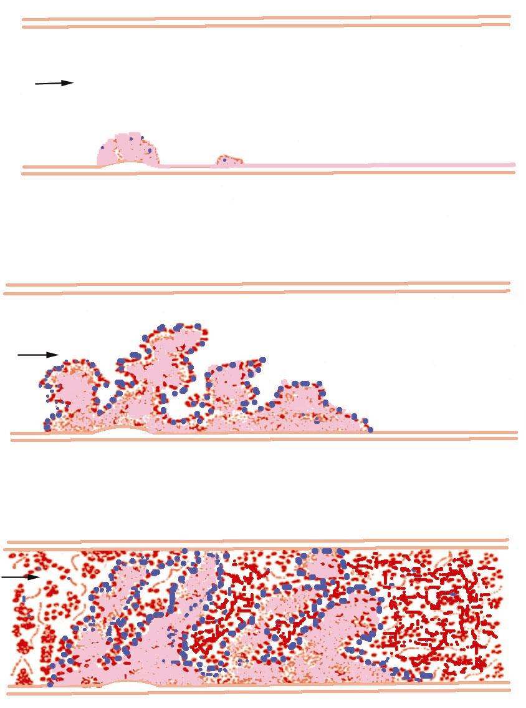
Steps in the formation of a thrombus

Slide 15
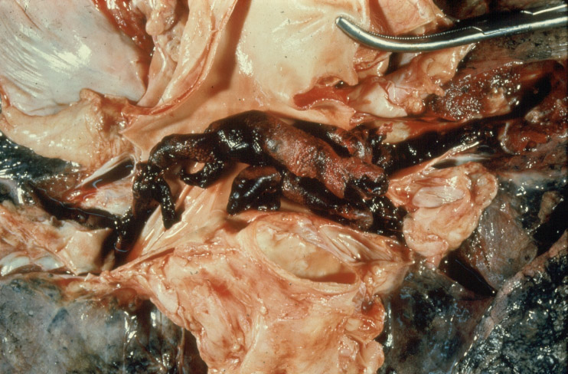
Photo is offered by Prof. Orr

Slide 16
Morphology of thrombi
Location: anywhere in the cardiovascular system (75% in veins and heart, 25% in arteries)
Aortic or cardiac thrombi are typically nonocclusive (mural) as a result of rapid and high-volume flow
Arterial thrombi are frequently occlusive
Cardiac and arterial thrombi usually begin at sites of endothelial injury or turbulence ,Venous thrombi occur in sites of stasis and are occlusive.
At sites of origin, thrombi are generally firmly attached
Arterial thrombi extend retrograde from the attachment
Venous thrombi extend into the direction of blood flow; the propagating tail may fragment to create thromboemboli.

Slide 17
Morphological types of thrombi
(1) pale thrombus
Constitution: alternating layers of platelet
Location: arteria, cardiac valves and the initiative part of venous thrombus

Slide 19
(2) red thrombus
Constitution: coagulated red blood cells
Location: at the end part of venous thrombus

Slide 20
(3) mixed thrombus
Constitution: fibrin with meshed red blood cells between platelet layers
Location: at the middle part of venous thrombus,ball thrombus in cardiac atrium

Slide 22
(4) Fibrin thrombus( Microthrombus)
Constitution: fibrin
Location: microcirculatin in DIC

Slide 23
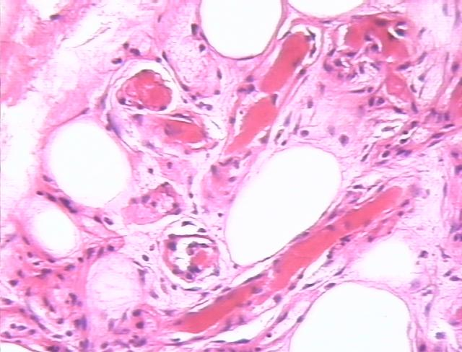

Slide 24
Venous thrombi
Occur in a stagnating environment,
the thrombi contain more enmeshed RBCs among sparse fibrin strands
appear as long, red-blue cast of the vein lumen

Slide 25
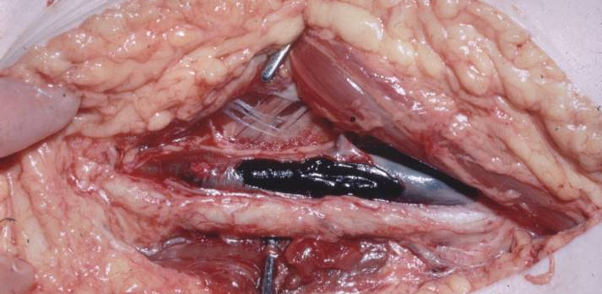
Marked passive
congestion
of the left lower leg
in a patient with a
deep venous thrombus
Surgical dissection
of the thrombus.

Slide 26
Arterial thrombi
are usually occlusive;
the most common sites, in descending order, are coronary, cerebral, and femoral arteries.
usually superimposed on an atherosclerotic plaque
typically firmly adherent to the injured arterial wall and are gray-white and friable,
composed of a tangled mesh of platelets, fibrin, erythrocytes, and degenerating leukocytes
pale layers of platelets and fibrin, alternating with darker, RBC-rich layers ( lines of Zahn)

Slide 27
Valvular thrombi
On heart valves, also called vegetations
May contain bacteria, e.g., in infective endocarditis
May be sterile, e.g., in patients with hypercoagulable states, particularly in those with disseminated cancer.

Slide 28
Mural thrombi
Thrombi occurring in heart chambers or in the aortic lumen
Causes of mural thrombi
Abnormal myocardial contraction (due to arrhythmias, dilated cardiomyopathy, or myocardial infarction)
endomyocardial injury (caused by myocarditis, catheter trauma)
Ulcerated atherosclerotic plaques and aneurysmal dilation promote aortic thrombosis

Slide 29
Mural thrombi.
A, Thrombus in the left and right ventricular apices, overlying a white fibrous scar.
B, Laminated thrombus in a dilated abdominal aortic aneurysm

Slide 30
Consequences of thrombosis:
(1) Resolution:
(2) Organization and re-canalization.
(3) Detachment: thromboembolism
(4) Calcification: intravascular "stones" are formed.
(5)Propagation, causing complete obstruction

Slide 31
Complications of thrombosis
Arterial occlusion: ischemic necrosis of the tissue supplied by the artery (infarction).
Venous occlusion: obstruction of venous flow and edema of the envolved extremity
Embolism (regardless of whether the thrombi are arterial, cardiac, or venous).
Infection. Thrombi are a fertile soil for bacteria and are easily infected.
Thrombophlebitis. Inflammation of the vein, induced by organization of infected thrombi

Slide 32
Disseminated intravascular coagulation

Slide 33
DIC
A thrombohemorrhagic disorder characterized by the formation of microthrombi in arterioles, capillaries, and venules.
Formation of these microthrombi consumes the platelets thrombocytopenia,
and leads to the depletion of fibrinogen and other coagulation proteins severe diffuse bleeding

Slide 34
Causes of DIC
Infections – Gram-negative sepsis, N meningitidis fungal infections
Neoplasms – carcinomas of the gastrointestinal tract and promyelocytic leukemia
Massive tissue injury - trauma, burns, and extensive surgery
Shock – any form
Obstetric complications – amniotic fluid embolism, eclampsia, and abruptio placentae

Slide 35
Pathogenesis
Intravascular coagulation can be initiated by three often interrelated pathways:
Activation of Hageman factor initiating the intrinsic coagulation cascade
Thromboplastins activating the extrinsic coagulation pathway
Endothelial cell injury

Slide 36
Pathologic findings
Gross:
hemorrhages of skin, mucous membranes, serosal surfaces, and viscera
LM:
numerous fibrin microthrombi in small vessels, particularly in the heart, brain, glomeruli of the kidneys, and other sites +microinfarcts
Most patients die before such foci of ischemic necrosis become histologically apparent

Slide 37
Laboratory findings
Bleeding tests (prothrombin [PT] and activated partial thromboplastin time [aPTT]) are prolonged
Thrombocytopenia
Fibrin degradation products in the urine

