Slide 1
TONSILITIS
DR.M.P.LAL.
Professor and Head of Dept of Surgery

Slide 2
TONSILS
The palatine tonsils are sub epithelial lymphoid collections situated in- between the faucial pillars. These help in protecting the respiratory and alimentary tract from bacterial invasions and are thus prone to frequent attacks of infections. Infections can be acute and chronic.

Slide 3
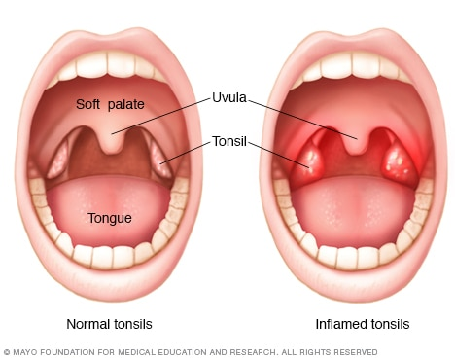
TONSILS

Slide 4
ACUTE TONSILITIS
AETIOLOGY - May occur as a primary infection or can be secondary.
Bacteria – Haemolytic Streptococcus, Staphylococcus,Haemophilus influenzae and Pneumococcus.
Predisposing factors – poor orodental hygiene, poor nutrition and congested surroundings.

Slide 5
CLINICAL FEATURES
Discomfort in throat,difficulty in swallowing and generaralised body symptoms like malaise , anorexia, fever and body ache.
On examination – patient is febrile and has tachycardia. The tonsils appear swollen ,congested with exudates in the crypts. Oedema of the uvula and soft palate may occur. The jugulodigastric (tonsillar) lymph nodes are enlarged and tender.

Slide 6
MANAGEMENT
General management includes bed rest and giving plenty of fluids.
Treatment - Symptomatic.

Slide 7
COMPLICATIONS
Chronic tonsillitis
Peritonsillar abscess
Para pharyngeal abscess
Acute otitis media
Acute nephritis and rheumatic fever

Slide 8
CHRONIC TONSILITIS
Chronic inflammatory changes are usually the result of recurrent acute infections.

Slide 9
CLINICAL FEATURES
Discomfort in the throat
Recurrent attacks of sore throat
Unpleasant taste (cacagus)
Bad smell in the mouth (halitosis)
ON EXAMINATION – Congested and hypertrophic tonsils. The anterior pillars are hyperaemic .Enlargement of the jugulodigastric lymph nodes is an important sign.

Slide 10
COMPLICATIONS
Peritonsillar abscess
Para pharyngeal abscess
Intratonsillar abscess
Tonsillar cyst
Tonsillolith
Rheumatic fever
Acute nephritis

Slide 11
TREATMENT
SYMPTOMATIC
TONSILLECTOMY

Slide 12
HOMOEOPATHIC THERAPEUTICS
BELLADONNA
BARYTA CARB
HEPAR SULPH
LACHESIS
MERC SOL
MERC DULCIS
MERC BIN IODIDE
MERC PROTO IODIDE
NITRIC ACID
PHYTOLACCA

