Slide 1
UPPER AND LOWER MOTOR NEURON
FUNCTION AND LESION
DR.T.AJAYAN
PROF. & H.O.D.
PM

Slide 2
CNS influence the activity of skeletal muscle through two sets of neuron
Upper motor neuron
Lower motor neuron

Slide 3
UPPER MOTOR NEURON
Upper motor neurons (UMN) are responsible for conveying impulses for voluntary motor activity through descending motor pathways that make up the upper motor neurons.
UMN send fibers to the LMN, and that exert direct or indirect supranuclear control over the LMN of the cranial and spinal nerves..

Slide 4
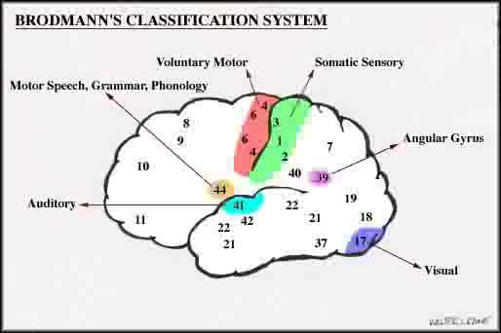
WHERE THEY COME FROM ?
.

Slide 5
Axons from the cortical areas form the corticospinal and corticobulbar tracts.
1/3 from primary motor cortex (Betz’s cell axons -3-5%, and other 95% from small neurons)
1/3 from the somatic sensory cortex (areas 1, 2, and 3), and
adjacent temporal lobe region.

Slide 6
HOW UPPER MOTOR NEURON FUNCTION ?
Upper motor neuron control lower motor neuron through two different pathways.
Pyramidal tract
Extra pyramidal tract

Slide 7
PYRAMIDAL TRACTS
corticospinal tract
EXTRAPYRAMIDAL TRACTS-
Reticulospinal Olivospinal
Vestibulospinal
Tectospinal
Rubrospinal tract
Corticobulbar tract
Corticorubral tract

Slide 8
Nerve pathways
Descending Tracts
Tract | Signal function
Corticospinal (pyramidal) | Fine voluntary motor control of the limbs. The pathway also controls voluntary body posture adjustments.
Rubrospinal | Involved in involuntary adjustment of arm position in response to balance information; support of the body.
Reticulospinal (1) Pontine | Regulates various involuntary motor activities and assists in balance (leg extensors). Some pattern movements e.g. stepping
(2) Medullary | Inhibits firing of spinal and cranial motor neurons, control of antigravity muscles.
Vestibulospinal (1) Medial | It is responsible for adjusting posture to maintain balance (neck muscles).
(2) Lateral | It is responsible for adjusting posture to maintain balance (body/lower limb).
Tectospinal | Controls head and eye movements, Involved in involuntary adjustment of head position in response to visual information.

Slide 9
Tracts

Slide 10
Descending pathways
Pyramidal system
Lateral and anterior corticospinal tracts
Extrapyramidal system
Tectospinal tracts
Vestibulospinal tracts
Rubrospinal tracts
Anterior, medial, and lateral reticulospinal tracts

Slide 11
Descending Pathways
Pathway | Upper limb | Lower limb
Cortico/-pyramidal | This Tract functions to modulate the activity of Alpha or Gamma Motor Neurons as directed by the Motor Cortex.
Rubro-spinal | Stimulates flexors
Reticulo-spinal | Medullary inhibits extensors and excites flexors Pontine excites extensors and inhibits flexors (Generally upper limb)
Vestibulo-spinal | Doesn’t affect upper limbs but helps position head and neck in response to body tilting (medial) | Stimulates extensors (lateral)
Tecto-spinal | Control of head, neck and eye movements.

Slide 12
Rubrospinal Tract

Slide 13
Ascending Pathway

Slide 14
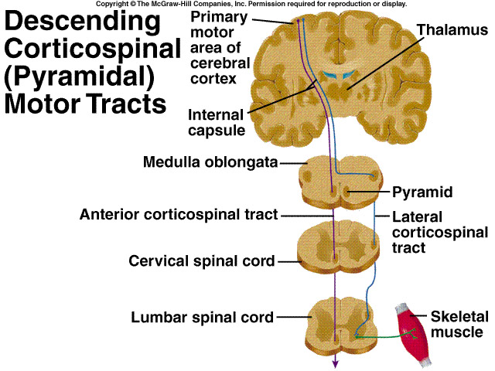

Slide 15
UPPER MOTOR NEURON LESION
Loss of dexterity, voluntary skillful movements. (corticospinal
Babinski sign(corticospinal)
Loss of superficial reflex (corticospinal)
.

Slide 16
weakness with no muscle atrophy
Spasticity is hallmark of the UMN disease. Spasticity is a state of sustained increase in muscle tension in response to muscle lengthening, in particular, with passive movements.
hyperreflexia. deep tendon reflex
Pseudobulbar palsy is hallmark of the UMN disorder

Slide 17
PSEUDOBULBAR PALSY
results from an upper motor neuron lesion to the corticobulbar pathways in the pyramidal tract.
It results from bilateral lesion of UMN’s of the muscles of the tongue (XII), face (VII), speech and swallowing (IX,X)
Individuals with pseudobulbar palsy also demonstrate inappropriate emotional outbursts.

Slide 18
WHAT ARE LOWER MOTOR NEURON
All voluntary movement depend upon excitation of lower motor neuron by upper motor neuron
These are the only neurons that innervate the skeletal muscle fibers, they function as the final common pathway, the final link between the CNS and skeletal muscles

Slide 19
WHERE THEY COME FROM
Motor Neuron in spinal cord
Motor component of cranial nerve nuclei in brain stem (Those in cranial nerves innervate the skeletal muscles associated with the movements of the eyes, tongue, chewing, swallowing, vocalizing.)

Slide 20
CLASSIFICATION OF LMN
Lower motor neurons are classified based on the type of
muscle fiber they innervate:
Alpha motor neurons (α-MNs) innervate
extrafusal muscle fibers, the most numerous type of muscle
fiber and the one involved in muscle contraction.
Gamma motor neurons (γ-MNs) innervate
intrafusal muscle fibers, which together with sensory afferents
compose muscle spindles. These are part of the system for sensing body position (proprioception)

Slide 21
LOWER MOTOR NEURON LESION
Flaccid paralesis
Muscle atrophy and Hyporeflexia
Muscle hypotonicity
Fasciculations

Slide 22
BULBAR PALSY
is a similar disorder as psedobulbar palsy but is caused by lower motor neuron lesions
It consists of LMN signs in regions innervated by the facial (VII), glossopharyngeal (IX), Vagus (X) and hypoglossal (XII

Slide 25
The corticobulbar tract projects bilaterally to all the cranial motor nuclei except
Part of facial nucleus that supply muscle of lower part of face receives corticobulbar fibers from same hemisphere
in UMN LESION muscle of lower part of face will paralyzed
in LMN LESION all muscle of affected side will be paralyzed

Slide 26
Part of hypoglossal nucleus that supplies the genioglossus muscle receive corticobulbar fiber from opposite hemisphere
in UMN LESION tongue will deviate to the side opposite to lesion
in LMN LESION tongue will deviate to the
side of lesion

