Slide 1
VEHICLES
DR.RAMYA S.S
ASSISTANT PROFESSOR
DEPT OF HOMOEOPATHIC PHARMACY

Slide 2
VEHICLES
Homoeopathic vehicles are material agents that are therapeutically inert, having no curative properties of its own, as well as chemically non-reactive with drug substances. They are a media for extraction of the properties of the drug, its preservation and conveyance of the properties of the drug to the intended site of action.

Slide 3
QUALITIES OF A HOMOEOPATHIC VEHICLE
A homoeopathic vehicle should have no curative property of its own, in the crude state, as also, when it is potentized with other remedial agents.
A homoeopathic vehicle should remain chemically neutral and non-reactive with the homoeopathic drugs to retain their active principles and their originality. Vehicles only act at a physical level, extracting the properties of the drug, liberating the potent energy by dynamization, preserving the curative properties of the medicine and conveying the effects of the remedy to the organism.

Slide 4
A homoeopathic vehicle should not be toxic in relation to the utility for which it is intended. It should be harmless and safe as regards its action on the human organism. It should be edible and palatable and by itself, it may be used safely for non-homoeopathic purposes.
A homoeopathic vehicle must itself be stable to ensure the stability of the homoeopathic drug that it carries.

Slide 5
UTILITY OF HOMOEOPATHIC VEHICLES * As menstrum or an extractive of the properties and the active principles from the original source to prepare homoeopathic mother tinctures. * As a solvent for dissolving the drug substances to prepare mother solutions. * For preparing mother substances as a starting point for the preparation of homoeopathic dynamizations. * As an important media for developing the dynamic curative energy of the drug to make it therapeutically active. It is also responsible to eliminate the toxicity of the drug substances by diluting the crude drug. This is effected by the process of homoeopathic succussions and triturations.

Slide 6
* As bases for preparation of external applications and for introduction of medicines via different routes. * As a preservative of homoeopathic medicines. * As a means of dispensing of homoeopathic medicines. * By itself, homoeopathic vehicles can act as 'placebo'. * In preparation of other homoeopathic vehicles. * By itself, vehicles serve various uses:

Slide 7
CLASSIFICATION OF HOMOEOPATHIC VEHICLES AND BASES
Homoeopathic vehicles, by the virtue of their physical state, under normal conditions, may be solid, liquid or semi-solid.

Slide 8
Semi-solid vehicles
(i)Paraffin:
Hard Paraffin Soft Paraffin - Yellow soft paraffin ,White soft paraffin Liquid Paraffin
(ii)Beeswax:
Yellow beeswax White beeswax
iii. Lanolin
iv. Spermaceti

Slide 9
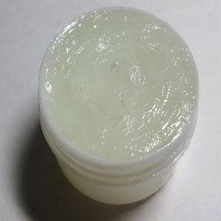
WHITE PARAFFIN

Slide 10
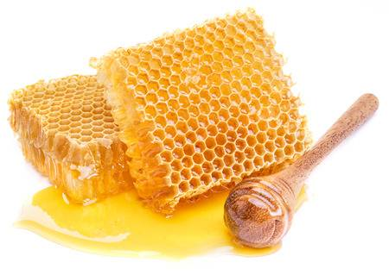
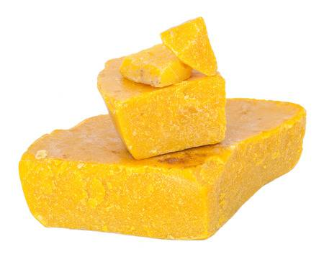
BEES WAX

Slide 11
v. Prepared lard
vi. Isinglass
vii. Soap:
Hard soap Soft soap Curd soap
viii. Starch

