Slide 1
WOUNDS
Wounds, Tissue repair & Scars
Prepared by,
Dr. Panchajani. R

Slide 2
Leaning objectives
At the end of this topic, you should be able to,
Define“Wound”
Causes of wounds
Classification of wounds
Wound healing
Phases of wound healing
Types of wound healing
Factors affecting wound healing
Complications of wound healing
Management of wounds

Slide 3
Wounds
Definition –Wound is a discontinuity or break in the surface epithelium.
A wound is a type of physical trauma whereby the integrity of the skin or of any tissue is compromised.
It is a separation or discontinuity of the skin, mucous membrane or tissue caused by physical, chemical or biological insult.

Slide 4
Wounds
Aetiology
The etiology of wounds can be classified as follows:-
Blunt injuries
Penetrating injuries
Surgical insult
Burn injuries

Slide 5
Wounds
Blunt injuries
RTA
Falls
Assault
Sport injuries
Bite injuries [animal or human]
Penetrating injuries
Stab wounds
Gunshot wounds
Surgical wounds
Wounds caused by a surgical procedure
Burn injuries
Thermal burn
Chemical burn
Electrical burn
Radiation burn
Cold injury

Slide 6
WOUND CLASSIFICATION
Aim:
Wound classification systems provide frameworks that:-
Aid diagnosis and stratification
Ensure uniformity of documentation
Offer prognostic information
Guide management

Slide 7
Types of wound classification
Wounds can be classified as follows:-
According to the etiology
According to Rank-Wakefield classification system
According to the duration of the wound healing
According to the integrity of the skin
According to wound depth
According to morphological characteristics
According to degree of contamination
According to severity

Slide 8
Wound classification
According to the etiology
Surgical wounds - These are wounds caused by surgical procedure
Penetrating wounds - Wounds caused by penetrating trauma , Stab injuries of abdomen is common. Look like an innocent injury but internal organs may be damaged. Pt. should be admitted & observed for at least 24 hrs. layer by layer exploration & repair is recommended.
Blunt wounds - Wounds caused by blunt trauma
Burn wounds - Wounds caused by burn injuries

Slide 9
Wound classification
According to Rank-Wakefield classification system -
Tidy wounds – wounds inflicted by sharp instruments and contain no devitalized tissue.
They are usually single , incised, clean cut , healthy tissue &seldom associated with tissue loss.
Such wounds can be closed primarily with the repair of all structures may be possible.(primary healing)
Associated fractures are uncommon in tidy wounds
Examples: surgical incisions, cuts from glass and knife wounds

Slide 10
Wound classification
Untidy wounds
These are wounds resulting from crushing, tearing avulsion, vascular injury or burns, and contain contaminated devitalized tissue & with tissue loss
They are usually multiple and irregular
Commonly associated with fractures
Such wounds can not be closed primarily and therefore should be allowed to heal by second intention
Contaminated wound with dead tissue requires debridement before repair can be carried out.
Multiple debridement are required after RTA which causes widespread muscle damage or even compartment syndrome.

Slide 11
Wound classification
According to the duration of the wound healing
Acute wounds
Acute wounds are wounds that usually heal in the anticipated time frame
Duration of the wound: immediately to few weeks
Examples are wounds acquired as a result of trauma or an operative procedure
Chronic wounds
Wounds that fail to heal in the anticipated time frame and often reoccur
Duration of the wound ⇒ > 4 weeks to 3 months
Wounds occur as a result of an underlying condition such as extended pressure on the tissues, poor circulation, or even poor nutrition
Pressure ulcers, venous leg ulcers, and diabetic foot ulcers are examples

Slide 12
Wound classification
According to the integrity of the skin
Open wounds
Type of wounds in which the skin has been compromised and underlying tissues are exposed
Open wounds can be classified into a number of different types, according to the object that caused the wound
Examples include incised wounds, laceration, punctured wounds , penetrating , crushed etc

Slide 13
Open wounds
Incised wounds –
caused by sharp objects
Has a sharp edge, Less contaminated
Primary suture is needed, as it gives a neat &clean scar.
Lacerated wounds ;caused by blunt objects, RTA
Edges are jagged
Injury involves only the skin & subcutaneous tissue or sometimes deeper structures.
Due to blunt nature of instruments there is crushing of tissues, which may results in hematoma, bruising or necrosis of tissue.
Treated with in 6 hrs. of injury.
Treated by wound excision & primary suturing .

Slide 14
Wound classification
Closed wounds
Wounds in which the skin has not been compromised, but trauma to underlying structures has occurred
Closed wounds have fewer categories, but are just as dangerous as open wounds
Examples of closed wounds are:
contusion, abrasion, haematoma

Slide 15
Closed wounds
Contusions (known as a bruise) –can be,
minor- soft tissue injury without break in the skin
Major- when run over by a vehicle
caused by blunt force trauma that damages tissue under the skin
It produces discolouration of skin due to collection of blood underneath.
Abrasion-epidermis of the skin is scrapped away exposing the dermis.
Painful as dermal nerve endings are exposed
Need cleaning & dressing
Hematoma - (also called a blood tumor) – collection of blood following injury
caused by damage to a blood vessel that in turn causes blood to collect under the skin
Occur spontaneously in pts. with bleeding tendencies
Sites- subcutaneous, intramuscular, subperiosteal
Small hematoma get absorbed
Knee joint hematoma need to be aspirated, if not they can get infected

Slide 16
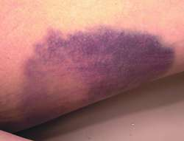
A contusion, commonly known as a bruise, is a type of hematoma of tissue in which capillaries and sometimes venules are damaged by trauma, allowing blood to seep, hemorrhage, or extravasate into the surrounding interstitial tissues.

Slide 17
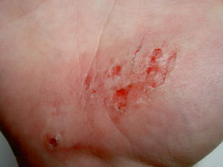
An abrasion is a type of open wound that's caused by the skin rubbing against a rough surface. It may be called a scrape or a graze.

Slide 18
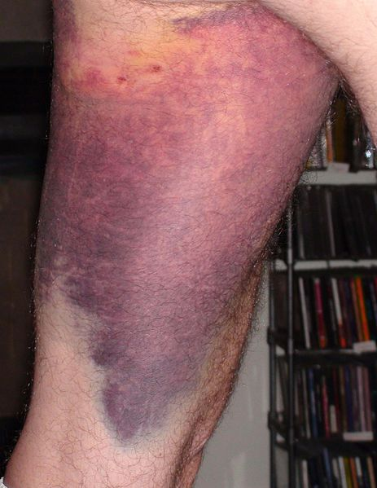
A Hematoma is a localized collection of blood outside the blood vessels, due to either disease or trauma including injury or surgery and may involve blood continuing to seep from broken capillaries. ‎

Slide 19
Wound classification
According to wound depth
Superficial wounds
Only the epidermis is affected and has to be replaced.
A truly superficial wound does not bleed and heals within a few days.
Examples include most abrasions and blisters.

Slide 20
Wound classification
Partial-thickness wounds
The epidermis and part of the dermis is affected
A partial-thickness wound does bleed
If left uncovered, a blood clot will cover the wound and a scar will form
The missing tissue will then be replaced, followed by regeneration of the epidermis
A partial-thickness wound can take from several days to several weeks to heal, depending on the patient and the wound treatments chosen.

Slide 21
Wound classification
Full-thickness wounds
A full-thickness wound involves the epidermis and the dermis
The underlying fatty tissue, bones, muscles, or tendons may also be damaged
If full-thickness wounds cannot be sutured, the healing process will create new tissue to fill the wound, followed by regeneration of the epidermis
The full-thickness wound takes longer time to heal than does a partial-thickness wound, sometimes as long as several months

Slide 22
Wound classification
According to morphological characteristics
Bruises / contusion
These are closed wounds
Caused by blunt trauma that damage the tissue under the skin without breaking the skin
Characterized by skin discoloration due to bleeding into the tissues
Blows to the chest, abdomen, or head with a blunt instrument can cause contusions

Slide 23
Wound classification
Hematoma
These are also closed wounds caused by damage to a blood vessel that in turn causes blood to collect under the skin
Initially this is fluid, but it will clot within minutes or hours ⇒later after few days the hematoma will again liquefy → increased risk of secondary infection → pus formation

Slide 24
Wound classification
Crush wounds or contused
Crush wounds are caused by a great or extreme amount of force applied over a long period of time
Caused by blunt trauma, run over by vehicle, wall collapse etc..
These occur when a heavy object falls onto a person, splitting the skin and shattering or tearing underlying structures
These wounds are dangerous they cause severe haemorrhage, death of tissue& crushing of blood vessels
more prone to gas gangrene & tetanus
They are often accompanied by degloving injuries and compartment syndrome
Treatment includes good debridement & removal of all dead & necrotic tissues.

Slide 25
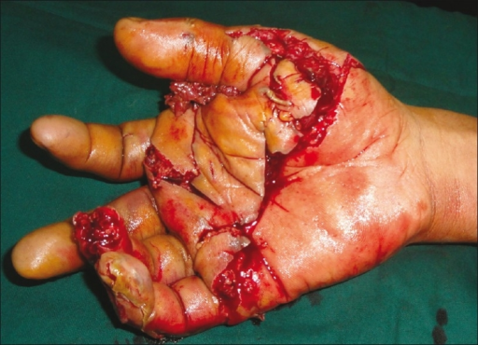
A crush injury is injury by an object that causes compression of the body. This form of injury is common following a natural disaster or after some form of trauma from a deliberate attack. Common concerns after an injury of this type are rhabdomyolysis and crush syndrome

Slide 26
Wound classification
Abrasions
An abrasion is a shearing injury of the skin in which the surface is rubbed off
Most are superficial and will heal by epithelialization
Lacerated wound
Caused by tearing of tissues
Wounds have irregular borders
Loss of tissue is limited to skin and s/c tissue

Slide 27
Wound classification
Penetrated wound
Cause by sharp pointed objects like nails
Have relatively small opening
May be very deep
Infection/ foreign particles might have been carried deep in to wound opening is inadequate for drainage
eg: punctured wound on foot due to gathered nail
Perforating wound
Have two opening one of entrance and other of exit
Eg. gunshot wounds

Slide 28
Wound classification
According to degree of contamination
Clean wounds
No break in aseptic technique
Incision is made under sterile conditions
No inflammation is encountered
The respiratory tract, alimentary, genital or uninfected urinary tracts are not entered
Primary closure
No drain
Eg- Herniorrhaphy,

Slide 29
Wound classification
Clean Contaminated wounds
Operative wounds in which the respiratory, alimentary, genital or urinary tract is entered under controlled conditions and without unusual contamination
Contaminated wounds
Open, fresh or accidental wounds; operations with major breaks in sterile technique or gross spillage from the gastrointestinal tract; and incisions in which acute, non-purulent inflammation is encountered
Dirty or Infected wounds
Old traumatic wounds with retained devitalized tissue and those that involve existing clinical infection

Slide 30
Wound classification
According to severity
Simple wounds
when skin only involved.
The integrity of the skin is traumatized without loss or destruction of tissue and without the presence of a foreign body in the wound
Complex wounds
involves the underlying nerves, vessels, tendons.
Tissue is lost or destructed by means of a crush, burn, or foreign body in the wound

Slide 31
WOUND HEALING
Definition -
Wound healing, or wound repair, is the body's natural process of restoring normal function and structure after injury.
The entire wound healing process is a complex series of events that begins at the moment of injury and can continue for months to years.

Slide 32
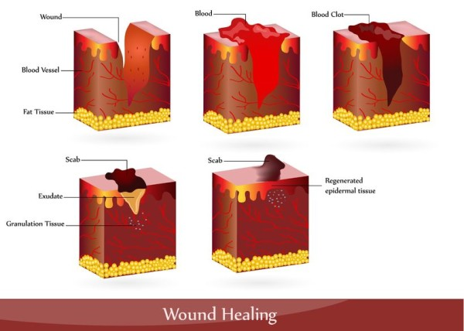
wound healing

Slide 33
WOUND HEALING
Phases of wound healing
Three phases of wound healing include:-
Inflammatory phase
Proliferative phase
Maturation and remodeling phase
Occassionally a haemostatic phase before the inflammatory phase

Slide 34
WOUND HEALING- PHASES
Inflammatory phase – Immediately after wounding & last for 2-3 days
Early infla.- platelet enriched blood clot & blood vessels
Late infla.- increased vascularity & increased poly morpho nuclear lymphocytes
Aim: to stop bleeding and to prevent further injury

Slide 35
WOUND HEALING
Characterized by :-
Clotting - haemostasis
Vasoconstriction and vasodilatation
Increased polymorphonuclear neutrophils
Increased Macrophages

Slide 36
Wound healing- Inflammatory phase
Vaso constriction & thrombus formation to limit the blood loss.
Platelets aggregation – platelet stick to the damaged endothelial lining of vessel releasing ADP which causes thrombocytic aggragates to fill the wound.
This clot acts to control active bleeding (haemostasis)
Platelet release several cytokines from their alpha granules, these atract inflammatory cells such as poly morphonuclear lymphocytes& macrophages.
Platelet and local injured site release vaso active amines ( histamine , serotonine , prosta glandin) which increase vascular permeability.

Slide 37
WOUND HEALING- INFLAMMATORY PHASE
vasoconstriction lasts 5-10 minutes and is followed by vasodilatation which peaks at about 20 minutes post-wounding.
Macrophages remove devitalised tissue and micro organism & regulate fibroblastic activity in the proliferative phase.
The initial frame work for structural support of cells is provided by fibrin produced by fibrinogen

Slide 38
WOUND HEALING
Vasodilatation is the result of factors released by platelets and other cells
The main factor involved in causing vasodilatation is histamine
Histamine also causes ↑ vascular permeability→ entry of inflammatory cells like leukocytes into the wound site from the bloodstream

Slide 39
WOUND HEALING
Increased polymorphonuclear neutrophils
Within an hour of wounding, PMNs arrive at the wound site and become the predominant cells in the wound for the first two days after the injury
These PMNs phagocytise debris and bacteria and also kill bacteria by releasing free radicals
They also cleanse the wound by secreting proteases that break down damaged tissue
PMNs usually undergo apoptosis once they have completed their tasks and are engulfed and degraded by macrophages

Slide 40
WOUND HEALING
Increased Macrophages
Macrophages are essential to wound healing.
They replace PMNs as the predominant cells in the wound by two days after injury.
Attracted to the wound site as monocytes from blood vessels by growth factors released by platelets and other cells.
Once they are in the wound site, monocytes mature into macrophages.

Slide 41
WOUND HEALING
The macrophage's main role is to phagocytize bacteria and damaged tissue and they also debride damaged tissue by releasing proteases .
Macrophages also secrete a number of factors such as growth factors and other cytokines that attract cells involved in the proliferation stage of healing to the area

Slide 42
WOUND HEALING- PHASES
Proliferative phase
After the inflammatory stage, the proliferative stage lasts from 3day to about 3 weeks (or longer, depending on the severity of the wound)
Aim: repair of wounded tissue
Characterized by
Fibroblastic activity
Angioneogenesis
Fibroplasia and granulation tissue formation
Re-epithelialization
Wound contraction

Slide 43
Proliferative phase
Fibroblastic activity with production of collagen & ground substance which helps in binding of collagen fibres.

Slide 44
WOUND HEALING
Angioneogenesis
Angiogenesis is the process of new blood vessel formation and is necessary to support a healing wound environment
New blood vessels are formed by vascular endothelial cells
Growth of new blood vessels as capillary loops
Endothelial cells are attracted to the wound area chemo tactically by angiogenic factors released by platelets and macrophages.
Endothelial growth and proliferation is also directly stimulated by hypoxia, and presence of lactic acid in the wound.

Slide 45
WOUND HEALING
Fibroplasia and granulation tissue formation
Fibroblasts begin accumulating in the wound site 2-5 days after wounding and peaks at 1-2 weeks post-wounding
Fibroblasts then deposit ECM into the wound bed, and later collagen and granulation tissue formation
Granulation tissue consists of new blood vessels, fibroblasts, inflammatory cells, endothelial cells, myofibroblasts, and extracellular matrix (ECM)
Fibroblast require vit. C to produce collagen
The wound tissue formed in the early part of this phase is granulation tissue .
In later part of this phase there is an increase in the tensile strength of the wound due to increased collagen & is of type III collagen.

Slide 46
WOUND HEALING
Epithelialization
Epithelial cells migrate across the granulation tissue to form a barrier between the wound and the environment
Epithelialization occurs from the edge of the wound by a process of cell migration & cell multiplication brought about by marginal basal cells .thus with in 48 hrs. the entire wound is re-epithelialised
Basal keratinocytes from the wound edges and dermal appendages such as hair follicles, sweat glands and sebacious glands are the main cells responsible for the epithelialization phase of wound healing.
Epithelialization phase is usually complete within 7-10 days
Wounds with skin loss skin appendages also helps in epithelialization .
Slowly surface cells get keratinised.

Slide 47
WOUND HEALING-PHASES
Maturation and remodeling phase
The maturation phase of tissue repair begin when the levels of collagen production and degradation equalize.
Maturation of collagen – type 1 replacing type III until the ratio of 4:1 is achieved
Re-allignment of collagen fibres along the lines.
The maturation phase can last for a year or longer, depending on the size of the wound and whether it was initially closed or left open

Slide 48
WOUND HEALING
Wound contraction
Contraction is a key phase of wound healing
If contraction continues for too long, it can lead to disfigurement and loss of function
Decreased wound vascularity & wound contracture due to fibroblast & myofibroblastic activity
Contraction commences approximately a week after wounding, when fibroblasts have differentiated into myofibroblasts and can last for several weeks .
Myofibroblasts, which are similar to smooth muscle cells, are responsible for contraction
Wound contracture readily occurs in loose skin as in back & gluteal region, reduced over tibia, malleoli.
Cortico- steroids, Uv radiation, chemotherapy delays wound contracture

Slide 49
Wound healing
Scar formation-
Changes –
Fibroplasia & laying of increased collagen
Vascularity becomes less
Epithelialization continues
Ingrowth of lymphatics & nerve fibres
Remodelling of collagen with ciccatrisation resulting in a scar.

Slide 51
WOUND HEALING- TYPES
Types of wound healing
Healing by primary intention (Primary closure)
Healing by secondary intention (Secondary closure)
Healing by tertiary intention (Delayed primary closure)

Slide 52
WOUND HEALING
Healing by primary intention (Primary closure)
Healing by primary intention (Primary closure) occurs when a wound is created aseptically with minimal tissue damage.
Occurs in clean incised wounds
Wound edges are opposed
Normal healing, minimal scar
Healing takes place by the approximation of tissue edges with suture, staples, wound sealant etc

Slide 53
WOUND HEALING
Healing by secondary intention (Secondary closure)
Occurs in wounds that are already infected , discharging pus or wound with skin loss
Wound is usually left open and allowed to heal by granulation, epitheliazation and wound contraction.
Increased inflammation & proliferation
May be caused by infection, excessive trauma, tissue loss, or inability to re- approximate the tissue
It is a slow process, poor scar.

Slide 54
WOUND HEALING
Healing by tertiary intention (Delayed primary intention)
Wounds that are heavily contaminated and are likely to develop an infection if closed primarily,
may be left open for 3-5 days, edges are later opposed when healing conditions favourable .
This allows the wound to be cleaned and allows the body’s natural defenses to decrease bacterial count
The wound can then be closed and allowed to heal, producing a wound with characteristics similar to primary closure

Slide 55
Abnormal healing
Some factors adversely affects healing
Delayed healing results in loss of function or poor cosmetic outcome
Aim is to achieve healing by primary intention & reduce the inflammation & proliferative responses

Slide 56
Factors affecting wound healing
Local factors affecting wound healing
Systemic factors affecting wound healing

Slide 57
Factors affecting wound healing
Local factors affecting wound healing
Site
Structures involved
Mechanism of wounding
Contamination
Loss of tissue
Infection
Surgical Technique
Movement
Hematoma formation
Vascular insufficiency – poor blood supply
Tissue ischemia- hypoxia
Presence of foreign body
Exposure to radiation
Pressure
Faulty technique of wound closure

Slide 58
Factors affecting wound healing
Systemic factors affecting wound healing
Aging
Nutritional status – vit. & mineral deficiency
Diseases states
Uremia
Jaundice
Diabetes
Malignancies
Immunosuppression
Smoking
Drugs
Steroids
anti-neoplastics
NSAIDs

Slide 59
Complications of wound healing
Dehiscence – wound rupture along the incision
Evisceration – to push outside through incision
Hemorrhage
Adhesions
Infection
Herniation
Fistula formation
Sinus formation
Suture complications
Hypertrophic scar
Keloids
Malignant changes

Slide 60
MANAGEMENT OF WOUNDS
Surgical toilet with:-
Primary closure
Delayed closure
Delayed primary closure
Skin grafting
Flaps
Wound dressing
Skin grafting

Slide 61
Management of wounds
Examine the whole patient according to acute trauma life support(ATLS) principles
Consider site, possible structures damaged, movement & sensation
Monitoring tempt., pulse, resp.
Bleeding wound elevated, pressure & packing applied
prophylaxis against tetanus- TT

Slide 62
Wound treatment
Cleaning& dressing
Suturing
Debridement & excision in aberation, RTA, explosion
Repair of all damaged structures
Repair of nerves & arteries under magnification
Skin repair by flap or graft

Slide 63
Wound closure / suturing
1. primary suturing –
Suturing with in few hours following injury(with in 6hrs.)
Done in incised or cut wound with sharp objects
Minimal injury to structures , no infection
Precautions while suturing-
Foreign body present ,removed
Associated injury to blood vessels, nerves, tendons repaired
Prevention of tetanus by TT

Slide 64
WOUND CLOSURE
2. Wound excision & primary suturing of skin
Indications-
Wound edges are jagged( lacerated)
Contaminated with organism or foreign body
Crushed or devitalized tissues
Wound is explored , devitalized tissues or foreign bodies if present removed.
Irrigated with antiseptic solution
Lacerated wound is converted in to incised & then sutured
Precautions-
done with in 6hrs.
Tetanus & gas gangrene prophylaxis taken.
Repair of tendons & vessels done

Slide 65
Wound closure
3. wound excision & delayed primary suturing
Indicated in lacerated wounds with major crush injuries
Primary suturing with in 6 hrs. is not done because of ,
oedema of the part, increased tissue tension, hematoma, contamination with bacteria.
Excision of all dead tissue is done
Wound is irrigated with saline & left open without suturing & dressing is applied
Wound is re-examined 4-6 days later
If there is no infection or non viable tissues wound is sutured.

Slide 66
Wound closure
4. wound with skin loss
Complications of skin loss
Secondary infection
Underlying structures tendons, nerves are in danger
Diabetic pts. can develop septicaemia
Deformity & disability can occur later
Tt. –Debridement
Done under G.A
Assess the extent of injury
Control bleeding
Excision of devitalised tissue
Saline irrigation
Skin grafting with proper asepis
Blood transfusion

Slide 67
MANAGEMENT OF ACUTE WOUND
Cleaning
Exploration & diagnosis
Debridement
Repair of structures
Skin cover if required

Slide 68
REFERENCE
Bailey and Love’s short practice of Surgery
Manipal manual of Surgery
SRB’s Manual of surgery
Text book of Surgery- ASI
Clinical Surgery, Das

Slide 69
Thank you,
Dr. Panchajani. R
Associate professor,
Dept. of Surgery,
SKHMC

