Slide 1

Acute abdomen
DR.BINO
Associate Prof.
DEPT OF SURGERY

Slide 2

The term
‘acute abdomen’
designates symptoms and signs of intra-abdominal disease usually treated best
by surgical operation.

Slide 3

Acute Abdomen
Continue
If I operate and the problem is not surgical, patient exposed to unnecessary risk, anesthetic, etc.
Risks greater with concomitant illness, older age
□
□
□
If I do not operate and problem is surgical, patient at risk because of wrong therapy.
Again the older patient is under greater burden.
□

Slide 4

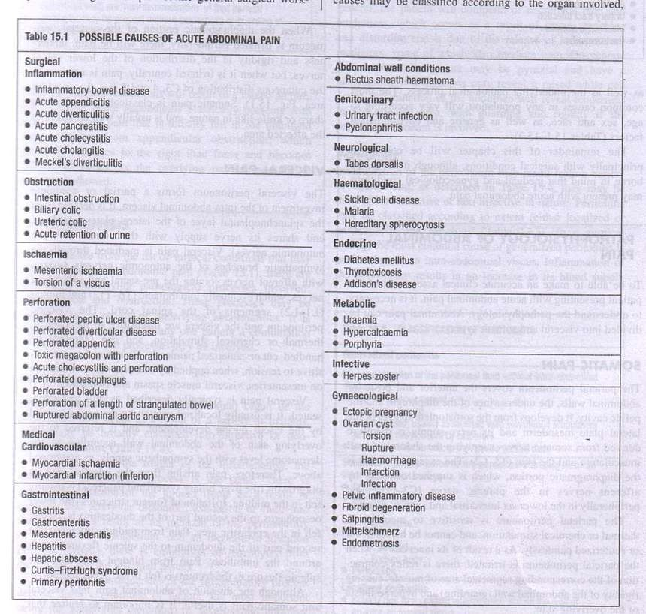

Slide 5

Characteristics of patients need surgery
□ Acute pain Septic & toxic
Board-like abdomen
Absent bowel sounds WBC 25,000
Free air under diaphragm
□
□
□
□
□

Slide 6

Characteristics of patients need NO surgery
□ Trivial pain
Robust appearance
Soft abdomen with no guarding Normal bowel sounds
Normal WBC
Normal plain and upright films of abdomen
□
□
□
□
□

Slide 7
Acute Abdominal Pain Non-surgical Emergencies
□ Mesenteric Adenitis Acute Enteric Infections Acute Enteric Poisonings
Inflammatory Bowel Disease Pancreatitis (usually)
□
□
□
□

Slide 8

Acute Abdominal Pain Metabolic Causes
□ Diabetic Ketoacidosis Heavy Metal Poisoning Acute Porphyria
Tabes dorsalis Sickle Cell Crisis
□
□
□
□

Slide 9

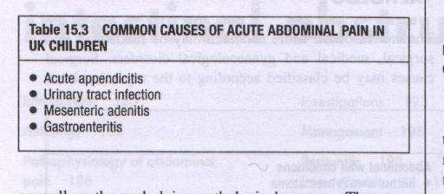

Slide 10

The Physiology of Abdominal Pain
T Abdominal pain from any cause is mediated by either visceral or somatic afferent nerves
n Several factors can modify expression of pain:
Age extremes
r Vascular compromise (pain ‘out of proportion’) r Pregnancy
c CNS pathology h Neutropenia

Slide 11


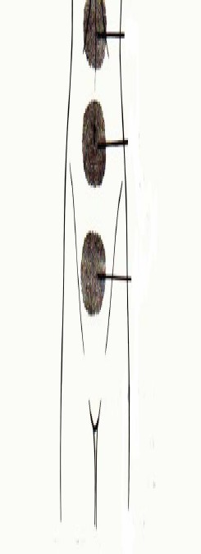
Visceral Pain
V Stimuli
l Distention of the gut or other hollow abdominal organ
Traction on the bowel mesentery i Inflammation
m Ischemia
I Sensation
a Corresponds to the embryologic origin of the diseased organ (foregut, midgut, hindgut)

Slide 12

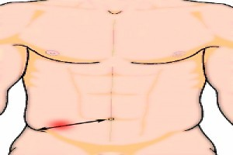
Somatic Pain
□ Stimuli
l Irritation of the peritoneum
I Sensation
t Sharp, localized pain
, Easily described
E Cardinal signs
Pain “tenderness”
Guarding d Rebound
u Absent bowel sounds

Slide 13
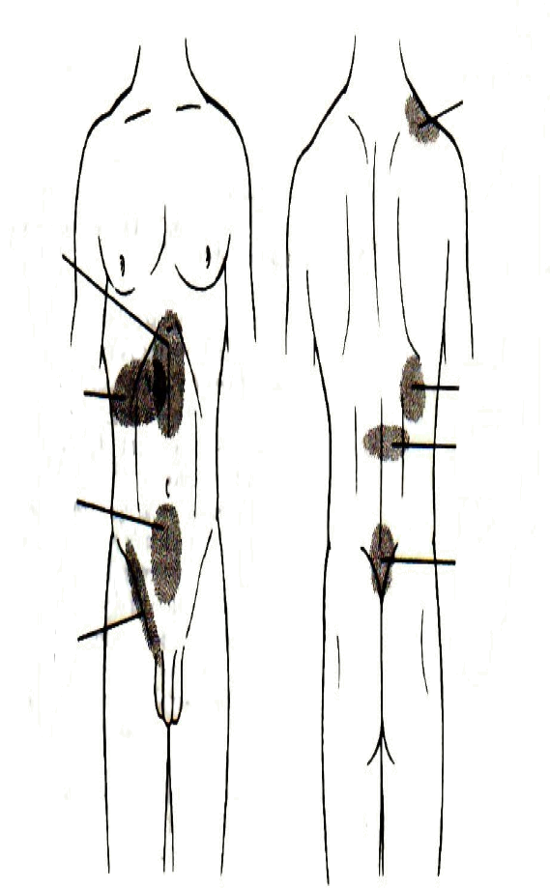
Pattern of referred pain
Diaphragmatic irritation
Gastric pain
Liver and biliary pain
Biliary colic
Pancreatic and renal pai
Colonic pain
, Uterine and rectal pain
Ureteral or kidney pain

Slide 14

History
□ Where does it hurt?
Know locations of major organs
But realize abdominal pain locations do not correlate well with source
■
■

Slide 15

History
□ What does pain feel like?
Steady pain - inflammatory process Crampy pain - obstructive process
■
■

Slide 16

History
□ Was onset of pain gradual or sudden?
Sudden = perforation, hemorrhage, infarct
Gradual = peritoneal irrigation, hollow organ distension
■
■

Slide 17

History
□ Does pain radiate (travel) anywhere?
■
Right shoulder, angle of right scapula = gall bladder
Around flank to groin = kidney, ureter
■

Slide 18

History
□ Duration?
> 6 hour duration = ? surgical significance
Nausea, vomiting? Bloody? “Coffee Grounds”?
■
□
Any blood in GI tract = Emergency until proven otherwise

Slide 19

History
□
Change in urinary habits? Urine appearance?
Change in bowel habits? Appearance of bowel movements? Melena?
□

Slide 20

History
□ Regardless of underlying cause vomiting or diarrhea can be a problem because of associated volume loss

Slide 21

History
□ Females
Last menstrual period? Abnormal bleeding?
■
■
In females, abdominal pain = Gyn problem
until proven otherwise

Slide 22

Physical Exam
□ General Appearance
■
Lies perfectly still peritonitis
Restless, writhing
inflammation,
■
obstruction
Abdominal distension?
Ecchymosis around umbilicus, flanks?
□
□

Slide 23

Physical Exam
□ Vital signs
■
Tachycardia ? Early shock (more important than BP)
Rapid shallow breathing peritonitis
■

Slide 24
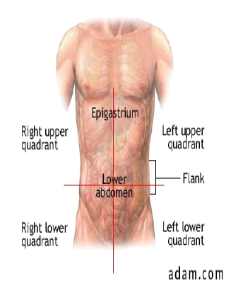
Physical Examination: The Quadrants

Slide 25

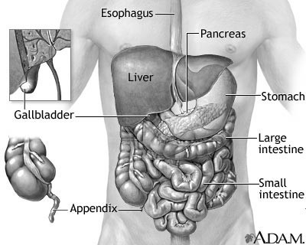

Slide 26

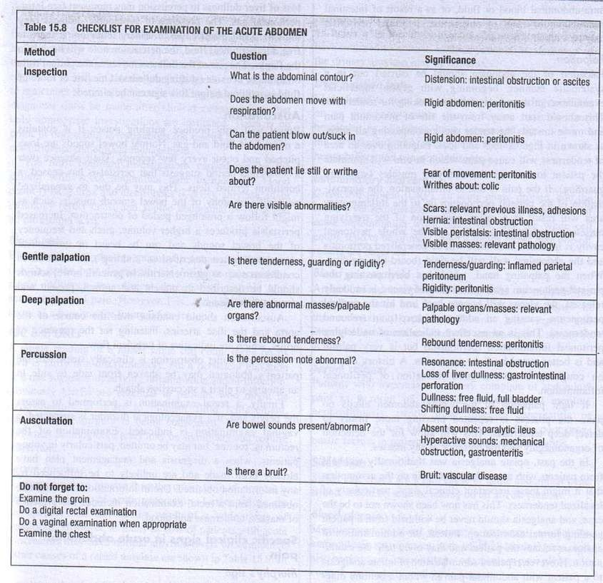

Slide 27
Special physical signs
□ Murphy’s sign Boas’s sign
Grey turner’s and Cullen's sign Rovsing’s sign
□
□
□

Slide 28

Diagnosis: Right Upper Quadrant (RUQ) Pain
Investigations n X-Ray
Upright chest
Upright and supine abdominal p Complete Blood count
o Urinalysis
r Amylase, Creatinine, BUN, Electrolytes

Slide 29
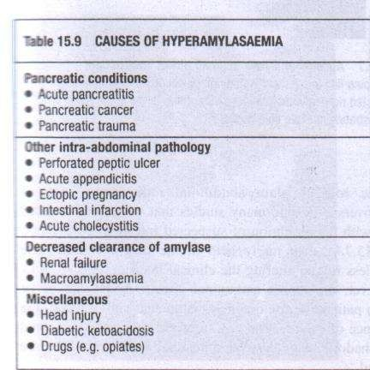

Slide 30

Differential Diagnosis: RUQ Pain
Condition | clues
Biliary colic, acute cholecystitis | Recurrent attacks, tender over gall bladder area
Acute hepatitis | Alcohol history, jaundice, medications
Right pyelonephritis | Dysuria, fever, costovertebral angle tenderness
Congestive heart failure | Edema, dyspnea, elevated JVP
Retrocecal appendicitis | Shift of pain, tenderness
Right lower lobe | Fever, tachypnea, bronchial breathing
pneumonia

Slide 31

Diagnosis: Left Upper Quadrant (LUQ) and Epigastric Pain
Investigations:
n Upright chest XR
p Upright and supine abdominal XR p CBC
B Amylase and lipase (if available

Slide 32

Differential Diagnosis: LUQ and Epigastric Pain
Condition |  | clues
Splenic rupture |  | History of trauma or splenic disease
Fractured ribs |  | History of trauma, gross deformity, extreme tenderness on palpation
Pancreatitis |  | History of alcohol consumption, history of similar event, elevated labs
Gastritis / Peptic ulcer disease |  | Recurrent, relationship to meals, relationship to posture
Pneumonia |  | Fever, XR findings, bronchial breathing

Slide 33

Diagnosis: Right Lower Quadrant (RLQ) Pain
Investigations
n Urinalysis (to exclude obvious urinary causes)
r Pregnancy test r Ultrasound
l Complete blood count

Slide 34
Differential Diagnosis: RLQ Pain
Condition | clues
Acute appendicitis | Shift of pain, anorexia, localized tenderness
Mesenteric adenitis | Fever, inconstant signs
Right renal colic | Colicky pain, hematuria
Torsed right testis | Tender swollen testis, usually young age
Crohn’s disease | Recurrent, several days history
Gynecologic causes | …see next

Slide 35

Gynecologic Causes of RLQ Pain
CONDITION | CLUES
Ruptured follicle | Fever, cervical excitation, discharge
Torsion of ovary | Midcycle, sudden onset
Ruptured ectopic pregnancy | Severe pain, vomiting
Pelvic inflammatory disease | Sudden onset, amenorrhea, shock

Slide 36
Diagnosis: Left Lower Quadrant (LLQ) Pain
( Pregnancy test
P Urinalysis to exclude unsuspected urinary source
u Ultrasound
U Complete blood count
C Upright and supine abdominal XR U CT scan if diverticular disease is
suspected

Slide 37

Differential Diagnosis: LLQ Pain
CONDITION | CLUES
Diverticular disease | Elderly patient, recurrent
Acute urinary retention | Palpable bladder, difficulty passing urine
Urinary tract infection | Dysuria, frequency
Inflammatory bowel disease | Recurrent attacks, diarrhea (+/- mucus, blood)
Large bowel obstruction | Colicky pain, constipation
Left renal colic | Colicky pain, hematuria
Torsion of testis | Tender, swollen testis, young age
Gynecologic causes as for RLQ pain

Slide 38
Immediate Treatment of the Acute Abdomen
1-Start large bore IV with either saline or lactated Ringer’s solution
2-IV pain medication
3-Nasogastric tube if vomiting or concerned about obstruction 4-Foley catheter to follow hydration status and to obtain urinalysis
Antibiotic administration if suspicious of inflammation or perforation
Definitive therapy or procedure will vary with diagnosis
Remember to reassess patient on a regular basis.

Slide 39
Thank you

