Slide 1
Dr.Nisha
Assistant professor
Dept:of practice of medicine

Slide 7
Normal values of Hb for different age groups accepted by WHO
Children (6months to 6 yrs) – 11g/dl and above
Adult males 13g/dl and above
Adult female(non-pregnant) – 12g/dl and above
Adult female(Pregnant) - 11g/dl and above
In India ,any HB level below 12g/dl in adult females and 11.5g/dl in adult females should be diagnosed as anaemia should be investigated.

Slide 24
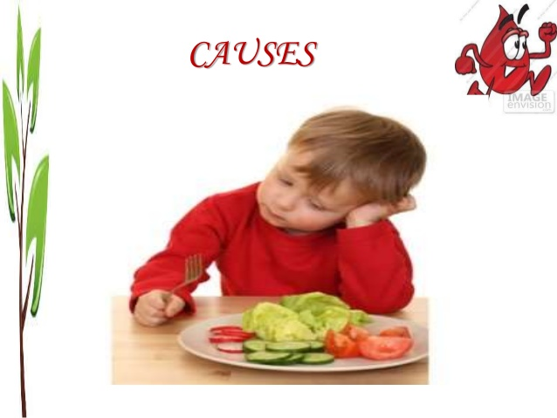

Slide 25
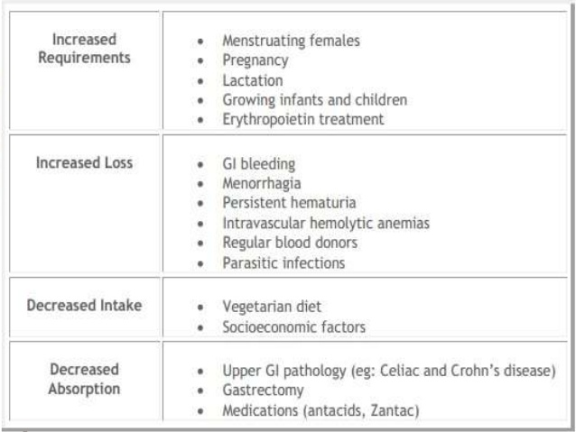

Slide 30
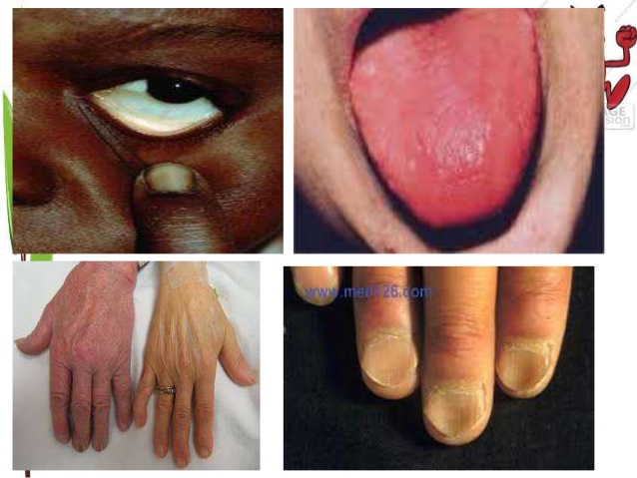

Slide 39
