Slide 1
Auscultation

Slide 2
Auscultatory areas
Aortic area- 2nd intercostal space in the right sternal border.
Pulmonic area- 2nd intercostal space in left intercostal border
Erbs point- Third intercostal space in left sternal border
Tricuspid area- Fourth (or fifth) intercostal space in left sternal border
Mitral area or apex- 5th intercostal space in left midclavicular line

Slide 3
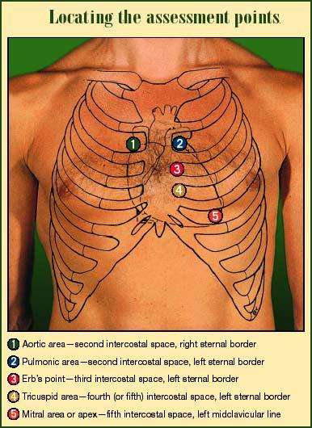

Slide 4
S1
The first heart sound or S1 (said to sound like “lub”) originates from mitral valve closure occurring at the beginning of ventricular systole. The tricuspid valve closes at the same time but tricuspid valve closure is usually quiet because of the low pressures in the right heart.

Slide 5
S2
The second heart sound or S2 (said to sound like “dub”) comes from aortic and pulmonic valve closure at the end of ventricular systole.

Slide 6
S3
A low pitch third heart sound or S3 that occurs early in diastole during rapid ventricular filling
It is normal in young athletics or healthy pregnant mothers
If heard in heart disease it indicates abnormal ventricular filling

Slide 7
S4
Low pitch fourth heart sound S4 occurs later in diastole
Cause – blood pumping into a stiff left ventricle during atrial contraction
ALWAYS Abnormal
It is absent if heart is not in sinus rhythm

Slide 8
Position in the cardiac cycle
early systolic
mid systolic
Systolic murmur late systolic
pan systolic
early diastolic
Diastolic murmur mid diastolic
late diastolic/pre systolic
Continuous murmur

Slide 9
Murmur should be graded according to their loudness:
Grade 1 – just audible when the room is quiet and the patient holding his breath;
Grade 2 – audible but faint or quiet;
Grade 3 – readily audible but not accompanied by a thrill;
Grade 4 – easily audible and accompanied by a thrill; (thrill may not be easily palpable in a heavy set or obese patient);
Grade 5 – very loud;
Grade 6 – loud enough to be heard without a stethoscope; the examiner only has to put his ear close to, but not on, the patient’s chest.
Pericardial rub is heard in acute pericarditis. It is a friction rub that sounds like rubbing sand papers together and heard both in systole and diastole.

Slide 10
Auscultation

