Slide 1
bronchiectasis
Dr. HARISANKAR V
Associate Professor
Dept. of Practice of Medicine

Slide 2
bronchiectasis
Permanent dilatation & distrotion of the bronchi
Aetiology
-ciliary dysfunction syndrome
- primary ciliary dyskinesia( immotile cilia syndrome)
-Kartagener’s Syndrome
-Cystic fibrosis
-Primary hypogammaglobulinaemia

Slide 3
Acquired –
Children
- Pneumonia
-Primary Tuberculosis
-Foregin body
Adults –
- Suppurative Pneumonia
-Pulmonary TB
-Allergic Bronchopulmonary Aspergillosis
-Bronchial tumors

Slide 4
pathogenesis
Due to bronchial distension resulting from the accumulation of pus beyond
A lesion obstructing a major bronchus
Compression by tuberculous hilar lymphnode
An inhaled foregin body/ bronchial tumor

Slide 5
pathogenesis
Middle lobe syndrome/Brock’s syndrome/ middle lobe bronchiectasis is sequale to pulmonary TB.

Slide 6
Kartagener’s Syndrome
Dextrocadia ,situs inversus
sinusitis
Defects of ciliary function in the bronchi
Non –motile sperms

Slide 7
pathology
Bronchial cavities
Lined by granulation tissues,
squamous epithelium normal ciliated epithelium
Deep layer s of bronchial wall
Inflammatory changes, hypertrophy of the bronchial arteries
Surrounding lung tissues
c/c inflammatory & fibrotic changes

Slide 8
Clinical features
Chronic
Site – left lower lobe
Children –affected
Age – early adulthood/ middle age
Males

Slide 9
clinical features
postural cough with production of large quantities of purulent
Foul smelling sputum- 3 layers
Recurrent infection → PNEUMONIA
BRONCHIECTASIS SICCA– bronchiectasis with mild / severe haemptysis with out purulent sputum.
DIGITAL CLUBBING -with hypertrophic pulmonary osteoarthropathy

Slide 10
Physical examination
- impairement of percussion note
- ↓respiratory sounds
DIAGNOSTIC FINDINGS
- presence of coarse,leathergy rales.

Slide 11
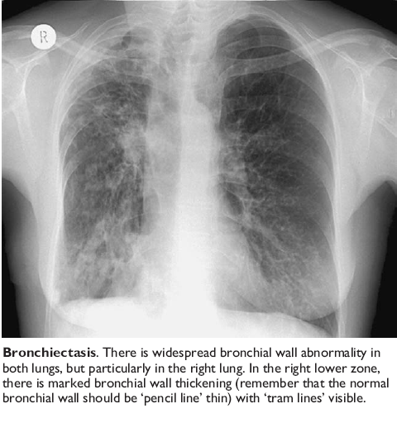

Slide 12
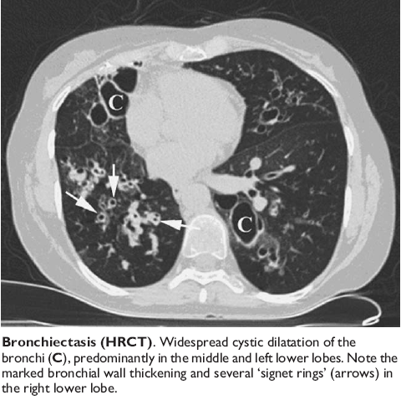

Slide 13
Complication –
- massive haemoptysis
-RA+ Pneumonia
- Emphysema
- Septicemia
-Brain Abscess
- Cor pulmonale
C /c sepsis- anaemia, haemoptysis.
In untreated cases 2nd Amyloidosis-develop.

Slide 14
diagnosis
Long History
Presence of clubbing
Postural cough
Coarse leathery rales over the affected part
High resolution computed tomography- -- INVESTIGATION

Slide 15
DIFFERENTIAL DIAGNOSIS
C /c bronchitis
Emphysema
Lung abscess
TB
Congenital cystic disease
Pulmonary sequestration
Malignancy

Slide 16
Management
General measures – high protein diet
Treatment of intercurrent infections
Removal of focal sepsis from upper respiratory tract
Respiratory exercises
Postural drainage,help to clear the bronchi & bring about relief.

Slide 17
Indications for Surgery
disease localised to 1 lung or 1 segment & is not amenable to medical therapy
Uncontrollable haemptysis is which the site of origin of blood, may be detected by emergency bronchoscopy
Surgical resection has to be planned.
To remove an obstructive lesion which tends to perpetuate the condition.
ex,.. Bronchial growth, bronchostenosis.

