Slide 1
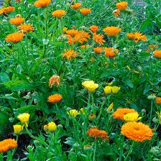
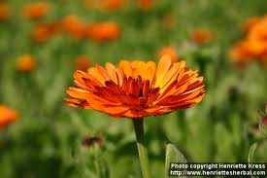
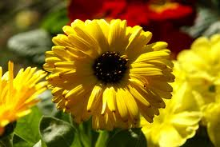
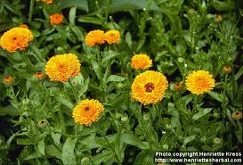
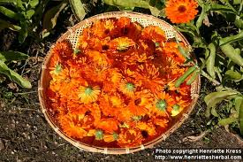
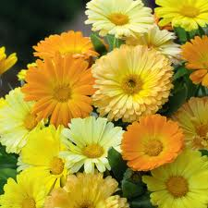
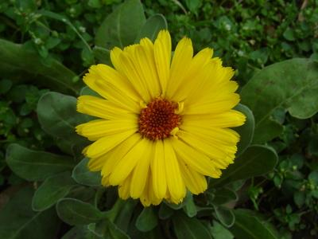
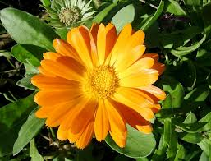
CALENDULA OFFICINALIS
Dr.P.R.SAIJI
ASSOCIATE PROFESSOR
DEPT OF MATERIA MEDICA

Slide 2
AETIOLOGY
CALED’S – the first day of the month
This flowers on the first of the month or at least once a month.
Common use as a medicine in 16th century

Slide 3
COMMON NAME
Pot marigold
Ruddles
Common marigold
Garden marigold
English marigold
Scottish marigold

Slide 4
Kingdom: Plantae
Order: Asterales
Family: Asteraceae
Tribe: Calenduleae
Genus: Calendula
Species: C. officinalis

Slide 5
CULTIVATION
Grown easily in sunny locations
In most kinds of soils.
Perennial
Treated as an annual also, particularly in colder regions where its winter survival is poor, or in hot summer locations where it also does not survive.

Slide 6
Easiest and most versatile flowers to grow in a garden, especially since they tolerate most soils
Pot marigolds typically bloom quickly from seed (in under two months) in bright yellows, golds, and oranges.
Calendula are used as food plants by the larvae of some Lepidoptera species including Cabbage Moth, The Gothic, Large Yellow Underwing and Setaceous Hebrew Character. Be advised not to plant in vegetable gardens.

Slide 7
CONSTITUENTS CONSTITUENTS
Part | Constituents
Petals and pollen | Triterpenoid esters and the carotenoids flavoxanthin and auroxanthin (antioxidants, and the source of the yellow-orange coloration).
Leaves and stems | Carotenoids - lutein (80%) and zeaxanthin (5%), and beta-carotene
Plant extracts | Saponins, resins and essential oils
Flowers | Flavonol glycosides, triterpene oligoglycosides, oleanane-type triterpene glycosides, saponins, and a sesquiterpene glucoside

Slide 8
PHARMACOLOGY PHARMACOLOGY
Common deep-orange flowered variety is considered to be of medicinal value
Anti-viral, Anti-genotoxic and Anti-inflammatory properties in vitro.
The methanol extract of C. officinalis exhibited antibacterial activity.
Both the methanol and the ethanol extracts showed antifungal activities.
Along with horsetails (Equisetum arvense), pot marigold is one of the few plants which is considered astringent despite not being high in tannins

Slide 9
SIDE EFFECTS
Allergies
Dermatitis
serum glucose, lipid and protein reduction
High doses of calendula may cause drowsiness. Thus, it may interact with narcotics, antidepressants, and blood pressure and glucose lowering agents.
Calendula should be avoided during pregnancy and lactation

Slide 10
USES
Considered edible. (calendula is high in antioxidant vitamins A and C)
Used to add color to salads
Added to dishes as a garnish and in lieu of saffron.
The leaves are edible but are often not palatable.
Have a history of use as a potherb and in salads.
Flowers were used in ancient Greek, Roman, Middle eastern and Indian cultures as a medicinal herb as well as a dye for fabrics, foods and cosmetics.
They are also used to make oil that protects the skin.

Slide 11
Remedy for skin problems and is applied externally to bites and stings, sprains, wounds, sore eyes, varicose veins etc
A cleansing and detoxifying herb and is taken internally in treating fevers and chronic infections
Used internally in order to speed the healing of wounds.
A tea of the petals tones up the circulation and, taken regularly, can ease varicose veins
An application of the crushed stems to corns and warts will soon render them easily removable.

Slide 12
Antiphlogistic, Antiseptic, Antispasmodic, Aperient, Astringent, Cholagogue, Diaphoretic, Emmenagogue, Skin, Stimulant, Anti cancerous And Vulnerary.
Appeared to interfere with the replication of HIV cells.
Flowers - skin lotions and when added to hair shampoos will lighten the hair colour
Protect the skin from premature aging and thinning of the skin.
Safe enough to be used on the delicate skin under the eyes to prevent crow's feet

Slide 13
Growing plant acts as an insect deterrent
Reduces the soil eelworm population
The flowers are an alternative ingredient of 'Quick Return' compost activator (This is a dried and powdered mixture of several herbs that can be added to a compost heap in order to speed up bacterial activity and thus shorten the time needed to make the compost)
The flowers close when wet weather is likely to occur and they can therefore be used as a rough means of weather forecasting

Slide 14
INTRODUCED INTO HOMOEOPATHY IN 1836
PROVER : FRANS, ARCHIEVE FUR HOM, HEILK., DR.PRICE
PARTS USED – TINCTURE OF LEAVES AND FLOWERS

Slide 15
SPHERE OF ACTION
SOFT PARTS
SPINE
LIVER

Slide 16
CHARACTERISTICS
Indicated in lacerated and suppurating wounds
Homoeopathic antiseptic
Restores vitality of an injured part making it impregnable against the forces of putrefaction
Prevents suppuration and pyemia
Hot calendula lotions are preferred over cold ones as they conserve the vitality of the injured parts
Hot calendula lotion after delivery gives the greatest comfort to the patient

Slide 17
Hot calendula fomentation – when intermittently applied are far better than poultices as applications to forming abscesses.
If they don’t abort the process they favour maturation and ultimate healing
Can be used as hot compress (an ounce to the pint) in pneumonia and other internal inflammations
Haemostatic in tooth extractions
Promotes healthy granulations and Rapid healing by first intention
Constitutional tendency to erysipelas

Slide 18
Great disposition to take cold, especially in damp weather
In cancer as an intercurrent remedy
Power to produce local exudations and help to make acrid discharges healthy and free

Slide 19
MIND
Great irritability
Consciousness returns, but drowsiness remains
Easily frightened

Slide 20
HEAD
Heaviness of head in morning as after long illness
Headache and feeling of heat in forehead in the evening and after meals
Pain in right side of neck.
Lacerated scalp wounds

Slide 21
EYES
Injuries to the eyes which tend to suppurate; after surgery
Blenorrhoea of lachrymal sac
Dryness and biting in the margins of the lids, as from smoke

Slide 22
EARS
Acuteness of hearing
Deafness worse in damp surroundings and with eczematous conditions
Hears best on train and distant sounds.

Slide 23
THROAT
Submaxillary glands are painful to touch with sensation as if swollen
Pressure in the oesophagus during deglutition

Slide 24
ABDOMEN
Diminished appetite at dinner, although he relishes his food
Hiccough when smoking
Stitching in left side during movement going off during rest
Stool in the morning, accompanied with feverish chilliness, preceded by pinching and uneasiness in abdomen

Slide 25
URINARY ORGANS
Frequent micturition, with emission of pale, clear, hot and even burning urine
Tearing in urethra during chilliness

Slide 26
RESPIRATORY
Cough with green expectoration, hoarseness; with distension of the inguinal ring.
Drawing pressure in left side of chest when standing, also in sternum, with stitches in right side of chest in evening when lying in bed.

Slide 27
FEMALE
Warts on the OS EXTERNUM
Uterine hypertrophy
Os lower than natural menorrhagia

Slide 28
FEVER
Coldness and great sensitiveness to the open air the whole body
Shuddering in the back, with pressure in the region of the last true rib of left side and movements in the stomach and abdomen as if he would faint
Feverish chilliness in the hands and feet, the whole morning, with rheumatic drawing and pressure in the whole body, and pain in the ribs as if pressed together and bruised after sitting

Slide 29
HEAT IN THE EVENING WITH COLDNESS OF THE HEAD AND HANDS INTERMINGLED WITH SHIVERING AND AVERSION TO DRINKS
HEAT IN THE AFTERNOON WITH FREQUENT THIRST, CHILLINESS AND SHIVERINGS INTERMIXED PARTICULARLY AFTER DRINKING.
Feeling of heat in the face, hands and after a meal, succeeded by thirst.
Great heat the whole morning with copious perspiration, feeling of qualmishness in the chest and burning in the axillae.

Slide 30
SKIN
Excessively painful, open, torn, cut, lacerated, ragged or suppurating WOUNDs
Haemorrhages in scalp wounds
Prevents pus
Promotes favourable cicatrization with least amount of suppuration
Slough, proud flesh and raised edges.
Superficial burns and scalds
Erysipelas (uses topically)

Slide 31
MODALITIES
WORSE
Damp weather
Heavy cloudy weather
During chill

Slide 32
THANK YOU

