Slide 1
CHRONIC PANCREATITIS
DR.BINO
Associate Prof.
DEPT OF SURGERY

Slide 2
◆ Chronic pancreatitis is an incurable, chronic inflammatory condition that is multifactorial in its etiology, highly variable in its presentation, and a challenge to treat successfully
◆ Chronic pancreatitis remains an enigmatic process of uncertain pathogenesis, unpredictable clinical course, and unclear treatment
◆ Inflammatory disease characterized by the progressive conversion of pancreatic parenchyma to fibrous tissue
◆ The peak of presentation occurs in patients between 35 to 55 years
of age.

Slide 3
◆ The process of fibrosis with consecutive loss of pancreatic parenchyma leads to exocrine insufficiency and maldigestion and, in advanced stages of the disease, to diabetes mellitus.
◆ The heterogeneity of patient population, the subjective nature of pain, and a poor understanding of its pathophysiology all are obstacles to studies directed at effectiveness of pain management

Slide 4
◆ Differences in
◆ Diagnostic criteria
◆ Regional nutrition
◆ Alcohol consumption
◆ Medical access
Account for variations in the frequency of the diagnosis
◆ The overall incidence of the disease has risen progressively over the past
50 years
◆ In 1878, Friedreich proposed that "a general chronic interstitial pancreatitis may result from excessive alcoholism (drunkard's pancreas)
◆ Even abstinence from excessive alcohol consumption, which seems to be the causative agent in most cases, cannot interrupt the process of continuing organ destruction

Slide 5
Etiological factors
◆ Alcohol, 70%
◆ Idiopathic (including tropical), 20%
◆ Other, 10%
◆ Hereditary
◆ Hyperparathyroidism
◆ Hypertriglyceridemia
◆ Autoimmune pancreatitis
◆ Obstruction
◆ Trauma
◆ Pancreas divisum

Slide 6
Classification

Slide 7
Pathogenesis
◆ “Burning out” of the organ- conservative approaches
◆ Oxidative stress hypothesis
◆ Toxic-metabolic theory
◆ Stone and duct obstruction theory
◆ The necrosis-fibrosis theory
◆ Sentinal acute pancreatitis event (SAPE) hypothesis

Slide 8
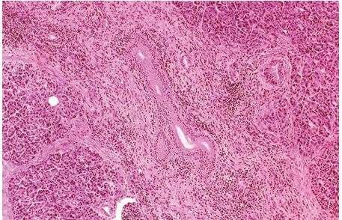
◆ Induration, nodular scarring, and lobular regions of fibrosis,infiltration of
mononuclear inflammatory cells throughout the interstitium of the pancreas

Slide 9
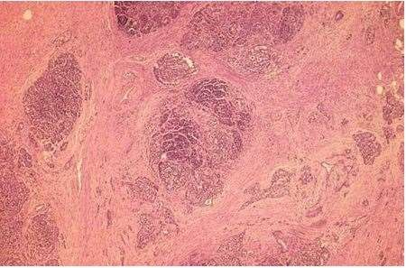
◆ Extensive sheets of fibrosis and loss of acinar tissue, with preservation of islet
tissue in scattered areas.

Slide 10
FIBROSIS
◆ Perilobular fibrosis that forms surrounding individual acini, then propagates to surround small lobules, and eventually coalesces to replace larger areas of acinar tissue
◆ Activation of PSCs that are found adjacent to acini and small arteries
◆ Proliferative factors such as transforming growth factor beta, platelet-derived growth factor, and proinflammatory cytokines and synthesize and secrete type I and III collagen and fibronectin

Slide 11
STONE FORMATION
◆ Calcium carbonate crystals trapped in a matrix of fibrillar and other material
◆ Initial noncalcified protein precipitate, which serves as a focus for layered calcium carbonate precipitation
◆ PSP-lithostathine- reg protein
◆ Increased pancreatic juice protein levels in alcoholic men are reversible by
abstinence from alcohol.
◆ Nevertheless, calcific stone formation represents an advanced stage of disease, which can further promote injury or symptoms due to mechanical damage to duct epithelium or obstruction of the ductular network.

Slide 12
Duct Distortion
◆ Although calculus disease and duct enlargement appear together as late stages of chronic pancreatitis, controversy persists over whether they are associated, are independent events, or are causally related
◆ Calcific stone disease is normally a marker for an advanced stage of disease, parenchymal and ductular calcifications do not always correlate with symptoms

Slide 13
PAIN
inflammation
neuropathy
duct obstruction
fibrotic encasement of sensory nerves
high pancreatic tissue pressure

Slide 14
◆ Type A pain - short relapsing episodes lasting days to weeks, separated by
pain-free intervals.
◆ Type B pain -prolonged, severe, unrelenting pain.
◆ Recent study suggests that type B pain is associated with worse quality of life, greater healthcare need and disability.
◆ Pain exacerbations are not always associated with elevations of serum
amylase and lipase levels

Slide 15
Malabsorption
◆ When pancreatic exocrine capacity falls below 10% of normal, diarrhea and
steatorrhea develop
◆ As exocrine deficiency increases, symptoms of steatorrhea are often accompanied by weight loss
◆ Lipase deficiency tends to manifest itself before trypsin deficiency
◆ Secretion of bicarbonate into the duodenum is reduced, which causes
duodenal acidification and further impairs nutrient absorption.

Slide 16
Apancreatic Diabetes
◆ Islets are typically smaller than normal and may be isolated from their
surrounding vascular network by the fibrosis
◆ Global deficiency of all three glucoregulatory islet cell hormones: insulin, glucagon, and PP
◆ Paradoxical combination of enhanced peripheral sensitivity to insulin
and decreased hepatic sensitivity to insulin.
◆ Patients are hyperglycemic when insulin replacement is insufficient (due to unsuppressed hepatic glucose production) or hypoglycemic when insulin replacement is barely excessive (due to enhanced peripheral insulin sensitivity and a deficiency of pancreatic glucagon secretion to counteract the hypoglycemia
◆ Brittle diabetes- requires special attention.

Slide 17
◆ Frank diabetes is seen initially in about 20% of patients with chronic pancreatitis, and impaired glucose metabolism can be detected in up to 70% of patients
◆ More than half of the diabetic patients required insulin treatment
◆ Ketoacidosis and diabetic nephropathy are relatively uncommon, but retinopathy and neuropathy are seen to occur with a similar frequency as in idiopathic diabetes

Slide 18
Parameter | Type I IDDM Juvenile Onset | Type II NIDDM Adult Onset | Type III Apancreatic Postoperative Onset
Ketoacidosis | Common | Rare | Rare
Hyperglycemia | Severe | Usually mild | Mild
Hypoglycemia | Common | Rare | Common
Peripheral insulin sensitivity | Normal or increased | Decreased | Increased
Hepatic insulin sensitivity | Normal | Normal or decreased | Decreased
Insulin levels | Low | High | Low
Glucagon levels | Normal or high | Normal or high | Low
Pancreatic polypeptide levels | High | High | Low
Typical age of onset | Childhood or adolescence | Adulthood | Any

Slide 19
Investigations
◆ Measurement of pancreatic products in blood
◆ Enzymes
◆ Pancreatic polypeptide II
◆ Measurement of pancreatic exocrine secretion
Direct measurements
◆ 1. Enzymes
◆ 2. Bicarbonate
Indirect measurement
◆ 1. Bentiromide test
◆ 2. Schilling test
◆ 3. Fecal fat, chymotrypsin, or elastase concentration
◆ 4. [¹⁴C]-olein absorption

Slide 20
Imaging techniques
◆ Plain film radiography of abdomen
◆ Ultrasonography
◆ Computed tomography
◆ Endoscopic retrograde cholangiopancreatography
◆ Magnetic resonance cholangiopancreatography
◆ Endoscopic ultrasonography

Slide 21
Test | Sensitivity | Invasiveness, Risk | Cost | Comments
USG | + | 0 | + | Reasonable screen Almost 100% specificity
CT | ++ | 0 | ++ | Detects advanced disease
MRI/MRCP | +++ | 0 | +++ | Assesses ducts and parenchyma Operator dependence Secretin enhancement may improve sensitivity
EUS | +++ | ++ | +++ | Assesses ducts and parenchyma Limited availability
ERCP | ++++ | +++ | +++ | Detects early ductal changes
Hormone-stimulated PFT | ++++ | ++ | ++ | Traditional methods not widely available Endoscopic methods in development

Slide 22
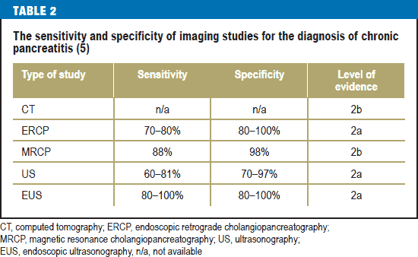

Slide 23
◆ Intrapancreatic complications
◆ Pseudocysts
◆ Duodenal or gastric obstruction
◆ Thrombosis of splenic vein
◆ Abscess
◆ Perforation
◆ Erosion into visceral artery
◆ Inflammatory mass in head of pancreas
◆ Bile duct stenosis
◆ Portal vein thrombosis
◆ Duodenal obstruction
◆ Duct strictures and/or stones
◆ Ductal hypertension and dilatation
◆ Pancreatic carcinoma
◆ Extrapancreatic complications
◆ Pancreatic duct leak with ascites or fistula
◆ Pseudocyst extension beyond lesser sac into mediastinum, retroperitoneum, lateral pericolic spaces, pelvis, or adjacent viscera

Slide 24
Medical
TREATMENT
Surgery

Slide 25
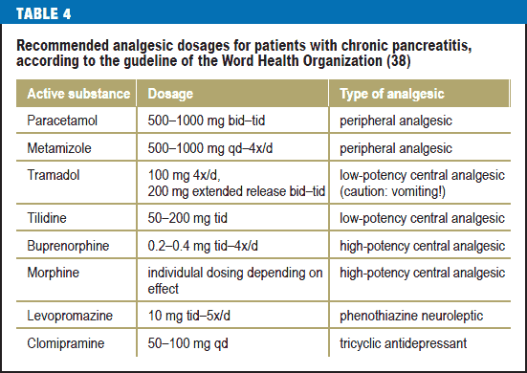
MEDICAL
◆ Analgesia and enzyme replacement

Slide 26
Name | Dose | Lipase/Protease (USP Units)
Conventional (non-enteric-coated) compounds
Viokase | 8 tablets each time | 8000/30,000
Ku-Zyme HP | 8 tablets each time | 8000/30,000
Enteric-coated compounds
Creon 10 | 2–3 capsules each time | 10,000/37,500
Creon 20 | 2–3 capsules each time | 20,000/75,000
Pancrease MT 10 | 2–3 capsules each time | 10,000/30,000
Pancrease MT 16 | 2–3 capsules each time | 16,000/48,000

Slide 27
◆ The dosing schedule is before meals; can also take a dose at night if patient
experiences pain.
◆ Conventional enzymes are the treatment of choice for pain relief→If no improvement occurs with conventional enzymes alone, add H₂-blockers or proton pump inhibitors to decrease peptic acid inhibition of the enzymes.
◆ Enteric-coated preparations are treatment of choice for steatorrhea. Acid- suppressive therapy should not be given with enteric-coated preparations

Slide 28
◆ Antisecretory Therapy
◆ Octreotide therapy and TPN
◆ Neurolysis
◆ EUS-guided celiac plexus blockade
◆ Endoscopic management
◆ Pancreatic duct stenting
◆ Proximal pancreatic duct stenosis,
◆ Decompression of a pancreatic duct leak,
◆ Drainage of pancreatic pseudocysts that can be catheterized through the main
pancreatic duct
◆ Pancreatic duct sphincterotomy
◆ Endoscopic stone removal
◆ Extracorporeal shock wave lithotripsy (ESWL)

Slide 29
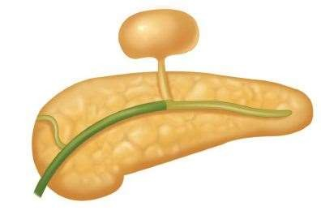
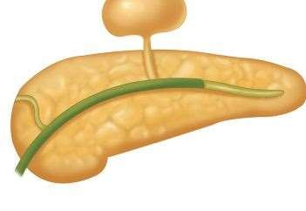
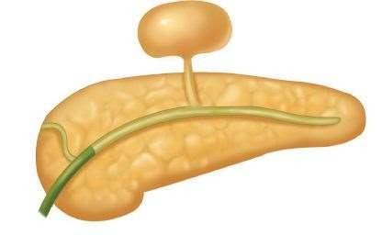

Slide 30
SURGERY
◆ Intractable pain
◆ Complications related to adjacent organs
◆ Endoscopically not permanently controlled pancreatic pseudocysts in conjunction with ductal pathology
◆ Neither conservatively nor interventionally tractable internal pancreatic fistula
◆ Inability to exclude pancreatic cancer despite broad diagnostic work-up

Slide 32
SPHINCTEROPLASTY
DRAINAGE PROCEDURES
RESECTION PROCEDURES

Slide 33
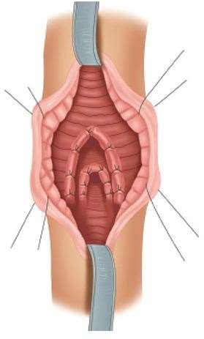
Sphincteroplasty

Slide 34
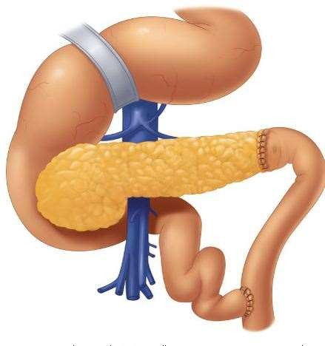
Drainage procedures
◆ Duval’s caudal pancreaticojejunostomy

Slide 35
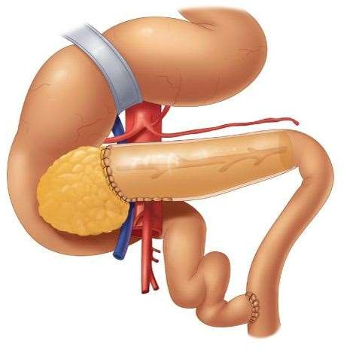
◆ Puestow and Gillesby's longitudinal pancreaticojejunostomy

Slide 36
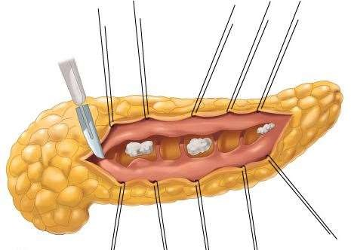
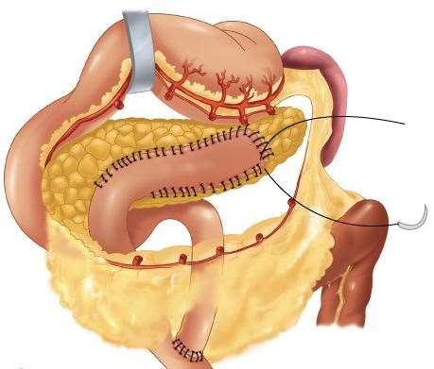
◆ Longitudinal dochotomy in obstructing calcific pancreatitis(Partington and
Rochelle)

Slide 37
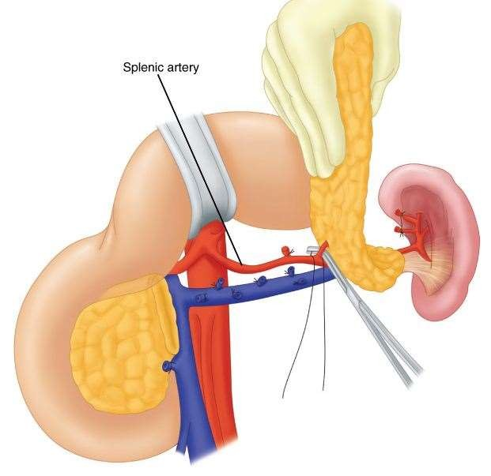
Resection procedures
◆ Distal (spleen-sparing) pancreatectomy

Slide 38
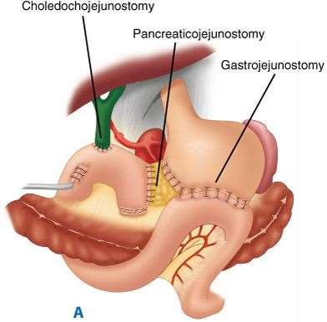
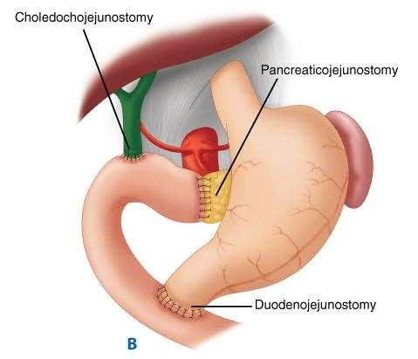
◆ Proximal pancreatectomy

Slide 39
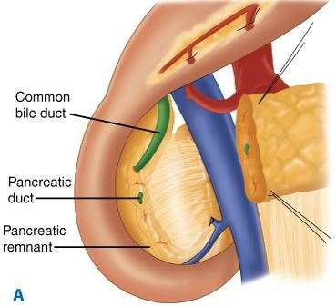
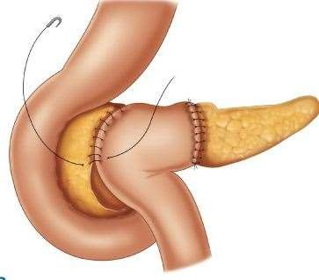
◆ Beger

Slide 40
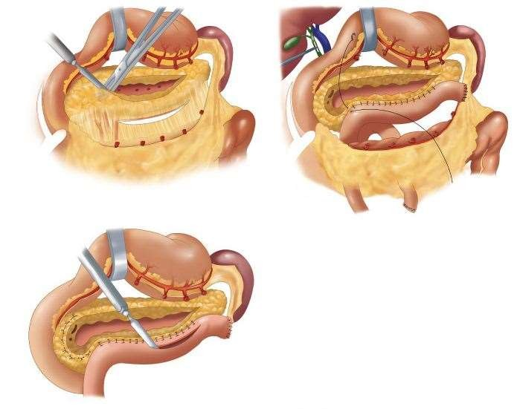
◆ Frey’s Procedure

Slide 41
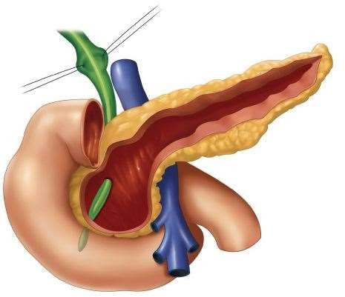
◆ Hamburg Modification

Slide 42
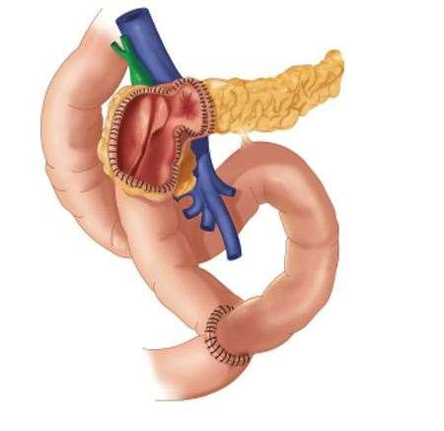
◆ BERNE’S MODIFICATION

Slide 43
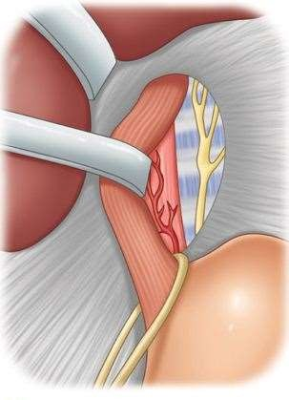
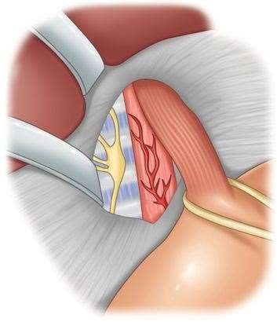
Denervation procedures
◆ Trans-hiatal splanchnicectomy

Slide 44
Signs and Symptoms | Treatment
Pseudocysts
Increased pain Vomiting Mild elevations in amylase and lipase levels | Drainage for large or symptomatic pseudocysts Endoscopic drainage (transmural or transpapillary) Surgical drainage (cyst gastrostomy or cyst jejunostomy)
Biliary Obstruction
Jaundice | Drainage of obstructing pseudocyst Endoscopic decompression Surgical decompression
Gastric Outlet Obstruction
Abdominal pain Early satiety Nausea and vomiting | Drainage of pseudocyst Surgical gastrojejunostomy
Pancreatic Adenocarcinoma
Increased pain Weight loss | Consider surgical resection Palliation
Pancreatic Ascites
Increased abdominal girth High-amylase ascites | Endoscopic stent placement Total parenteral nutrition
Pleural effusion
Shortness of breath High-amylase pleural fluid | Therapeutic thoracentesis Endoscopic stent placement Total parenteral nutrition
Splenic vein thrombosis
Bleeding from gastric varices | Splenectomy

Slide 45
Conclusion
◆ The nidus of inflammation in chronic pancreatitis due to any cause is the head of the gland. Therefore, treatment approaches that address the disease in the head have the best long-term results
◆ Pancreatic surgery is technically demanding and bears many pitfalls and potential complications.
◆ It should be left to experts in high-volume hospitals to minimize mortality and morbidity.
◆ Multimodality approach

Slide 46
References
◆ Schneider A, Whitcomb DC. Hereditary pancreatitis: A model for inflammatory diseases of the pancreas. Best Pract Res Clin Gastroenterol. 2002;16(3):347-363.
◆ Yadav D, Whitcomb DC. The role of alcohol and smoking in pancreatitis. Nat Rev Gastroenterol Hepatol. 2010;7(3):131-145.
◆ Bhardwaj P, Garg PK, Maulik SK, Saraya A, Tandon RK, Acharya SK. A randomized controlled trial of antioxidant supplementation for pain relief in patients with chronic pancreatitis. Gastroenterology. 2009;136(1):149-159.e2.
◆ Kirk GR, White JS, McKie L, et al. Combined antioxidant therapy reduces pain and improves quality of life in chronic pancreatitis. J Gastrointest Surg. 2006;10(4):499-503.
◆ Siriwardena AK, Mason JM, Sheen AJ, Makin AJ, Shah NS. Antioxidant therapy does not reduce pain in patients with chronic pancreatitis: The ANTICIPATE study. Gastroenterology. 2012;143(3):655-63.e1.
◆ Uden S, Bilton D, Nathan L, Hunt LP, Main C, Braganza JM. Antioxidant therapy for recurrent pancreatitis: Placebo-controlled trial. Aliment Pharmacol Ther. 1990;4(4):357- 371.
◆ Kaufman M, Singh G, Das S, et al. Efficacy of endoscopic ultrasound-guided celiac plexus block and celiac plexus neurolysis for managing abdominal pain associated with chronic pancreatitis and pancreatic cancer.J Clin Gastroenterol. 2010;44(2):127-134.
◆ Cahen DL, Gouma DJ, Nio Y, et al. Endoscopic versus surgical drainage of the pancreatic duct in chronic pancreatitis. N Engl J Med. 2007;356(7):676-684.
◆ Cahen DL, Gouma DJ, Laramee P, et al. Long-term outcomes of endoscopic vs surgical drainage of the pancreatic duct in patients with chronic pancreatitis. Gastroenterology.
2011;141(5):1690-1695.
◆ Harris H. Systematic review of total pancreatectomy and islet autotransplantation for chronic pancreatitis (br J surg 2012; 99: 761-766). Br J Surg. 2012;99(6):767.
◆ Bramis K, Gordon-Weeks AN, Friend PJ, et al. Systematic review of total pancreatectomy and islet autotransplantation for chronic pancreatitis. Br J Surg. 2012;99(6):761-766.
◆ Whitcomb DC, Lehman GA, Vasileva G, et al. Pancrelipase delayed-release capsules (CREON) for exocrine pancreatic insufficiency due to chronic pancreatitis or pancreatic surgery: A double-blind randomized trial. Am J Gastroenterol. 2010;105(10):2276-2286.
◆ Gubergrits N, Malecka-Panas E, Lehman GA, et al. A 6-month, open-label clinical trial of pancrelipase delayed-release capsules (creon) in patients with exocrine pancreatic insufficiency due to chronic pancreatitis or pancreatic surgery. Aliment Pharmacol Ther. 2011;33(10):1152-1161.
◆ Thorat V, Reddy N, Bhatia S, et al. Randomised clinical trial: The efficacy and safety of pancreatin enteric-coated minimicrospheres (creon 40000 MMS) in patients with pancreatic exocrine insufficiency due to chronic pancreatitis--a double-blind, placebo-controlled study. Aliment Pharmacol Ther. 2012;36(5):426-436.

Slide 47
Thank You ☺

