Slide 1
CLEFT LIP & CLEFT PALATE
Dr. Varun. S
Dept.of . Surgery
SKHMC

Slide 2
Learning Objectives
At the end of this lecture, students should be able to:
Develop an understanding terms Cleft lip & Palate Develop an understanding of incidence of the condition Describe the etiology and pathogenesis
Describe classification and dental implications
•
•
•
•

Slide 3
Contents
Cleft Lip & Palate
Incidence
Causes
Method of Transmission
Pathogenesis
Normal Process
Classification
Dental Implications
References

Slide 4
Cleft Lip & Palate
The term cleft lip & palate is commonly used to represent two types of malformation
cleft lip with or without cleft palate (CL/P)(fig.1)
cleft palate (CP) (fig.2)

Slide 5
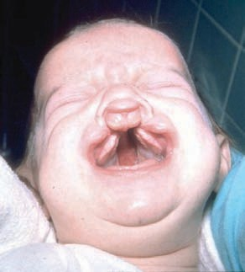
Bilateral cleft of lip & palate
(fig.1)

Slide 6
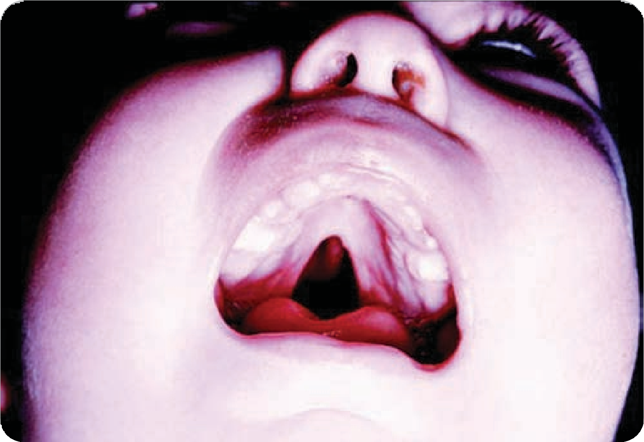
cleft of the hard & soft palates
(fig.2)

Slide 7
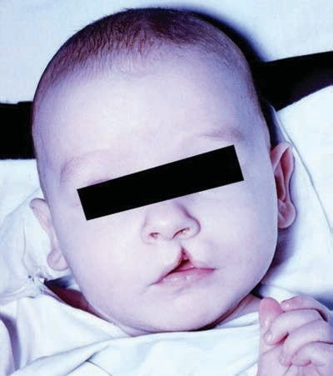
Unilateral cleft of lip
(fig.3)

Slide 8
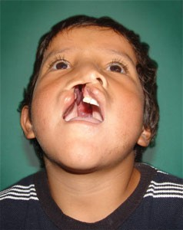
cleft of lip & palate
(fig.4)

Slide 9
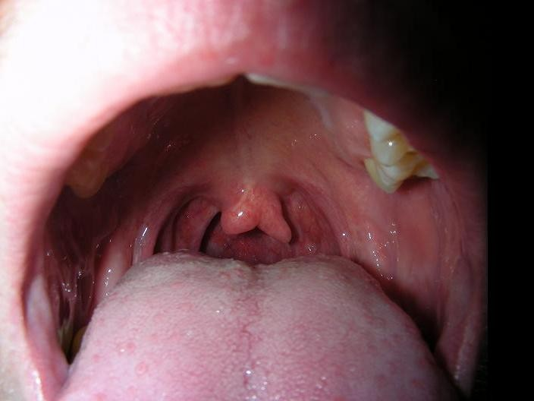
Bifid uvula
(fig.5)

Slide 10
Cleft lip, cleft palate, and the combination of cleft lip and palate are considered to have a multifactorial cause, including both environmental and genetic elements.

Slide 11
incidence
common congenital malformation
reported incidence varies from 1 in 500
to 1 in 2500 live births
male:female 2:1
Asian population have higher incidence compared to the caucasian population

Slide 12
Causes
Oral clefts have been linked to genes l o c a t e d o n m o r e t h a n s e v e r a l chromosomes including 1, 2, 4, 6, and 19, among others

Slide 13
Causes
maternal smoking (especially more than 20/day) and exposure to passive smoke
Drugs: Accutane, phenytoin, ethanol
maternal folic acid deficiency
ingest large quantities of Vit A
warfarin

Slide 14
Method of Transmission
Depends on the specific cause of the clefting.
Multifactorial clefts can exhibit evidence of autosomal dominant, autosomal recessive, and sex-linked inheritance patterns
spontaneous mutation or mutations in one or more genes.

Slide 15
Method of Transmission
If one of the parent has a cleft lip, his/her child face a risk of 20%
If their is one child with cleft lip, the following child faces risk of 14%
A non cleft parent with a cleft lip faces a risk of 4% for the following child

Slide 16
Pathogenesis
The face and facial structures are formed out of three plates, each migrating toward a meeting point in the middle area of the face.

Slide 17
The facial structures of the orbicularis muscle form the lip. They are joined at the philitrum lines.
join by 4th week of pregnancy

Slide 18
The palate is then formed out of the structure that begins as the tongue and palate.
Between the fourth and the eighth weeks of gestation, the tongue drops down and the palatal segments then move from the sides and toward the middle, fusing in the center.

Slide 19
A cleft, therefore, is not something that is formed, so much as it is something that does not form.

Slide 20
Normal Process
6 Weeks
Maxillary process
Lateral nasal process
Median nasal process
These three processes join and fuse to form the primary palate

Slide 21
Normal Process
7 Weeks
Median nasal process and maxillary process have fused creating upper lip and anterior maxillary alveolus

Slide 22
Normal Process
8 Weeks
Complex totally fused and mesodermal migration completed Tongue, which has been postured superiorly between lateral palatal shelves of maxilla, moves inferiorly allowing palatal processes to grow toward midline and fuse, form nasopalatine foramen to uvula

Slide 23
Normal Process
11 Weeks
Total palatal closure

Slide 24
Classification
The Veau Classification system (table.1)
The Striped-Y Classification system (fig.6)

Slide 25
The Veau Classification system
Class | Description
I | Soft palate only
II | Hard & soft palate to the incisive foramen
III | Complete unilateral of soft, hard, lip, & alveolar ridge
IV | Complete bilateral of soft, hard, and/or lip and alveolar ridge
These descriptions can be modified with the words incomplete, right, left, one/third, and so on.
(Table.1)

Slide 26
The Striped-Y Classification system
R
L
Lip
Alveolus Primary
palate
Foramen incisivum
Vomer
Spinae
So pa
ft late
(fig.6)

Slide 27
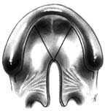
R
L
Cleft palate
(fig.7)

Slide 28
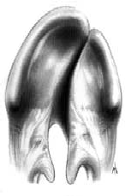
R
L
Left-sided unilateral complete cleft lip and palate
(fig.8)

Slide 29
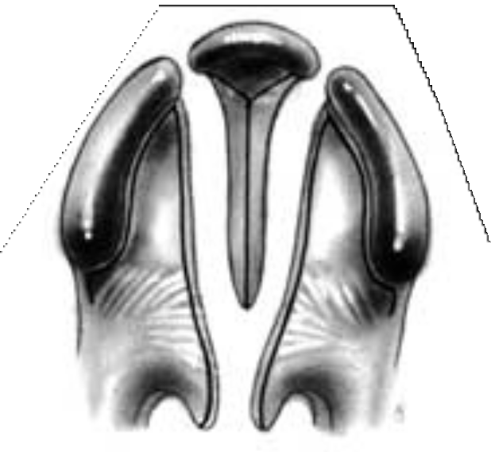
R
L
Bilateral complete cleft lip and palate
(fig.9)

Slide 30
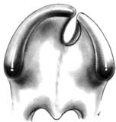
R
L
Bilateral-right incomplete, left complete- cleft lip and primary palate
(fig.10)

Slide 31
Dental Implications
The dental implications of cleft lip and/or palate depend on the number of dental abnormalities present and the stage of treatment.
The dentist play an important role in managing the care of the individual with a cleft lip and/or palate through education and preventive dental hygiene therapy.

Slide 32
Numerous surgical and other medical and dental treatments are necessary to correct cleft lip/palate. The surgeries are scheduled starting at about 3 months of age & ending at about 1 year to correct simple clefts.

Slide 33
THANK YOU

