Slide 1
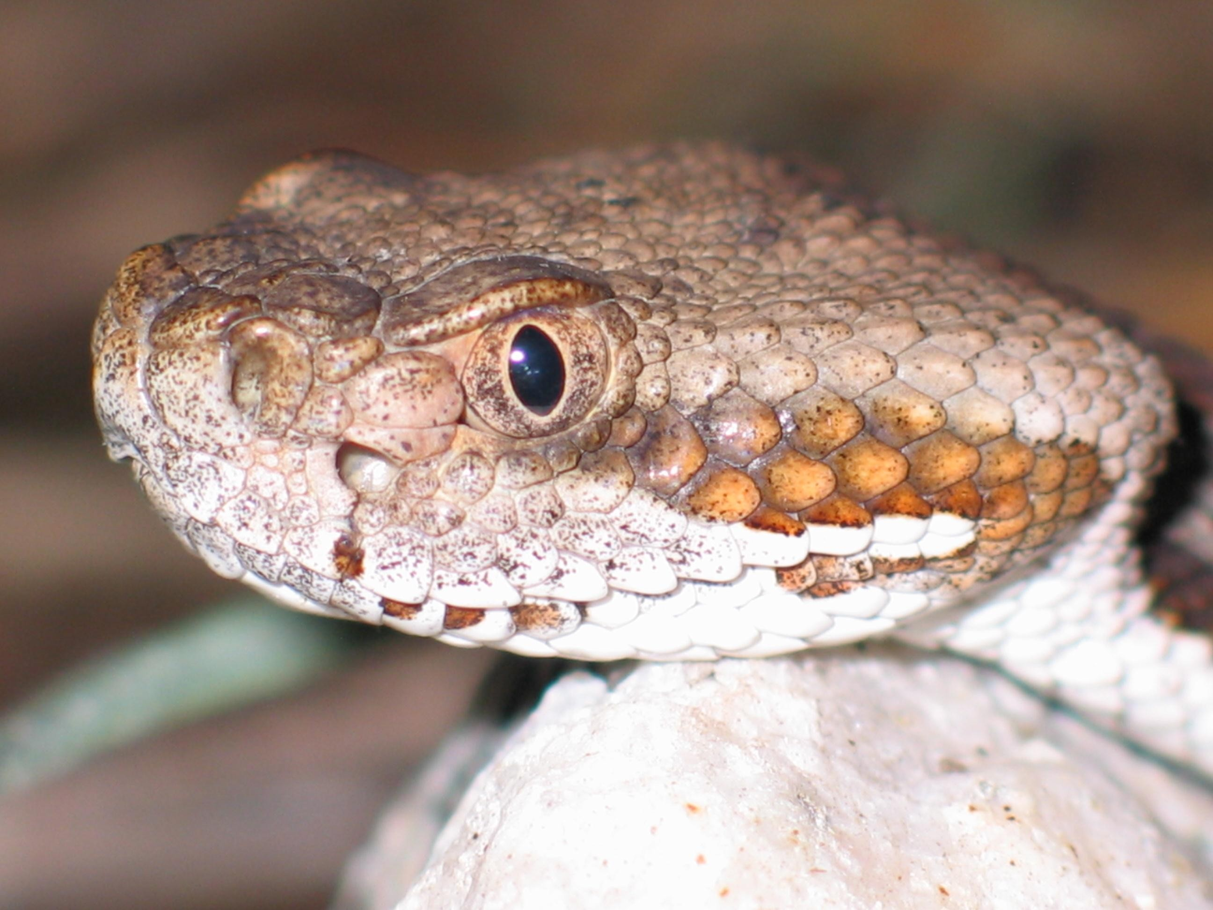
CROTALUS HORRIDUS
Rattlesnake
Prepared by,
Dr. Gokul Krishna K
Asst. Professor, Dept. of Materia Medica

Slide 2
SPHERE OF ACTION
Cerebro spinal nerve centres and secondarily upon the fibrin of blood and liver
PATHOGENESIS:
It causes decomposition of blood and produces hemorrhage from all orifices of the body eg. Eyes, ears, nose etc
cerebrospinal nerve centres producing rapid and direct depressing influence on sensorium and medulla oblongata

Slide 3
CONSTITUTION
ESP. Strumous, debilitated, broken down constitution
Particularly in drunkards with tendency to carbuncles or blood boils
Choleric temperament
Psora
Haemorrhagic diathesis

Slide 4
GUIDING SYMPTOMS
Haemorrhage flows from eyes, ears, nose and all orifice of body and even pores of the skin; blood fluid, dark, non-coagulable and offensive
Malignant jaundice
Right side
Bad effects of vaccination

Slide 5
General < morning on waking or < wakes the patient up at night
Tongue fiery red; smooth, polished, intensely swollen, difficulty in swallowing
Purpura haemorrhagica; sudden bleeding from all orifice skin, nail, gums
Low septic condition with blood decomposition

Slide 6
Black, coffee- ground and offensive stool
Desires for stimulants and aversion to meat
A\F- Fright, sun, alcohol foul water and vaccination

Slide 7
HAEMORRHAGE
In malignant diseases of uterus
Great tendency of hemorrhage
Blood discharge is Dark, fluid, decomposed and non-coagulable
The blood loses all power of coagulation; hence clots are not usually detected in the haemorrhage

Slide 8
In intestinal hemorrhage when occuring in typical septic or zymotic diseases where the blood is dark fluid and offensive
The blood flows from all the orifices of the body. Eg. Ear, nose,eyes and even pores of skin

Slide 9
Purpura haemorrhagica coming suddenly from all the orifice eg. Skin, nails, gums etc
During hemorrhage the skin become cold and dry, the patient wants fanning, usually right side is more affected

Slide 10
SIMILARITIES BETWEEN CROTALUS AND LACHESIS
Both are potenised from snake poison
Haemorrhage remedies
Worse from sleep and sleeps in to aggravation
Intolerant of pressure and tight clothing
Loquality
Blueness of parts

Slide 11
Bloody sweat
Yellowness and jaundice look of the skin
Wants fanning

Slide 12
DISSIMILAR
Crotalus affects right side more, lachesis left
Crotalus skin is cold and dry, but lachesis skin is cold and clammy
Crotalus has more hemorrhage than lachesis
Crotalus has more specific effects on liver than lachesis
Lachesis is more suited ton patients of climacteric age than crotalus

Slide 13
Malignant jaundice is more marked in crotalus than in lachesis
General Modalities
Agg – Lying on right side; open air, evening, morning and after sleep
Amelioration –Rest, fanning

