Slide 1
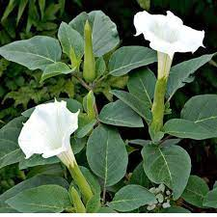
DATURA FASTUOUSA
DR.SANJU.S
Assistant Professor
Forensic Medicine And Toxicology

Slide 2
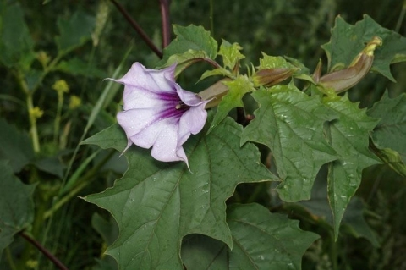
DATURA FASTUOUSA
Dryness
Difficulty in talking
Dysphagia
Dull voice
Dark face
Dilated pupil
Diplopia leading to darkness
Don’t want the relatives
Don’t want to pass urine

Slide 3
Drunken gait
Deep reflex increased
Delirium
Drowsiness
Delusion &Hallucination
Death from respiratory failure

Slide 4
Difference between Datura seeds and Capsicum seeds:
Trait | Datura seeds | Capsicum seeds
Size | Large and thick | Small and thin
Shape | Kidney shaped | Rounded
Colour | Dark or yellowish brown | Pale yellow
Margin | Laterally compressed and double edged art the convex border | Convex border is simple and sharp

Slide 5
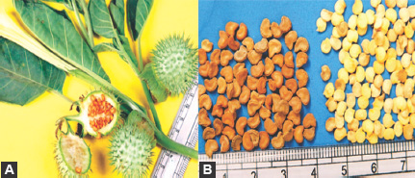
Surface | Numerous small depressions | Smooth
Smell | Odourless | Pungent
Taste | Bitter | Pungent
Embryo | On longitudinal; session embryo is curved outward at the hilum | Embryo is curved inwards

Slide 6
Fatal Dose : 0.6-1 gm(100-125 seeds)
Fatal period: 24 hrs
Treatment:
Emetics
Stomach wash
Activated charcoal
Cathartic
Physostigmine
Avoid Morphine
Bromides and Barbiturates
Ether and Chloroform for delirium
Light diet and purgative

Slide 7
MEDICOLEGAL IMPORTANCE
Road poison : By criminals for stupifying a victim.
Abortifacient.
Aphrodisiac property.
Accidental in children.
Person suffering from delirium of Datura is not criminally responsible for this act.

Slide 8
MYDRIATRIC TEST
A drop of solution is put into eyes of a cat. The pupils dialate with in half hour.

