Slide 1
Diabetic Foot
DR.BINO
Associate Prof.
DEPT OF SURGERY

Slide 2
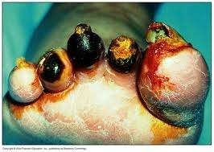
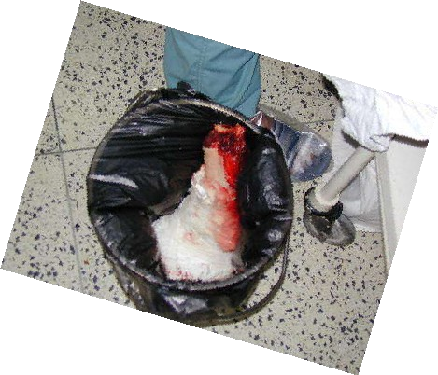
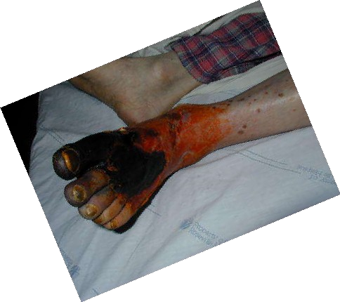
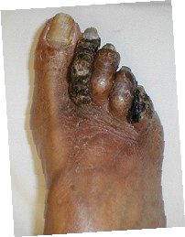
Diabetic Foot
DR.BINO
Associate Prof.
DEPT OF SURGERY

Slide 3
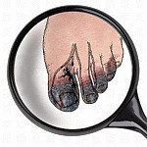
Introduction
The complication of long-standing diabetes mellitus often appear in the foot, causing chronic disability.
15 % of patients with diabetes mellitus will develop a lower extremity ulcer during the course of their disease.
They are a major source of morbidity, a leading cause of hospital bed occupancy and account for substantial health care costs and resources
Foot complications result from a complex interplay of i s c h a e m i a , u l c e r a t i o n , i n f e c t i o n a n d d i a b e t i c
C h a r c o t ’ s j o i n t . They can be reduced

Slide 4
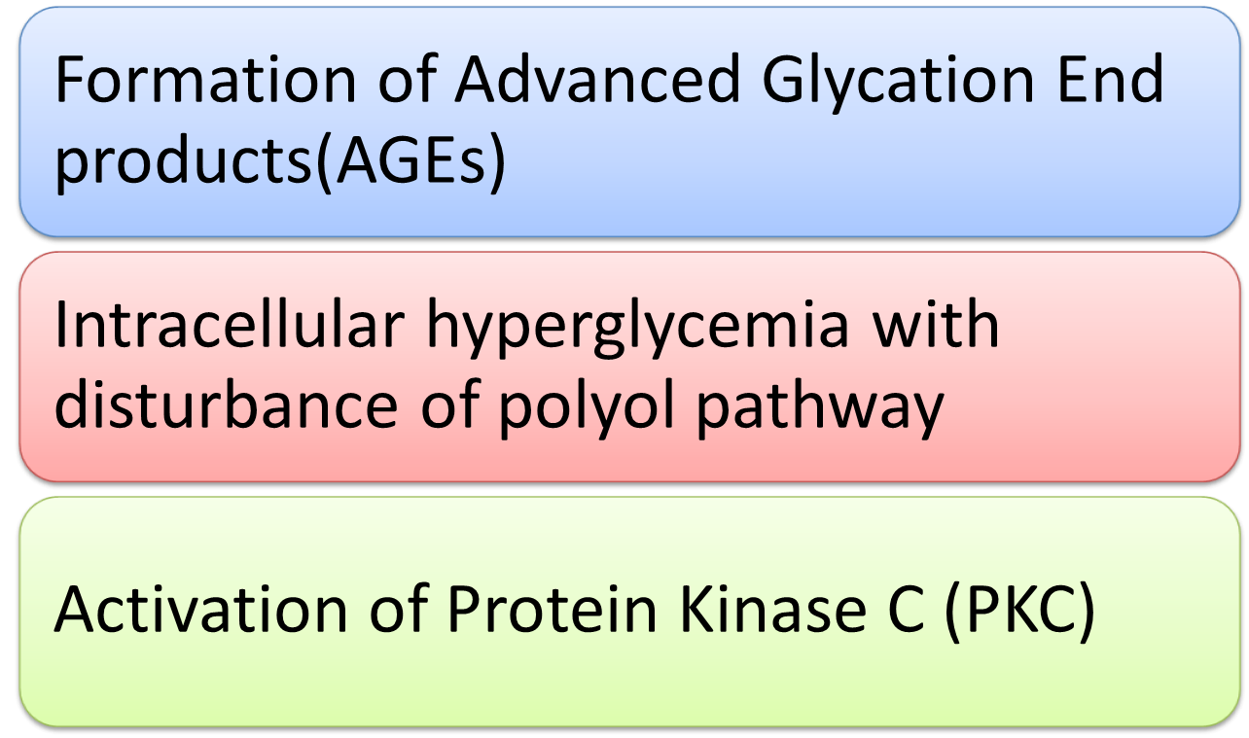
Pathogenesis of Chronic Complication of diabetes mellitus

Slide 5
Hyperglyceamia
N o n e n z y m a t i c g l y c o s y l a t i o n of collagen and other proteins in interstitial tissue and blood vessel wall
Formation of irreversible advanced glycosylation end products (A G E S )
Cause c r o s s l i n k between polypeptides
T r a p plasma and interstitial proteins including L D L
Promote the d e p o s i t i o n o f c h o l e s t e r o l in the blood vessel
intima
Accelerated the process of a t h e r o g e n e s i s
Formation of a t h e r o s c l e r o t i c p l a q u e
Atherosclerosis

Slide 6

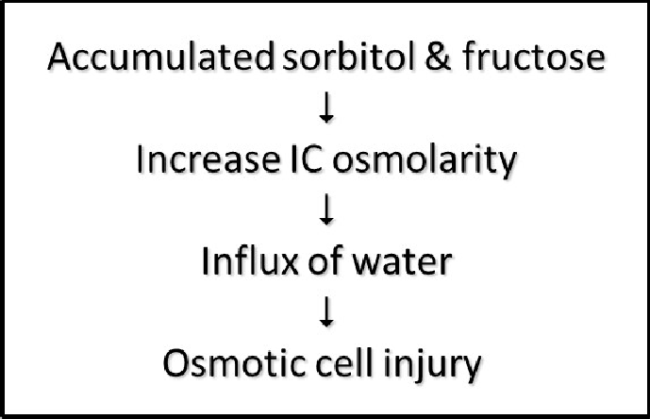

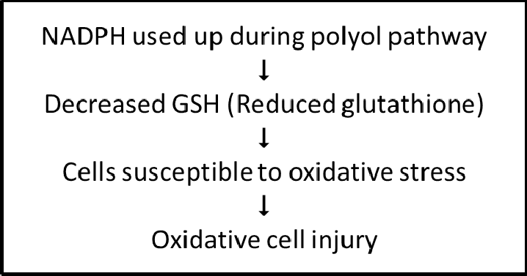
Disturbance in polyol pathway
Glucose
NADPH + H⁺
Aldose
reductase
Sorbitol
Polyol
dehydrogenas
e
NADH + H⁺
Fructose

Slide 7

Hyperglycaemia
↓
stimulate polyol pathway
↓↓
accumulation sorbitol + fructose in Schwann cells Increase IC osmolality

influx of water → osmotic cell injury

damage schwann cell (demyelination )

axon degeneration irreversibly

disrupt neural function

Diabetic neuropathy

Slide 8

Diabetic foot result from:
a) Peripheral vascular disease
d) Osteoporosis
b) Neuropathy
c) Infection

Slide 9


a) Predisposing peripheral vascular disease
Atherosclerosis
(medium-sized vessels below the knee)
 | Compromised blood supply
 | Ischemia
 | Coagulative necrosis
 | Ulcer
Infection
Dry gangrene
 | Wet gangrene

Slide 10

Predisposing peripheral vascular disease
Artheroma plaque narrowing the arterial lumen
Ischaemic toes due to artherosclerosis

Slide 11
b) Neuropathy
Neuropathy
Motor
Sensory
Autonomic
Muscle wasting Foot weakness Postural deviation
↓ Proprioception, Unawareness of foot position
Reduced sweating
↓ nociception
Stress on bones & joints Plantar pressure
Dry skin
Deformities, stress and shear pressures
Callus formation
Fissures and cracks
Trauma
Ulcer
Infection

Slide 12
Neuropathy
Involve all nerves: motor, sensory, autonomic
Motor
  Occlusion of vaso nervorum dt AGEs > Ischaemic damage to the nerves > Somatic motor neuropathy > muscle weakness/wasting
  Muscle weakness of intrinsic muscle of foot > plantar arch cannot maintained > exaggerated plantar arch > abnormal distribution of pressure
> ulcer on pressure point

Slide 13
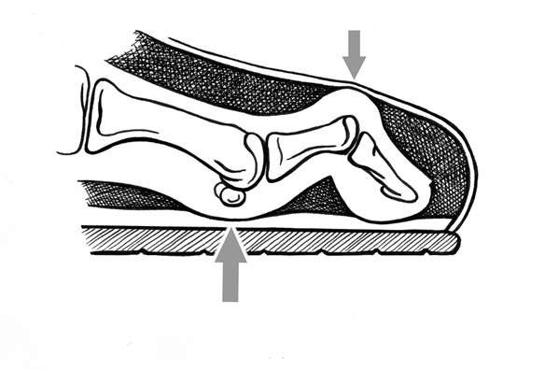
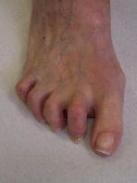
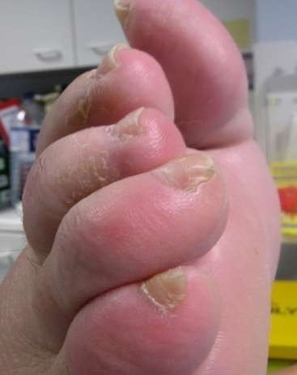
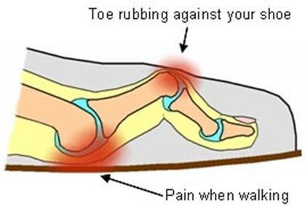
Claw toe
S vere atrophy of the intrinsic foot muscles (lumbrical & interossei)
d/t motor neuropathy resulted in imbalance of foot muscles & cocked-up toes.

Slide 14
Neuropathy
Sensory
  Early signs –loss of vibration, pain and temperature sensation in the feet
  Later signs –impaired proprioception
  loss of tendon reflex in the lower limbs
  In glove and stocking distribution
  this result in loss of protective sensation to prevent tissue damage.

Slide 15
Neuropathy
3. Autonomic
– denervation of dermal structures leads to decreased sweating > dry skin and fissure formation > ulcer

Slide 16
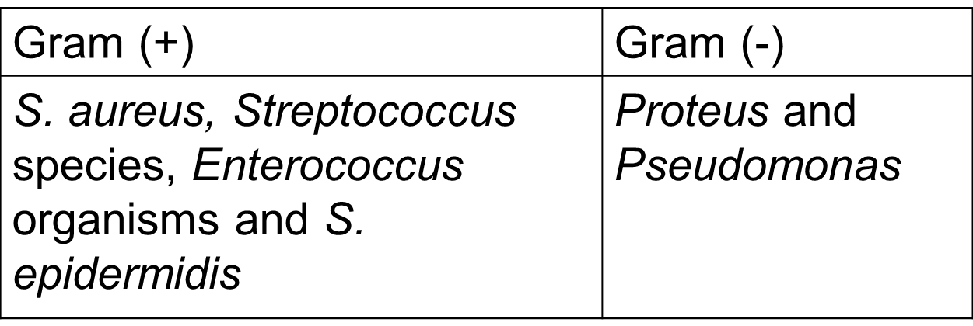
c) Infection
Individuals with DM have a greater frequency and severity of infection.
Reasons:
  abnormalities in cell-mediated immunity and phagocyte function
  diminished vascularization
  Hyperglycaemia aids the colonization and growth of a variety of organisms (Candida and other fungal species).
Common pathogens:
Combined with local ischemia, insensitivity to skin injury and localized pressure d/t deformity, more susceptible to infection

Slide 17
d) Osteoporosis
Generalize lost of bone density
May severe enough to cause insufficiency fracture

Slide 18

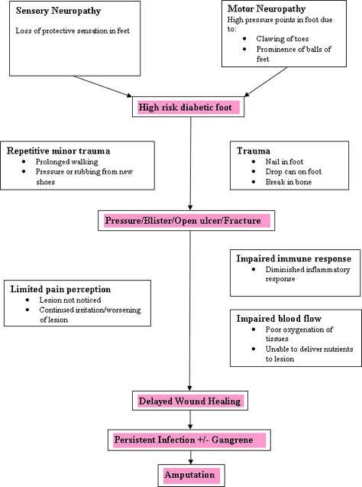

Slide 19
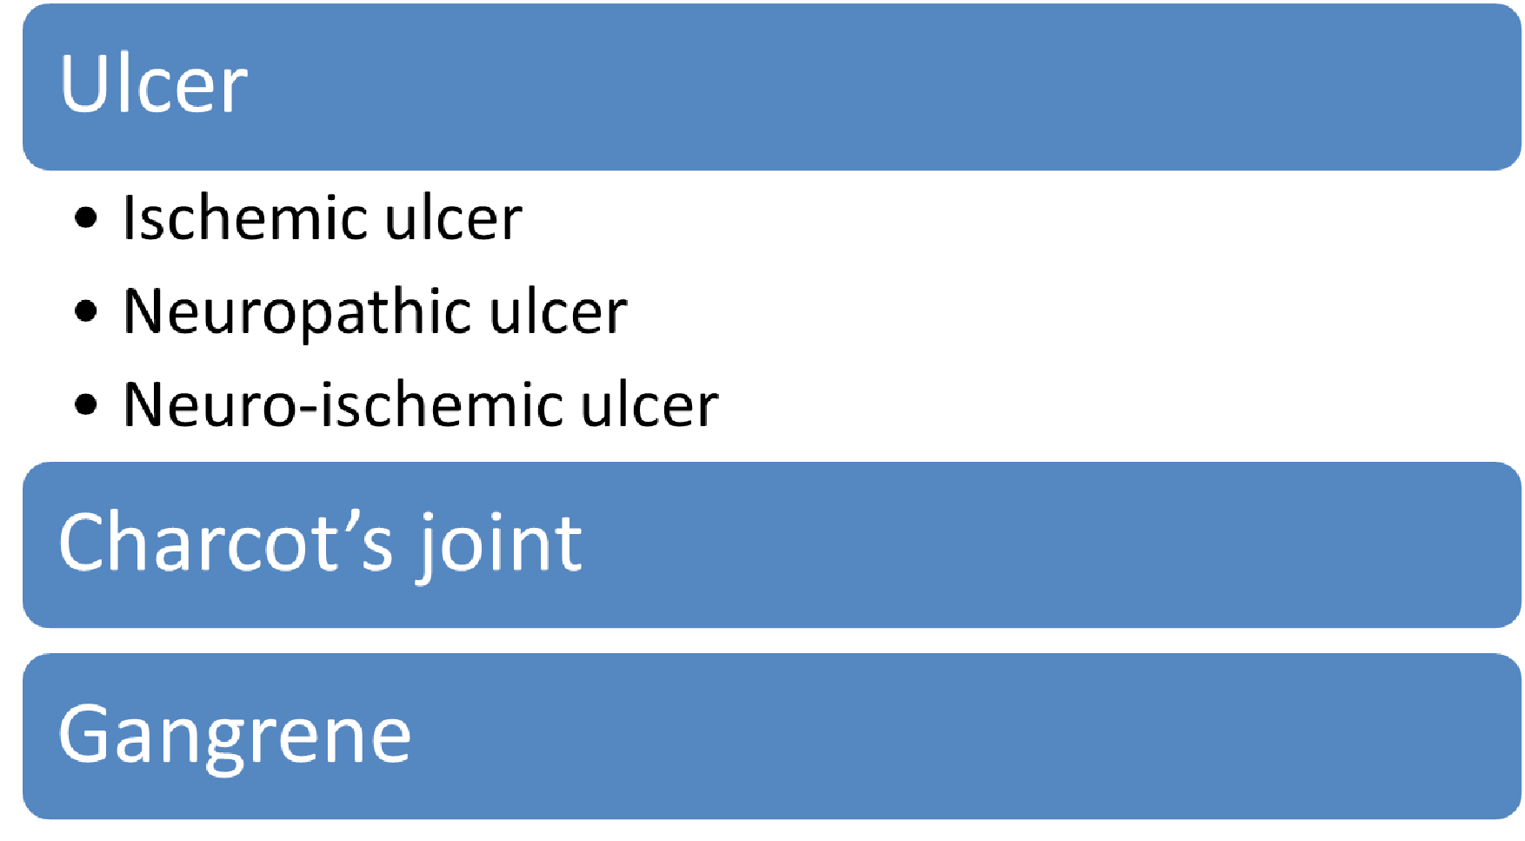
Clinical presentation of diabetic foot

Slide 20
Diffentiation of Ischaemic and Neuropathy Ulcer
Ischaemia Neuropathy
Symptoms
Claudication
Usually painless
Or painful neuropathy
Rest pain
Inspection
Dependent rubor Trophic changes Gangrenous digits
High arch + clawing of toes
No trophic changes Surrounded by callus
Palpation
Cold
Warm palpable pulses
Pulseless
Ulceration
Painful
Painless Sites of pressures
(metatarsal heads, heels)
At the distal and over
bony prominences

Slide 21
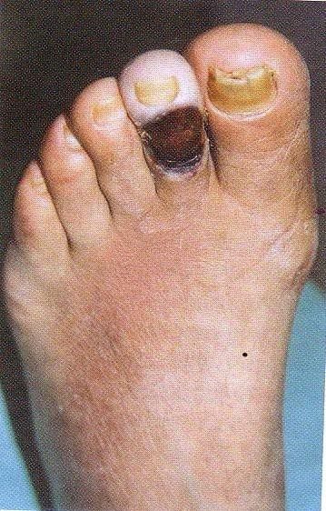
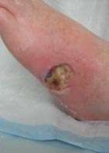
Ischemic foot ulcer

Slide 22
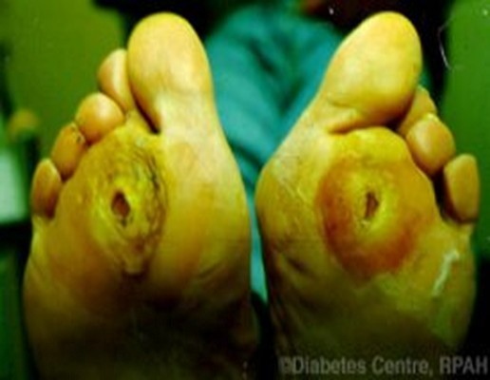
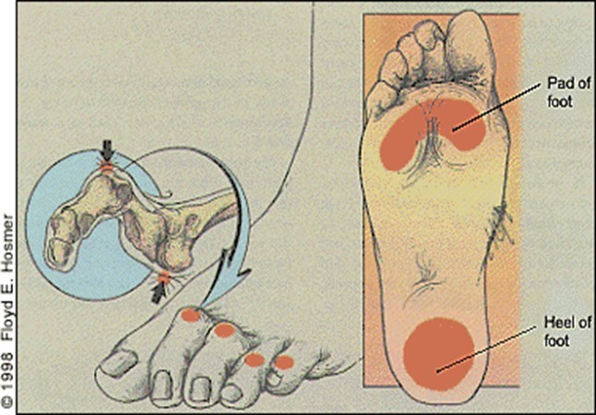
Neuropathic foot ulcer
Callus formation on its surrounding ulcer lesion.

Slide 23
Charcot Joint
Any destructive arthropathy arising from loss of pain sensibility and position sense
Lack of the normal protective reflex against abnormal stress/injury > repetitive trauma > articular surface and bone destruction > deformity of the joint
characterized by pathological fracture, joint dislocation and fragmentation of articular cartilage
Diabetic neuropathy is the most common cause.
An acute Charcot’s foot will have swelling, erythema,raised skin temperature, joint effusion and bone resorption in an insensate foot

Slide 24
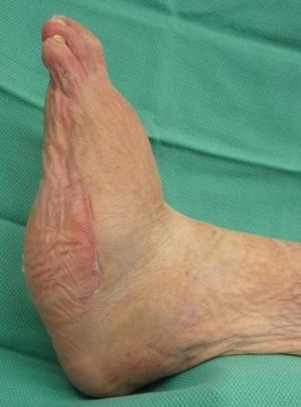
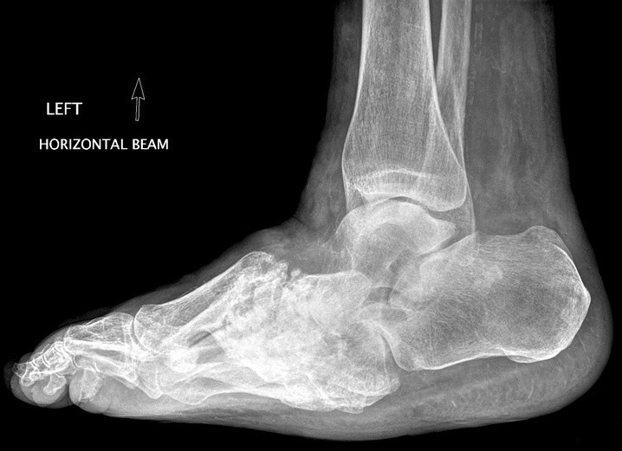
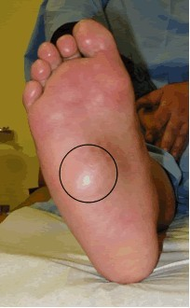
Charcot Joint
Rocker bottom charcot foot

Slide 25
Gangrene
•
Gangrene is a condition that involves the death and decay of tissue, usually in the extremities due to loss of blood supply.
Dry gangrene Wet gangrene
no infection
little tissue liquefaction
In early stages, dull, aching pain, extremely painful to palpate, cold, dry and wrinkled.
In later stages, skin gradually changes in color to
Bacterial infection
copious tissue liquefaction
offensive odor
swollen, red and warm.
usually develops rapidly due to blockage of venous and/or arterial blood flow
dark brown, then
dark purplish-blue, then
completely black
•
Treatment is surgical debridement and amputation.

Slide 26
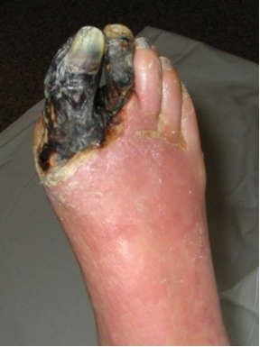
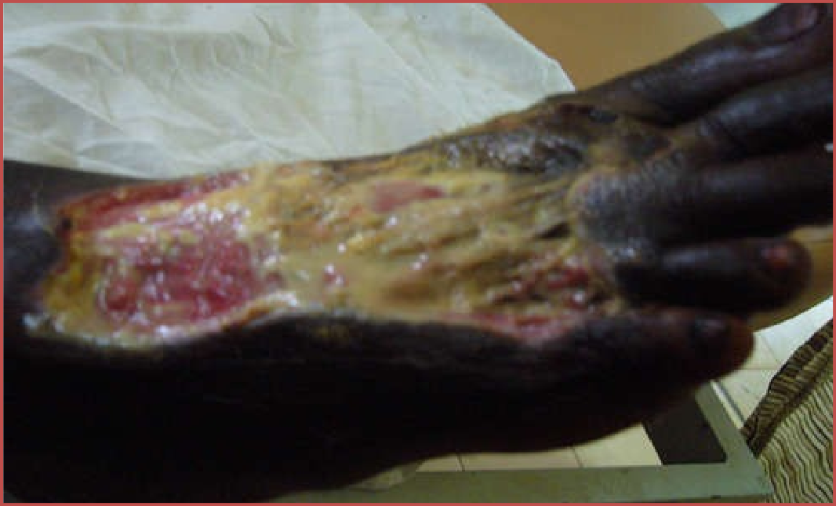

Slide 27


