Slide 1




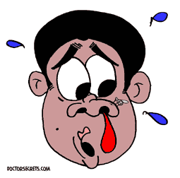

Dr.Varun.S
Dept.of .Surgery
Skhmc

Slide 2


INTRODUCTION
Bleeding from nostril, nasal cavity or nasopharynx
Most often self limited, but can often be serious and life threatening
5-10% of the population experience an episode of epistaxis each year, 10% of those will seek a physician and 1% of those will need a specialist
Can occur in all age groups

Slide 3

REASON FOR EXCESSIVE BLEEDING
Rich vascularity
Supplied by both internal and external carotid system
Various anastomoses between arteries and veins
Blood vessels run under the mucosa unprotected
Larger vessels on the turbinate run in bony canals – cannot contract

Slide 4

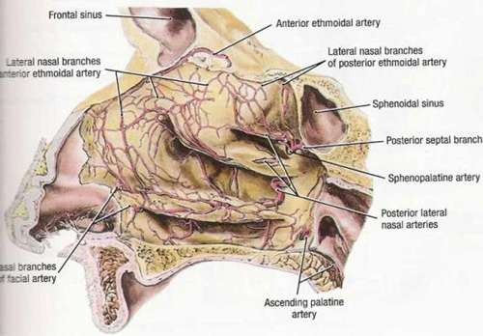
VASCULATURE OF NOSE
 Branches of internal
carotid system :
. Anterior Ethmoidal artery
. Posterior ethmoidal artery
 Branches of external carotid system :
. Sphenopalatine artery- major branch
. Greater palatine artery
. Superior labial branch of facial artery
. Infraorbital branch of maxillary artery

Slide 5

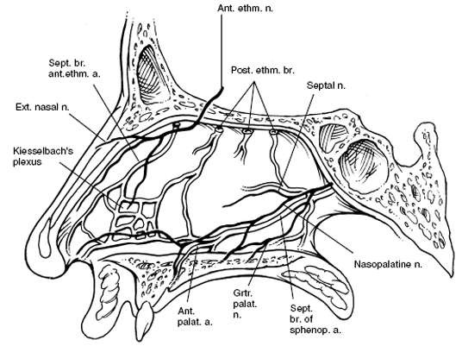
KIESSELBACH’S PLEXUS (Little’s area)
In anterior inferior part of nasal septum
Most common site for
epistaxis
Mainly anterior epistaxis
septal br. Of sphenopalatine
Anterior ethmoidal
Septal br. Of superior labial
greater palatine arteries anastomose here

Slide 6

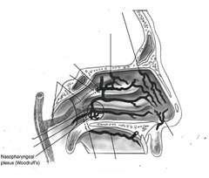
WOODRUFF’S PLEXUS
Posterior end of middle turbinate
Sphenopalatine artery anastomoses with posterior pharyngeal artery
Most common site for posterior epistaxis

Slide 7

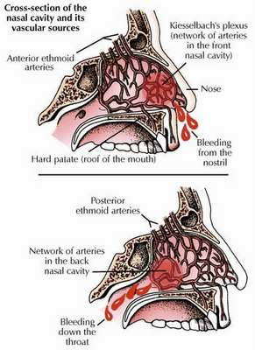
CLASSIFICATION
 Anterior Epistaxis
 Posterior Epistaxis
. More common
. Occurs in children and young adults
. Usually due to nasal mucosal dryness
. Alarming as bleeding seen readily but generally less severe
. Usually older population
. HTN and ASVD are the most common causes
. Significant bleeding in posterior pharynx
. More severe and treatment more challenging

Slide 8

LOCAL CAUSES OF EPISTAXIS
.
A. Congenital – Hereditary telengiectasia
B. Trauma
. Nose picking
. Facial and skull bone fractures
. Foreign body
. Iatrogenic trauma
. Hard blowing, violent sneeze

Slide 9

Inflammatory
. Infective rhinitis
Specific
. Acute – Diphteria
. Chronic granulomatous- TB, Leprosy, Syphilis, Rhinosporiodiasis

Slide 10

Non Specific
. Viral – Common cold, Influenza
. Bacterial – Secondary bacterial rhinitis sinusitis
. Fungal rhinosinusitis
. Atrophic rhinitis
Physiological
. High altitude
. Extreme cold or hot climate

Slide 11

Neoplastic
. Benign – Juvenile angiofibroma, angioma of septum, capillary and cavernous hemangioma
. Malignant – SCC, Olfactory neuroblastoma, Nasopharyngeal carcinoma
Miscellaneous
. Deviated septum & spur
. Rhinitis sicca
. Spontaneous rupture of vessels
. Rhinolith

Slide 12
SYSTEMIC CAUSES
Hypertension- commonest
Cardiac –CCF, Mitral stenosis
Pulmonary –COPD
Cirrhosis – Vitamin K
deficiency
Renal –Nephritis
Drugs – Excessive use of salicylates , anticoagulants
Coagulopathies – Clotting disorders bleeding disorders Agranulocytosis Leukemia
Vitamin K deficiency Exanthematous fevers
Hormonal – Vicarious Menstruation, endometriosis, granuloma gravidarum
Idiopathic Causes

Slide 13

PATIENT HISTORY
Previous bleeding episodes
Onset, duration, frequency, amount of blood loss
h/o trauma
Family history of bleeding
Hypertension
Hepatic diseases
Drug history
Any other medical ailment

Slide 14

MANAGEMENT
Locate the bleeding site
Anterior and Posterior rhinoscopy
Diagnostic Nasal Endoscopy
INVESTIGATIONS :
. Hematological investigations – Hb%, TLC, DLC, BT, CT,
Platelet count, prothrombin time
. Blood urea, liver function tests
. Radiology – x-ray and CT scan of nose, PNS and nasopharynx
. Other investigations depending upon the possible cause

Slide 15

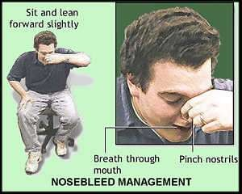
TREATMENT OF EPISTAXIS
 First aid
. ABC
. Trotter’s method- Make patient sit up, pinch the nose for 5-10 minutes. Head bent forward. Open mouth and breathe
. Ice packs

Slide 16

DEFINITIVE TREATMENT
CAUTERIZATION
. Chemical cautery with Silver nitrate sticks, TCA (3%), Chromic acid bead
. Electrocautery
Vasoconstrictor sprays / anesthetics
Anterior nasal packing or anterior epistaxis balloons for refractory epistaxis

Slide 17

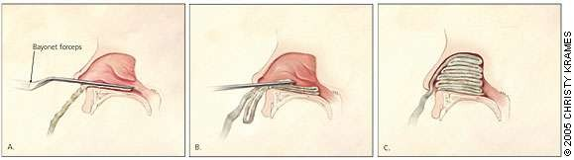
ANTERIOR NASAL PACKING

Slide 18

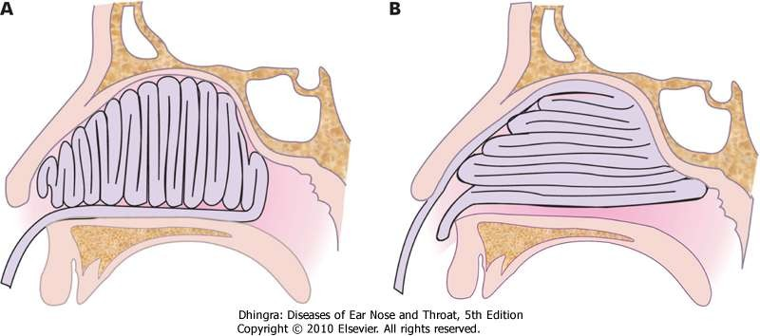
METHODS OF INSERTING ANTERIOR NASAL PACK

Slide 19

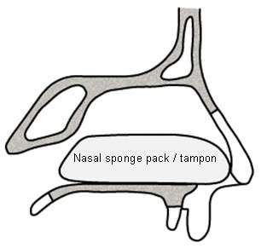
NASAL SPONGE PACK/TAMPON

Slide 20

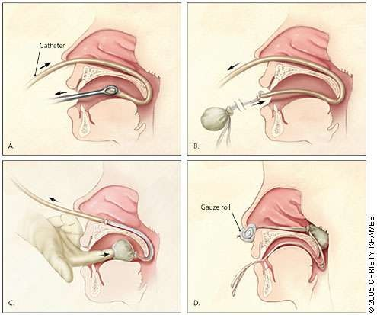
POSTERIOR NASAL PACKING
If bleeding does not stop after anterior packing
Posterior epistaxis

Slide 21

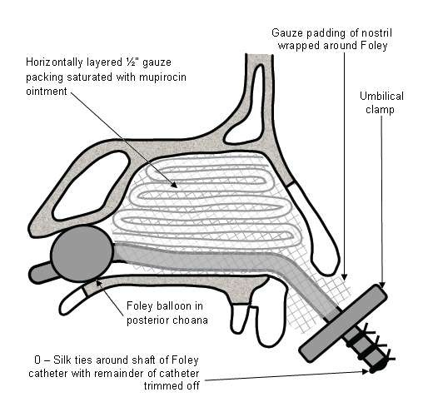
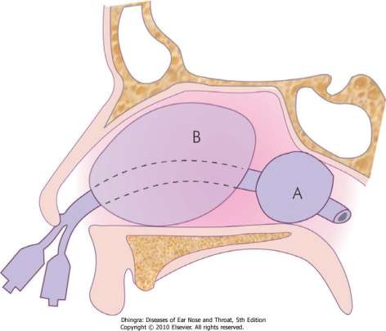
FOLEY’S CATHETER and EPISTAXIS BALLOON

Slide 22

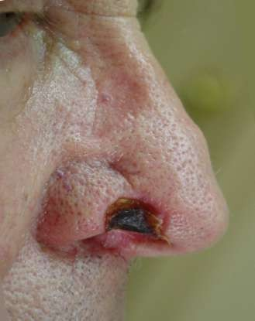
COMPLICATIONS OF NASAL PACKING
SEPTAL HAEMATOMA / ABSCESS
SINUSITIS
PRESSURE NECROSIS
TOXIC SHOCK SYNDROME
NECROSIS OF ALA

Slide 23

PATIENTS ON NASAL PACK
Best to place patient on antibiotics to decrease risk of sinusitis and toxic shock syndrome
Advise patient to avoid straining, bending forward or removing pack early
If other nostril is unpacked advise patient topical saline spray or saline gel to moisturize nasal mucosa
Admitted and monitored in severe cases

Slide 24

OTHER TREATMENTS FOR REFRACTORY EPISTAXIS
Greater palatine foramen block
Septoplasty
Endoscopic cauterization
Internal maxillary artery ligation
Transantral sphenopalatine artery ligation
Intraoral ligation of maxillary artery
Anterior and posterior ethmoid artery ligation
Selective embolisation
External carotid artery ligation

Slide 25

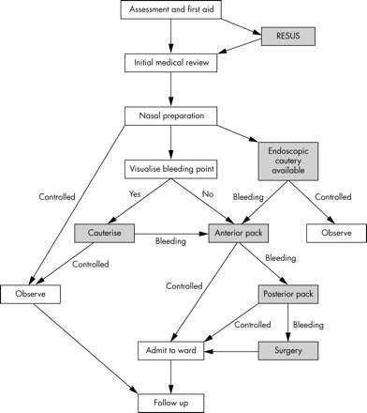

Slide 26


THANK YOU

