Slide 1





Dr.Varun.S
Dept.of. Surgery skhmc

Slide 2


There are two types of nasal polyp
Antrochoanal
Ethmoidal

Slide 3

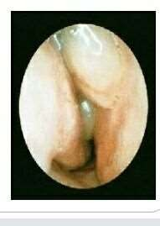

Slide 4
Antrochoanal type
 It arises from the maxillary antrum and grows backwards in to nose towards the choana and nasal cavity riches the nasopharynx .

Slide 5

Ethmoidal
They are multiple bilateral and arises from numerous ethmoidal sinuses.
It is very commonly found

Slide 6

Etiology
ANTROCHOANAL POLYP-
Exact cause is not known.
AGE: usually it occurs in children and young adults.
NUMBER: usually it is single.
INFECTION and ALLERGY may result in ANTROCHOANAl POLYP.

Slide 7

ETHMOIDAL POLYP
AGE; ethmoidal polyps occurs at any age
SEX: both sexes are equally affected
PREDISPOSING FACTOTRS:
Allergy
Vasomotor
Infection
Mixed infection

Slide 8

Polysaccharide changes
Bernouillis phenomenon: when air passes through a narrow area in the nose negativre pressure develops in the viscinity in the paranasal sinuses leading to increased formation of tissue fluids this may encourage polyp formation.

Slide 9

Asthma can be associated with ethmoidal polyp.
Aspirin sensitivity

Slide 10

Pathology
Antrochoanal polyp
Macroscopic :antral part : arise from maxillary antrum.
Mucosa:oedamatous
Nasal part: arise from hiatus semilunaris in nose and reaches the choana

Slide 11

Pharyngeal part :enters the naso pharynx through choana.
ETHMOIDAL POLYP:
Arised from mucosa ethmoidal sinuses and hang down in the nasal cavity .

Slide 12
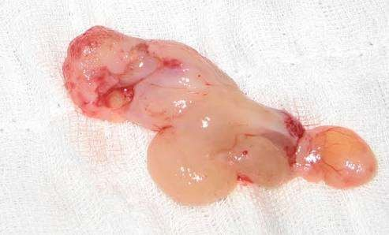
antrochoanal polyp showing choanal (c)nasal (n) antral (a) parts
A
N
C

Slide 13

Microscopic
Mucous membrane: metaplastiv changes.
Polyp: ulcerated or protruded
Submucoasal tissue:oedamtoius.
Cellular infiltration occurs
Polyp is avascular and pain less
Blood vessels and nerves supply scanty

Slide 14
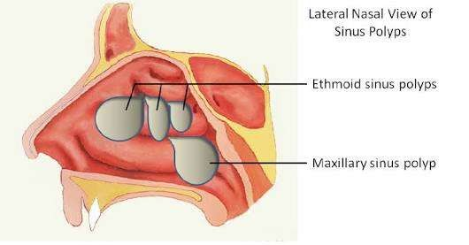
DIAGRAM OF NASAL POLYPI

Slide 15
Clinical features
Blocking of nose
Sneezing
Discharger clear
Expansion of nose
Anosmia
Snoring and mouth breathing
headache

Slide 16

Epiphora
Postnasal discharge
Speech:hyponasal

Slide 17

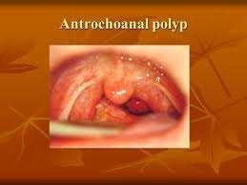

Slide 18

Signs
External nose: Frog like appearance “BROAD NOSE”
Anterior rhinos copy:
antrochonal :rarely visible
Ethmoidal:multiple like n bunch of grapes
Posterior rhinoscopty
Antrochoanal :large visible like pear shaped
Ethmoidal :fairly visible and grow slowly

Slide 19
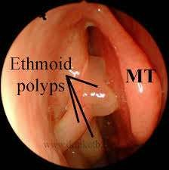

Slide 20

Investigation
Nasal secretion : culture and sensitivity test
Radiography test of nose and sinuses.
Ct scan of nose and par nasal sinuses.
Biopsy of polyp

Slide 21

DIFFERENTIAL DIAGNOSIS
Hypertrophic turbinate's
Rhinospordiosis
Malignancy
Angioma
Adenods
Nasopharangeal angiofibroma
Nasophrangeal malignancy
Glioma
menegiocle

Slide 22
Treatment
antrochoanal polyp: conservative
nasal decongestant
anrttibiotics
surgical:polypectomy
sinoscopy
cold weell luc-operation

Slide 23
ETHOMOIDAL POLYP
conservative:antihistamine
steroids
antibiotics xecongesatant
surgical:polypectomy
ethmoidectomy
sinoscopy

Slide 24

HOMOEOPATHIC TREATMENT
calc.carb
kreosotum
phosphorus
hamamelis

Slide 25

DNS
deviated nasal septum:
defination:deviation of the septum occurs very frquentlybut it requires treatment only if it produces symptoms

Slide 26

ETIOLOGY
AGE:puberty
upto 20 yrs
sex :both sexes
hereditoyry
developmental cause
high arched palate
congenital

Slide 27

trauma
secondary :tumor
mass
polyp

Slide 28
PATHOLOGY
deviation
spurs
thickening
dislocation
c-shaped or s shaped deviation
hypertrophy of turbinates

Slide 29

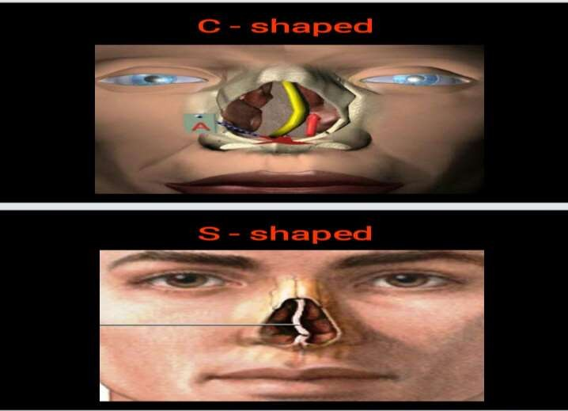

Slide 30

SYMPTOMS
asypmtomatic
blocking of nose
vacuum headache
neuralgic headche
recurrent cold
epistaxis
anosmia
deformity

Slide 31

INVESTIGATION
examination of nose
anterior rhinoscopy
posterior rhinoscopy
radiography of face or nose

Slide 32

COMPLICATION
recurrent sinusitis
middle ear infection
mouth breathing
asthma
atrophic rhinitis

Slide 33
DIFFERENTIAL DIAGNOSIS
hypertrophic turbinates
polyp
septal haematoma

Slide 34

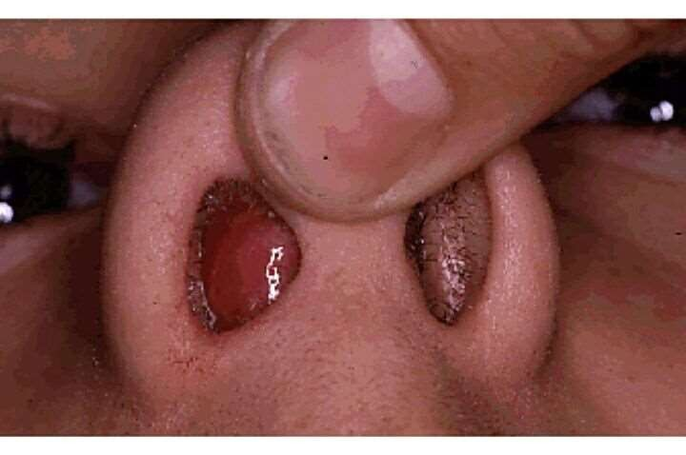
HAEMATOMA

Slide 35

TREATMENT
SMR(submucosal resection of nasal septum)
septoplasty

Slide 36

HOMOEOPATHIC TREATMENT
ars.alb
aconite
thuja

Slide 37



