Slide 1
OSTEOCHONDROMA
CASE PRESENTATION
DR. T. AJAYAN
(HOD-, DEPT. OF MEDICINE)

Slide 2
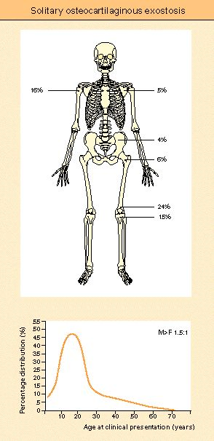
Osteochondroma represents the most common bone tumor and is a developmental lesion rather than a true neoplasm.
Osteochondroma
-Cartilage capped bony projection / exostosis -Commonest benign tumour of bone -Developmental abnormality of the
metaphyseal area of any bone formed in
cartilage (endochondral ossification)
It constitutes 20%–50% of all benign bone tumors and
10%–15% of all bone tumors
It arises from the precartilagenous cells

Slide 3
Incidence
Accounts for 45% of benign bone tumours
12% of all bone tumours
most become evident under 20 years
May be solitary or multiple (diaphyseal aclasis)
Any bone developing by endochondral ossification may be involved

Slide 4
Diaphysial Aclasis: (osteochondroma-herditary related)
Autosomal dominant
Disordered endochondral growth
Multiple osteochondromas and disordered metaphyseal growth
Short stature and bowing of limbs
Treat individual lesions as necessary and observe for malignant change
Malignancy Risk = ~ 20% overall or 0.2% per lesion
Trevor's Disease: Osteochondroma on epiphyseal side of the growth plate

Slide 5
Osteochondromas are composed of cortical and medullary bone with an overlying hyaline cartilage cap and must demonstrate continuity with the underlying parent bone cortex and medullary canal.
Osteochondromas may be solitary or multiple, the latter being associated
with the autosomal dominant syndrome, hereditary multiple exostoses
Grow away from the epiphysis on abony pedicle and become hooked structures

Slide 6
Pathology
Normal bone covered by a cap of normal cartilage
Cartilage cap resembles layers of the normal growth plate
The cartilage is more disorganized than normal
Binucleate chondrocytes in lacunae
Covered with a thin layer of periosteum.

Slide 7
PATHOLOGIC CHARACTERISTICS
Osteochondromas are developmental lesions rather than true neoplasms and are often referred to as an osteocartilaginous exostosis (or simply exostosis). These lesions result from the separation of a fragment of epiphyseal growth plate cartilage, which subsequently herniates through the periosteal bone cuff that normally surrounds the growth plate (encoche of Ranvier) . The mechanism for this separation is not entirely clear, although it likely results from the "cut-back" remodeling during growth of the long bone. Persistent growth of this cartilaginous fragment and its subsequent enchondral ossification (maturation) result in a subperiosteal osseous excrescence with a cartilage cap that projects from the bone surface. The stalk of the osseous protuberance must be in direct continuity with the underlying cortex and medullary canal to be considered a true osteochondroma.
Osteochondromas enlarge from growth at the cartilage cap, identical to a normal physeal plate. After adolescence and skeletal maturity, osteochondromas usually exhibit no further growth.

Slide 8
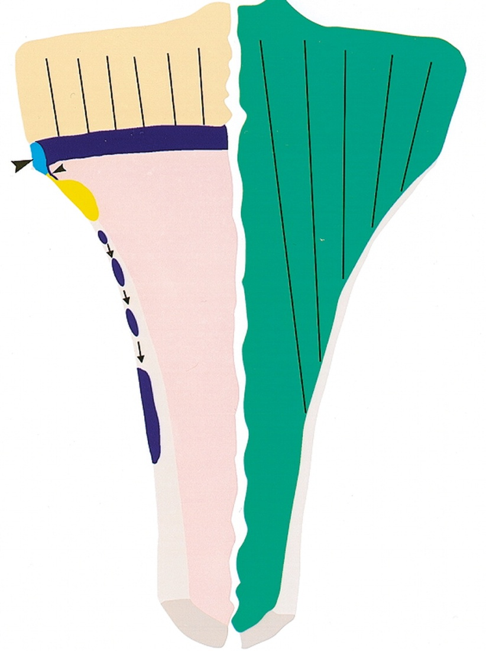
OSTEOCHONDROMA DEVELOPMENT.
Diagram illustrates the normal long bone with the epiphysis (tan), epiphyseal plate (blue), and "cut back" zone of remodeling (yellow). Periosteal bone cuff or encoche of Ranvier (large arrowhead) is shown with herniation of a small amount of physeal tissue (small arrowhead). This tissue migrates into the metaphysis from patient growth (arrows). The intracortical location of this physeal tissue and subsequent growth results in osteochondroma formation.

Slide 9
MACROSCOPIC FEAUTURES
At gross examination, the cartilage cap of an osteochondroma has a bosselated, shiny, and glistening, bluish-gray surface, reminiscent of cauliflower. Osteochondromas vary dramatically in size but are usually between 1 and 10 cm. The thickness of the cartilage cap is typically 1–3 cm in young patients, whereas in adults it is often only a few millimeters thick or entirely absent, leaving a surface composed of eburnated bone. The hyaline cartilage cap is also usually undulating and lobulated, with areas that invaginate into the underlying medullary component of the lesions. On cut sections, the cartilage cap often appears with opaque yellow-to-gray areas due to calcification within the cartilage matrix.

Slide 10
MICROSCOPIC EXAMINATION
The cartilage cap appears to merge with the underlying bone and is covered with a thin layer of fibrous capsule that functions as a perichondrium. The cartilage cap resembles a growth plate with columns or clusters of chondrocytes evenly distributed and maturing in an enchondral process. These chondrocytes can be mildly increased in number with binucleate forms (caused by mechanical or traumatic forces) that, in certain instances, may be mistaken for a more histologically aggressive process. The process of enchondral ossification leads to medullary bone, typically with yellow rather than hematopoietic marrow, and large calcified areas or calcific debris. Examination by electron microscopy reveals proliferating and degenerating chondrocytes that are indistinguishable from normal chondrocytes.

Slide 11
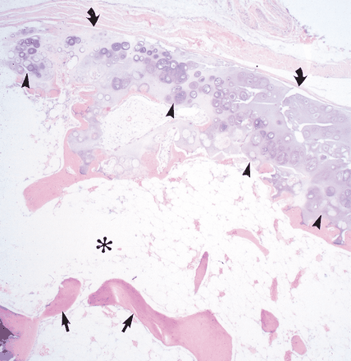
Resected solitary benign osteochondroma. Coronally sectioned whole mount specimen (hematoxylin-eosin [H-E] stain) There is undulation of the hyaline cartilage that invaginates in several areas into the medullary component (straight arrows) of the osteochondroma. Photomicrograph (original magnification, x250; H-E stain) reveals yellow marrow (*) and trabeculae (straight arrows) within the osteochondroma, the hyaline cartilage cap with columns of cartilage cells (arrowheads), and fibrous capsule or perichondrium.

Slide 12
CLINICAL FEAUTURES.
The most common symptom related to osteochondroma is a nontender, painless cosmetic deformity related to the slowly enlarging exophytic mass. Additional complications that cause symptoms include osseous deformity, fracture, vascular compromise, neurologic sequelae, overlying bursa formation, and malignant transformation.
[ The vast majority of solitary osteochondromas are asymptomatic and, if detected, are found incidentally. Symptomatic lesions usually occur in younger patients, with 75%–80% of such cases being discovered before the age of 20 years]

Slide 13
Clinically
Present with lump or interference of tendon function
Excise if troublesome in second decade
50% are distal femur, upper tibia or proximal humerus
May be sessile or pedunculated
Active growth during skeletal growth ->become latent
Move towards the diaphysis with growth and usually angle away from the growth plate
During growth period bone scan ->activity at the tip
Increased activity on bone scan after maturity suggests malignant change

Slide 14
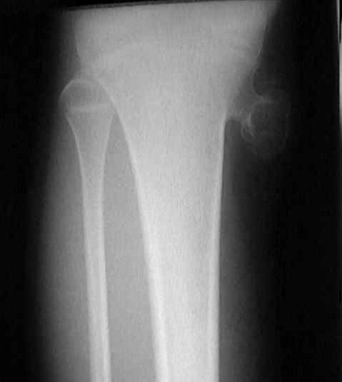
Radiology
x-ray hallmark is blending of tumour into underlying metaphysis
flat, sessile lesion or a peduculated (stalk like) process
pedunculated osteochondromas are oriented in proximal direction
look for a well defined metaphyseal excrescence of bone with a mottled density
Cartilaginous cap displays irregular areas of calcification

Slide 15
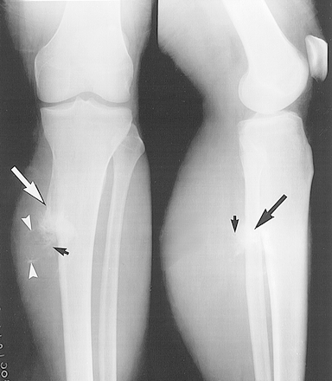
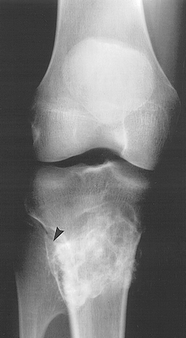
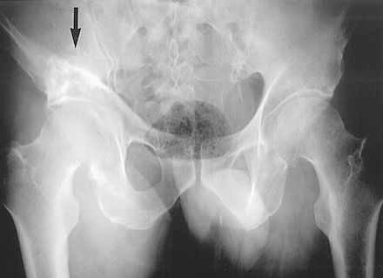

Slide 16
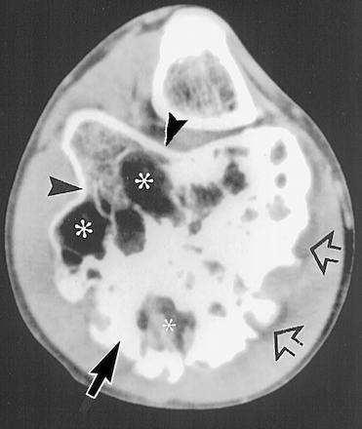
The various degrees of maturity and calcification in the areas of enchondral mineralization cause a heterogeneous appearance on CT and MR images and can be seen in the photograph of the axially sectioned gross specimen. Mature areas of bone formation contain yellow marrow architecture (*).

Slide 17
The radiographic appearance of solitary osteochondroma, particularly in long bones, is frequently pathognomonic. The lesion is composed of cortical and medullary bone protruding from and continuous with the underlying bone. The areas of osseous continuity between parent bone and osteochondroma may be broad, involving a large portion of the bone circumference (dimension of the lesion base exceeding its length—sessile osteochondroma), or narrow, with a bulbous tip (pedunculated osteochondroma). Identifying the characteristic cortical and medullary continuity between lesion and parent bone on radiographs is dependent on lesion type (sessile or pedunculated), location, and image projection. This relationship is usually well delineated in lesions of long bones, particularly pedunculated osteochondromas, with standard radiographic projections (although often only on one view). However, in osteochondromas of flat bones with complex anatomy (ie, pelvis, spine, scapula) and sessile lesions, the continuity and thus the diagnosis may not be apparent on radiographs alone. Pedunculated lesions usually point away from the nearest joint owing to the forces of the overlying tendons and ligaments (although not typically attached to the osteochondroma).

Slide 18
COMPLICATIONS
Complications are commonly associated with these exophytic masses and include cosmetic and osseous deformity, fracture, vascular compromise, neurologic sequelae, overlying bursa formation, and malignant transformation. Variants of osteochondroma include subungual exostosis, dysplasia epiphysealis hemimelica, turret exostosis, traction exostosis, bizarre parosteal osteochondromatous proliferation, and florid reactive periostitis.

Slide 19
Treatment
Nil required unless symptomatic (persistent irritation (from bursitis or tendon) or neurovascular compromise)
Extra capsular marginal excision
Including the cartilaginous cap & overlying perichondrium
Deep bony base has minimal activity & may be removed piecemeal
The cartilaginous cap should not be traumatised during removal
Recurrence = < 5%
Decreased risk of recurrence if excised after maturity

Slide 20
Prognosis
Risk of malignant change ~ 0.2% in a solitary lesion
Risk of malignant change in diaphyseal aclasis 20%
Sarcomatous change usually ->low grade
Evidence of transformation to Chondrosarcoma:
Cartilaginous cap thicker than 1 cm in an adult (in child may be 2-3 cm thick)
Cartilage cap > 8cm diameter
Fluffy outline
Bone scan - Marked increase in uptake in an adult
CT/MRI - soft tissue mass or displacement of a major neurovascular bundle

Slide 21
CASE ANALYSIS

Slide 28
Built tall lean
Delayed mile stones
Mental symptoms
-thinking of complaints <
-grief about her complaints
-forgetfulness

Slide 29
Physical symptoms
-head pain esp. forehead
< cold season
leg pain ,
Lf. Side , below knee
associated with numbness & coldness of Foot.
<cold
>warmth application
menses profuse associated with back pain.
Desires- salt , Meat And Warm food

Slide 30
SECOND PRESCRIPTION

Slide 31
A Second prescription is the
prescription after the one, that
has acted

Slide 32
A second prescription may be –
A repetition of the first prescription
An antidote of the first prescription
A change of remedy
→ A complementary
→ A cognate remedy
→ A new remedy itself for the change of plan
of treatment.

Slide 33
Importance of a second prescription

Slide 34
In order to make a rational second prescription the first
prescription should act curatively or it has been
permitted to act the full time.

Slide 35
We cannot make a second prescription with out getting a through knowledge of the case before the first medicine has administered, the changes it has made on the patient, the order of disappearance of symptoms or the appearance of new symptoms or its stand still state etc.

Slide 36
So, the best second prescription can be done only by that physician who has done the first prescription.
The mere keen observation and careful case study by the Homoeopath based on organon of medicine can make a successful second prescription.

Slide 37
Requisites for a second prescription

Slide 38
-First prescription should act curatively
-It should cease its action completely in its full extent
-The changes it has made on the patient should be able to perceive.
-Through restudy of the case in each visit should be done.
-The full detailed history of the patient should be enquired.
-Don’t leave a constitiutional remedy that has proven the best similimum for a considerable period, until it has contributed all its benefits to that
case.
-Apply the rule – “ WAIT IN DOUBT OR GIVE OUR SECOND BEST MEDICINE. NEVER DO A HASTY OR HURRY SECOND
PRESCRIPTION.”

Slide 39
Conditions where the second prescription is made

Slide 40
Return of the original symptoms :
The fact that the return of the original symptom is the indication that the first prescription was a correct one and it has acted in its full extent and the case is curable. When the patient has the same generals and the particular as formerly then the second prescriptions must be the repetitions of the first prescription.

Slide 41
Appearance of a lot of new symptoms taking the
place of old symptoms:
Which have no relation to the history of or the pathogenesis of the first prescription they must be antidoted. After that a second remedy should be prescribed which should correspond more particularly to the new symptoms combining with the old ones.

Slide 42
The patient comes to a stand still :
Then the physician should wait a long time until we are quite sure that the remedy has ceased to act. Then the another dose of the same med can be considered and no other medium can fill in became there are no strong indication for another remedy & no marked new symptoms have arisen which guide another remedy.

Slide 43
Condition to change a Remedy

Slide 44
BASIS OF PRISCRIPTION

Slide 45
→ New symptoms with no relation to the former history of patient.
® In c/c constitutional treatment when the case has came is a stand still and the repetition becomes useless, retake the case and a second prescription is done.
→ A/C exacerbation of a c/e condition → a complementary or cognate remedy is used as second prescription
® for change of plan of treatment – esply in anti miasmatic remedies, after one remedy, other may show another miasmatic background which has to be treated with the another miasmatic remedy as second prescription.

Slide 46
No prescription can be made for any patient, except after a careful & prolonged study of the case, to know what it promises in the symptom & everything that has existed previously. This is the fact of Homoeopathic prescription.

Slide 47
THANK YOU

