Slide 1

PULSE - AN OUT LOOK & EXAMINATION..
DR.Arun nair
FOR DEPT. OF PRACTICE OF MEDICINE

Slide 2
DEFINITION
PULSE is a transmitted pressure wave along with the arterial wall that is felt by the palpating finger and it is produced by cardiac systole which transverses the arterial tree in a peripheral direction at a rate faster than that of blood column.
Caused by pressure changes in aorta.
systolic ejection of bl. From LV, aorta expands & then recoils- setting up pressure wave or pulse wave.
Pulse wave travels faster than blood with velocity of 5-8m/sec, (bl.flows at velocity of 0.5/sec)

Slide 3
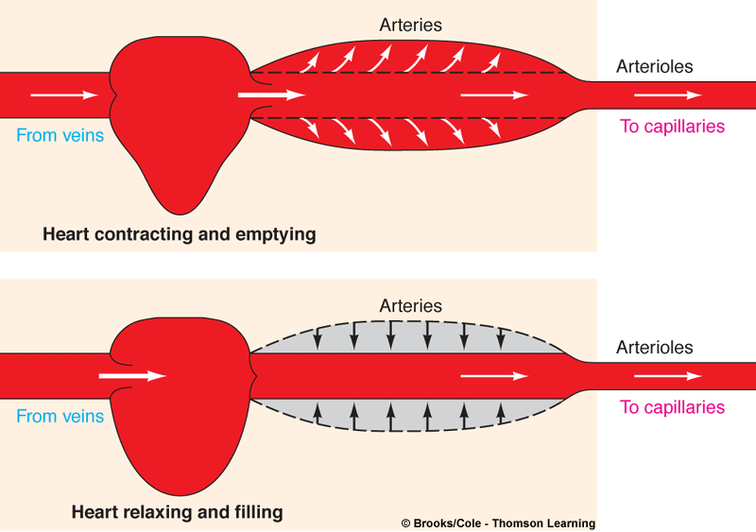
What do u understand by term PULSE?
The alternate expansion and recoil of elastic arteries after each systole of the left ventricle creating a traveling pressure wave that is called the PULSE.

Slide 4
The normal pulse rate is 60-100 bpm.
It is under control of ANS
HR increases with incr. sympathetic activity
Decreases with increased parasympathetic activity
A HR more than 100- Tachycardia
HR less than 60-Bradycardia.
Normally higher in children and low in elderly.
HR is higher in inspiration and lower in expiration.

Slide 5
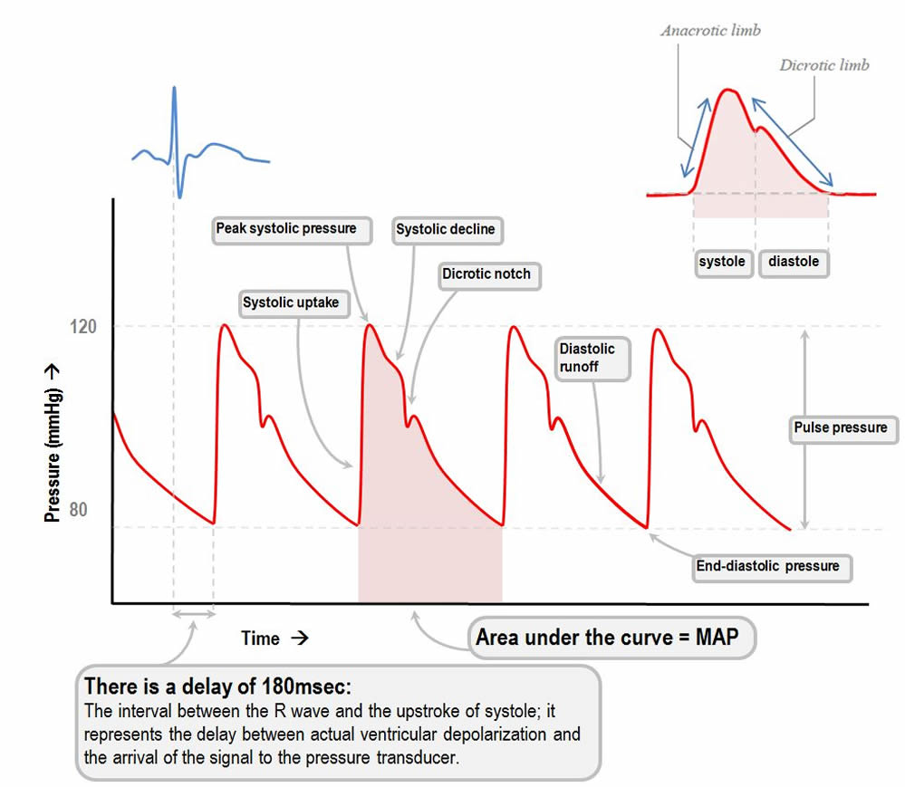

Slide 6
INTERPRETATION(1/2)
Anacrotic limb is the ascending limb, percusssion wave –expansion of artery due to ventricle systole, corresponds to max.ejection phase.
Catacrotic limb is the descending limb.

Slide 7
  INTERPRETATION(2/2)
  Dichrotic notch- notch on downstroke,similar to incisura of of aortic pressure curve-due to reflux of blood back into aorta, closure of aortic valve.negative wave.
Dicrotic wave-positive wave, wave below dicrotic notch,blood rebounds from closed aortic valve

Slide 8
Abnormal character of
the arterial pulse wave

Slide 9
Anacrotic pulse-
2 upbeats, seen in aortic stenosis,
Results in slow ejection of blood from LV
Pulse is typically small volume,slow rising
Peak is delayed compared with normal pulse.

Slide 10
Slow rising or Pulsus Parvus
(Parvus=small), small, weak pulse rises slowly and has a late systolic phase.
Weak upstroke is due to decreased stroke volume.
Seen in conditions diminished LV stroke volume and narrow pulse pressure-Aortic, Mitral stenosis, LVF and hypovolemia

Slide 11
Collapsing or water hammer pulse
Corrigan pulse
This is a sign of aortic regurgitation, although it is sometimes also seen in patients with a hyperdynamic circulation and with a rigid arterial system. A stiff arterial system leads to an accentuated systolic peak in the peripheral pulses. The pulse has an early peak and then quickly falls away, giving it a tapping quality. The preferred method is to palpate the brachial pulse with the whole palm applied to the flexor aspect of the wrist

Slide 12
COLLAPSING PULSE
When a collapsing pulse is detected look for the following signs,
Duroziez sign: Seen in severe aortic regurgitation. Place the diaphragm of the stethoscope over the femoral artery and press downwards. Initially a systolic murmur will be heard. Gradually increase pressure over the artery- a diastolic murmur will become evident also related to the flow reversal with profound aortic regurgitation. Now tilt the proximal edge of the stethoscope further downwards – if aortic regurgitation is present the systolic murmur is accentuated and the diastolic component is diminished. Now tilt the distal edge of the stethoscope downwards, the diastolic component will now be accentuated and the systolic reduced. This sign has a positive predictive value of close to 100% for aortic regurgitation, and can detect this lesion in some patients in whom it is not possible to hear the characteristic diastolic murmur on auscultation of the heart

Slide 13
COLLAPSING PULSE
Traubes sign: A “pistol shot” sound heard over the femoral artery with the aid of a stethoscope. It is necessary to compress the femoral artery distal to the stethoscope head to produce the characteristic double tone sound.
Hills sign: This is a nonspecific sign of aortic regurgitation- it is also seen in other causes of a hyperdynamic circulation, such as thyrotoxicosis, beri-beri, or pregnancy. Check the blood pressures in the upper and lower limbs. If the pressure in the lower limbs exceeds that in the upper limbs by more than 20 mmHg then the sign is positive.
Quinkes sign: Pulsatile blanching of the nail bed
De Musset’s sign: Named after the famous French poet whose head nodded in time with his arterial pulsations due to his syphilis related aortic regurgitation

Slide 14
Pulsus bisfereins
Combination of above 2.
Slow rising and collapsing pulses.
Seen in combined aortic stenosis and aortic regurgitation.

Slide 15
Pulses paradoxus
Pulse becomes smaller or disappear at end of deep inspiration.(dec. in pulse volume,normal fall is 8-10mmHg).
It is called paradoxus – as heart sounds still be heard on auscultation over precordium, when no pulse is palbable at radial artery.
Commonly seen in- large pericardial effusion(Cardiac tamponade).
Constrictive pericarditis.

Slide 16
Pulsus Alterans
Arterial pulses typically show alternate large & small amplitude, but regular beats.
It is seen when Lt.ventricle is severely damaged (Myocardial infarction),LVF.
This causes alternate strong and weak contractions,beats.
Seen in arterial hypertension,coronary artery disease.

Slide 17
Pulse delay
Delay in appearance between radial and femoral pulse is useful for diagnosis of –
Coarctation of aorta.
Significance-
To asses the state of myocardium,valves.
To asses cardiac arrythmias
To asses condition of vessel wall
Rough guide to estimate the arterial BP.

Slide 18
Dicrotic Pulse
There are 2 palpable waves
1 in systole other in diastole
Encountered in patients with very low stroke volume.
In those with dilated(congestive) cardiomytopathy, infarction.

Slide 19
Plateau Pulse
Pulse wave rises slowly
Delayed and sustained peak
Pulse fades away slowly
Such pulse is sometimes seen in aortic stenosis.

Slide 20
Apical impulse-apex beat
Lower most, outer most point of cardiac pulsation.
Normally felt in Lt.5th intercostal space
Half inch medial to midclavicular line.
This is apical area, corresponds with mitral area.
Impact of ventricles against chest wall.

Slide 21
Describing the pulse
The pulse is described by
Rate
Rhythm
Volume
State of the vessel wall
Synchronous with other pulse /EQUALITY.

Slide 22
1.RATE
The rate of the pulse is recorded in beats per minute. The rate should be counted over a minimum of thirty seconds.
The normal resting pulse rate is 72/min.
Abnormal slow (bradycardia)<60/min
Abnormal fast (tachycardia) >100/min

Slide 23
2.RHYTHM
Normally pulse beat at – Regular inteverval.
Regular or Irregular,
If irrrgular-Regularly irregular( Extra systole).
Irregularly irregular-( due to atrial fibrillation).

Slide 24
Irregularly irregular pulse
Seen in atrial fibrillation
Irregularity occurs not only in interval between beats.
Also in the volume of beats.

Slide 25
Irregular rhythm is due to-
Sinus irregularity,or premature contractions.
Sinus irregularity- S.arrhythmia- pulse rate is greater in inspiration but it becomes marked in sinus arrythmia.
Premature contractions- Extrasystole, occurs due to impulse generation from ectopic focus( ectopic beat).

Slide 26
3.VOLUME
The volume of the pulse is a crude indicator of the stroke volume of the heart (the amount of blood ejected by the heart)
It is increased in exercise (full or bounding) and reduced in states of low blood volume (weak or thready)

Slide 27
4.STATE OF THE VESSEL WALL
The normal arterial wall is compressible and has an elastic feel
Diseased arteries may feel inelastic and even hard in cases of calcification

Slide 28
5.EQUALITY ON BOTH SIDES
Compare each of the above features with other sides.
Normally in health all features should be same.
Important note-
Other main peripheral arterial pulses; brachial, carotid, femoral, popliteal, post.tibial and dorsalis pedis artery pulse is noted.
Volume is compared with other side.

Slide 29
READING THE PULSE

Slide 30
While palpating radial pulse-
Middle 3 fingers are used
Index finger is used for occlusion or compression.
Middle is used for assessing the volume and rate of pulse
Ring finger to study the condition of vessel wall.

Slide 31
Common pulse sites
Radial Pulse
Lateral aspect of the lower forearm just proximal to the wrist joint
Feel the bony prominence
Move fingertips medially
Tips of fingers drop into a groove in which lies the artery
Examine the pulse by compressing the artery backwards against the bone, using the finger tips

Slide 32
The brachial pulse
Medial aspect of the antecubital fossa at the line of the elbow joint.
The artery is felt by compressing backwards with fingers or thumb.
Divides just below elbow to form radial and ulnar arteries

Slide 33
Carotid pulse
1-1.5 cm lateral of the midline in the neck at the upper level of the thyroid cartilage
Readily palpable at anterior border of sternomastoid muscle
May be felt with finger tips or thumb which are used to push posteriorly

Slide 34
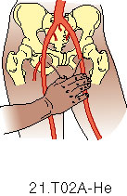
Femoral artery
The femoral artery enters the upper leg by passing under the inguinal ligament.
It enters the leg at the mid-inguinal point.
The femoral artery is usually easily palpated and is an important point of access to the arterial system.

Slide 35
Popliteal artery
The popliteal artery is palpable in the popliteal fossa.
The artery passes through the fossa slightly medially to laterally.
The popliteal artery can be palpated in about the midline of the fossa at the level of the femoral condlyes.
Artery best felt with knee in slight flexion.

Slide 36
Tibialis posterior artery
The tibialis posterior artery is found on the medial aspect of the ankle.
It is palpable at a position midway between the prominence of the medial malleolus and the prominence of the calcaneus.

Slide 37
Dorsalis pedis artery
Dorsalis pedis is a continuation of the tibialis anterior.
Tibialis anterior is often palpable at the ankle joint in a mid-malleolar position, medial to the extensor hallucis longus tendon.

Slide 38

THANKS FOR SILENT WATCHING & SLEEP..
Good bye till we meet again with good news....take care..

