Slide 1
SPIROMETRY

Slide 2
Introduction
Spirometry measures the lung function, specifically the amount (volume) and speed(flow) of air that can be inhaled and exhaled.
A simple and safe Pulmonary Function Test(PFT)

Slide 3
USES
To detect respiratory disease in patients presenting with breathlessness
To diagnose and differentiate between Obstructive lung disease and Restrictive lung disease
To Indicate a patient’s optimal response to treatment or the rate of decline in lung function

Slide 4
Volumes
Lung volumes refer to the volume of air associated with different phases of respiratory cycles.
It is the qualitative assessment of lung functions
Tidal volume
Inspiratory reserve volume
Expiratory reserve volume
Residual volume

Slide 5
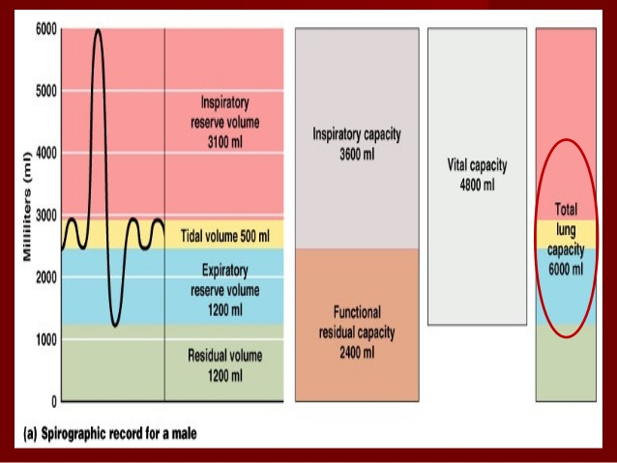

Slide 6
Lung capacity
Lung capacities are inferred from lung volumes
It is the quantitative assessment of lung functions
Inspiratory capacity
Expiratory capacity
Functional residual capacity
Vital capacity
Total lung capacity

Slide 8
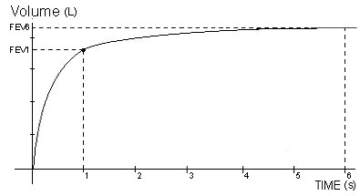
Spirogram
Spirometry reveals 2 types of graph :
1. Volume-Time graph( Volume in Y axis, Time in X axis)

Slide 9
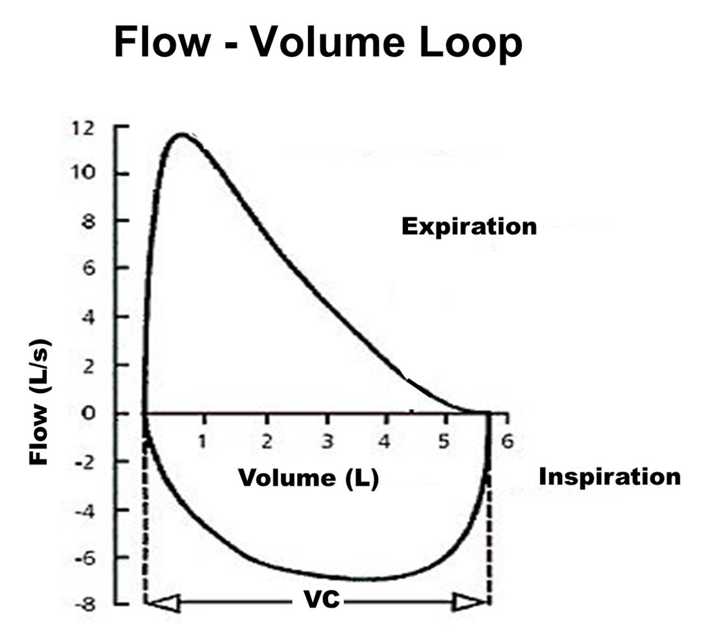
Spirogram
2. Flow- volume graph(loop)( rate of airflow in Y axis, Total volume inspired/expired in X axis)

Slide 11
Contraindications
Hemoptysis
pneumothorax
Recent angina/MI
Aneurysm
Recent eye surgery
Recent viral infection
Undiagnosed hypertension

Slide 12
IDENTIFICATION
The basic components of Spirometer are:
Mouth piece
Tube / hose- connecting mouth piece and spirometer
An electronic device to measure flows and calculate spirometry parameters.

Slide 13
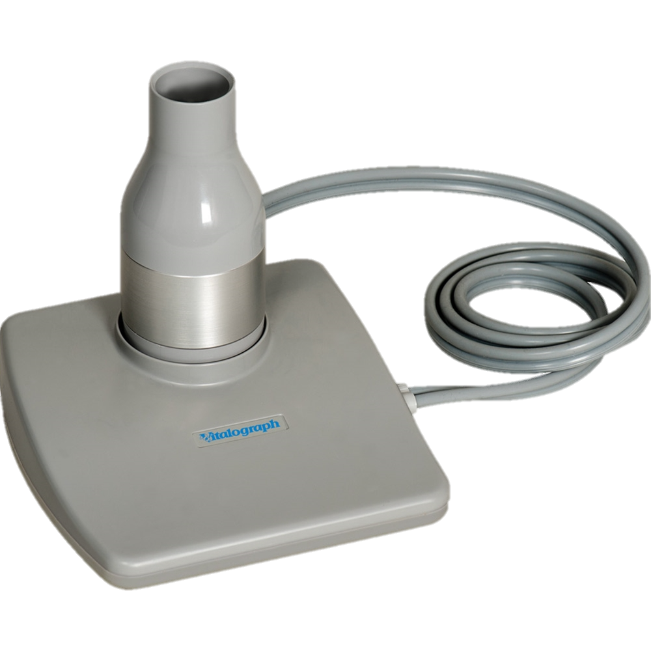
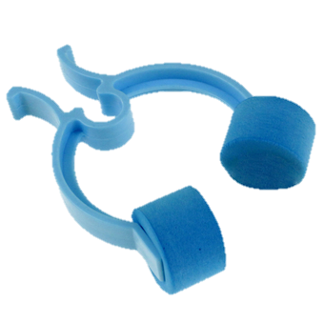
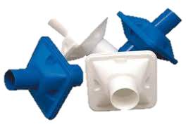
IDENTIFICATION

Slide 14
PROCEDURE
The patient should be seated in a chair with arms
Two relaxed measurements of vital capacity should be performed first ,(the patient should use nose clips)followed by three forced vital capacity measurements
A large breath to full inspiration is taken through mouth

Slide 15
PROCEDURE
The mouth piece is placed into the patient’s mouth and the patient is asked to place his or her lips and teeth around the mouth piece to form a tight seal
For the relaxed VC, the patient breathes out at a comfortable speed, but for the FVC the patient should breathe out hard and quickly until all air is expired
The FVC should take 6s, but in some patients with obstructive breathing patterns it can take up to 15s

Slide 16
CAUTION
At least 30s should be left between blows to enable the patient to recover
A mininum of three and a maximum of eight blows should be attempted at any one time
It is vital that patients inhale completely, to total lung capacity, and continue to exhale until they have fully emptied their lungs
Observe the shape of the flow/ volume or volume/time curves to detect poor effort

Slide 17
Spirometry

