Slide 1































Surgical Disorder of Spleen
Dr. BINO

Slide 2
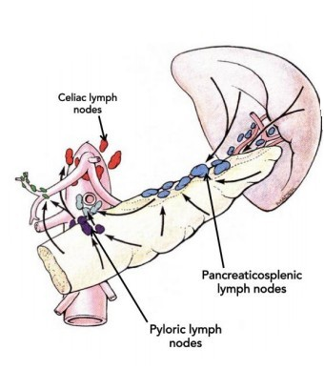
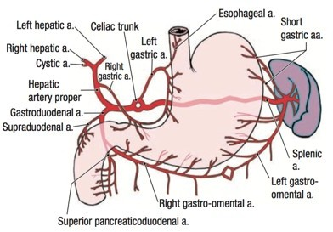
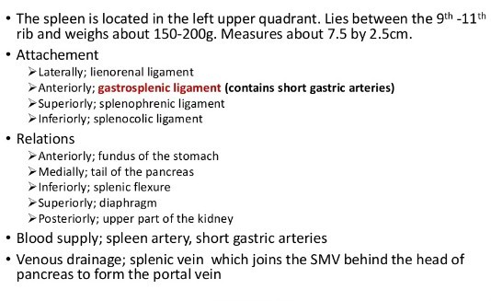
Anatomy

Slide 3
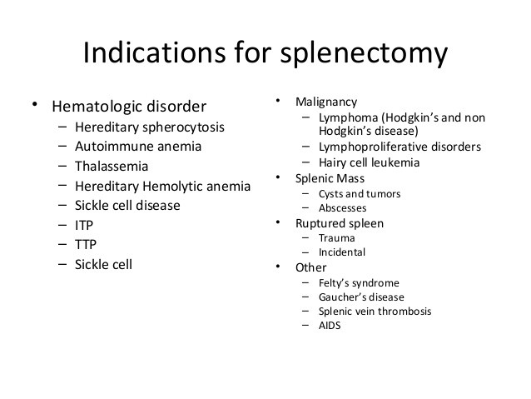

Slide 4
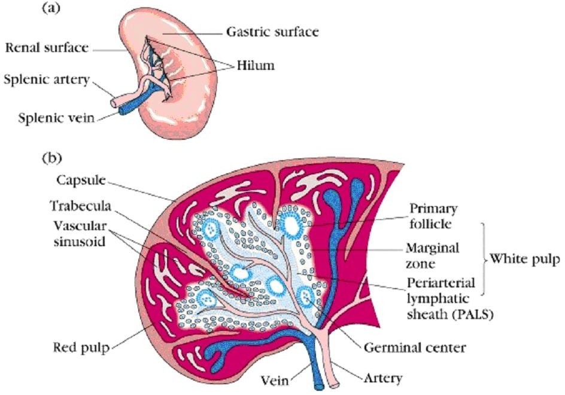
Splenectomy for Hematologic Diseases
Rarely cures the disease
Alleviates symptoms
Corrects hematologic abnormalities
Staging & Diagnosis

Slide 5
Splenectomy for Hematologic Diseases
Autoimmune Hemolytic Anemia (AIHA)
^{λ} Treatment Of Choice
λ
λ
λ
#1 is Corticosteroids 1-2 mg/kg/day
PRBC’s for severe anemia
Splenectomy (80% favorable clinical response) if:
λ
λ
medical tx fails
Intolerance to steroids or its side-effects
Sickle Cell Disease (SCD)
Splenectomy (palliative)
Acute sequestration crises (recurrence = 40%-50% with 20% Mortality rate)
Rapid hypersplenism
Abscess formation

Slide 6
Splenectomy for Hematologic Diseases
ITP
Spleen is not enlarged
TTP
Splenomegaly
#1 TOC
Plasmaphoresis
Splenectomy is #2
Red Cell-Related Indications
Hereditary Spherocytosis (HS)
Most common type of hemolytic anemia Splenomegaly & Gall stones
Dx by (+) spherocytes in the blood
Splenectomy in the 4th year of life
+/- cholecystectomy if (+) cholelithiasis
λ
λ
λ
λ
Splenectomy if fail steroid tx
λ
λ
Thalassemia
Thalassemia major (homozygous B)
Splenectomy indicated if:
Symptomatic splenomegaly
↑ rate of infections after splenectomy
Risk vs. Benefit

Slide 7
White Cell - Related Indications
Leukemia
Hodgkin’s Disease
Current indications for surgical staging:
Stage I or Stage II Staging procedure Wedge liver biopsy LN sampling:
Retroperitoneal Mesenteric Hepatoduodenal Splenectomy
λ
λ
CLL & Hairy cell leukemia (HCL)
Splenectomy
λ
λ
improves cytopenias (75%)
Ameliorates symptomatic splenomegaly
Non-Hodgkin’s Lymphoma (NHL)
λ
Splenectomy
λ
λ
Painful splenomegaly Cytopenia
λ
No role for staging

Slide 8
Tumors, Cysts, and Abscesses of the Spleen
Malignant Tumors
Spleen - mostly secondary involvement
non-Hodgkin’s Lymphoma – most common malignancy
λ
Main Tx: Chemo +/- RT
^{λ} Spleen is the primary site
λ
λ
10% Hodgkin’s disease
30% of resected spleens (staging procedure) have (+) histology
^{λ} Hairy cell leukemia
λ
Resect for symptomatic splenomegaly
λ
Improved survival
^{λ} CML & CLL
λ
symptomatic splenomegaly = splenectomy

Slide 9
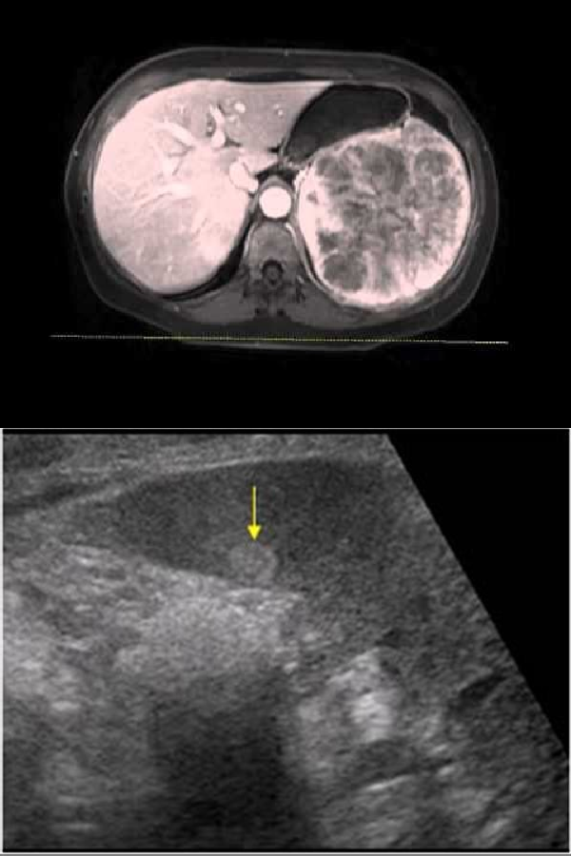
Malignant Tumors
λ
Angiosarcoma
λ
λ
λ
λ
Non lymphoid malignant tumor of the spleen Early metastatic disease
Aggressive with rapid growth
Spontaneous splenic rupture and hemolytic anemia
Benign Tumors
λ
Hemangioma
λ
λ
Risk of rupture + platelet sequestration (Syndrome?) No tx unless symptomatic
λ
λ
Hamartoma Lymphangioma

Slide 10
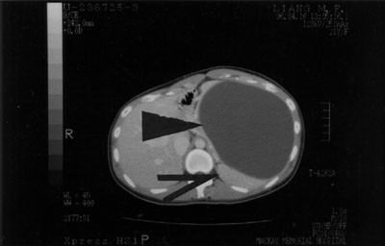
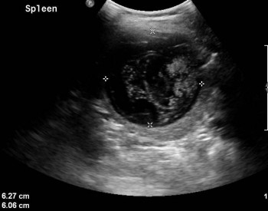
Splenic Cysts
Nonparasitic
Epithelium-lined cysts Epidermoid cysts – most common Mostly asymptomatic
Young children + young adults LUQ pain, N/V, early satiety
Dx: CTscan (+)unilocular +/- Ca⁺⁺
Complications
Parasitic
5% in US
Abroad – Hydatid disease
Echinococcus granulosus
Mostly asymptomatic
Associated with liver cysts
If only spleen is involved?
^{λ} Tx: Splenectomy
λ
λ
λ
λ
λ
λ
λ
λ
λ
λ
λ
Infection, bleeding, rupture
Tx: Splenectomy
^{λ} partial

Slide 11
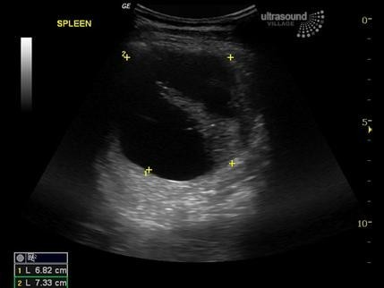
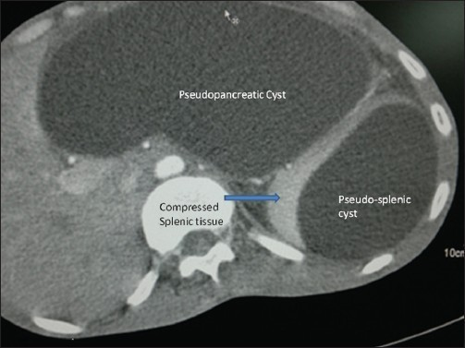
Splenic Cysts
^{λ} Splenic Pseudocysts
λ
λ
Lack epithelial lining
Account for most cystic splenic dz in US
λ
λ
Pancreatic pseudocyst Posttraumatic
λ
Splenectomy is indicated when:
λ
λ
Size >10 cm or symptomatic

Slide 12
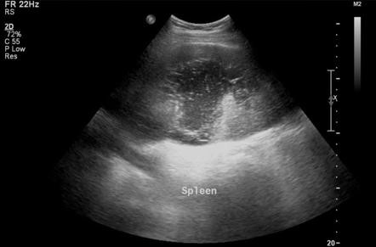
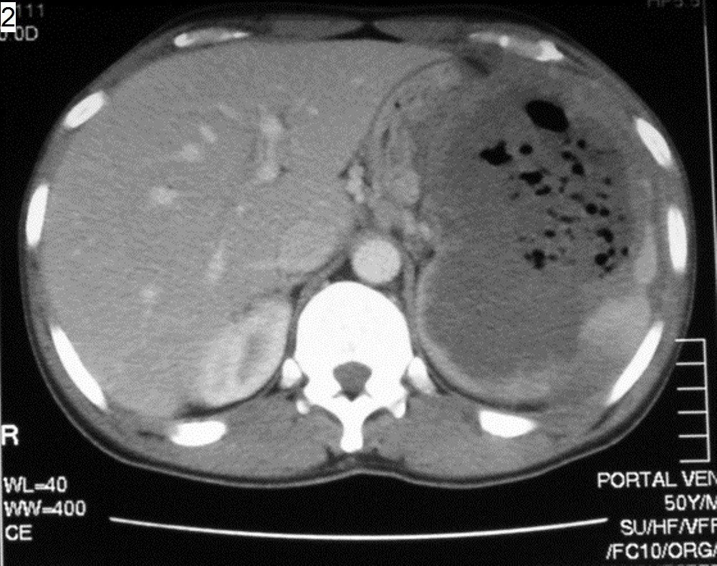
Splenic Abscess
λ
Uncommon, but fatal
λ
Erode into adjacent structures
λ
Most are secondary in etiology
λ
λ
λ
λ
Bacterial endocarditis
Intrabdominal infections (pyelo-, etc) Infected splenic hematoma
Infected splenic infarctions (embolizations, ischemia, etc)
λ
S/S: fever, WBC;
λ
50% (+) blood cultures
λ
λ
λ
λ
Dx by CT scan + IV contrast Staphylococcus & Streptococcus E.coli, Salmonella, anaerobes Tx:
λ
λ
Splenectomy + IV Abx
Percutaneous drainage

Slide 13
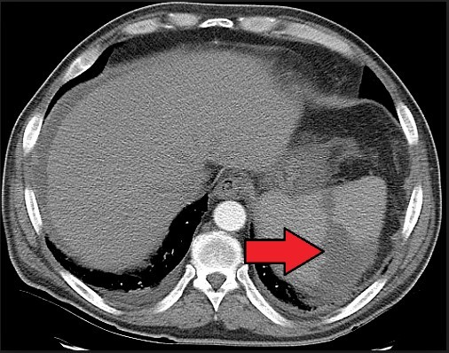
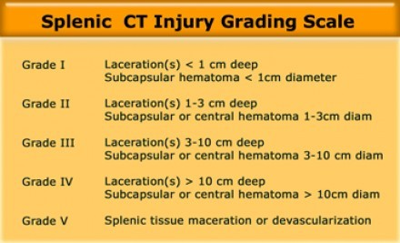
TRUMATIC MANGMENT

Slide 14
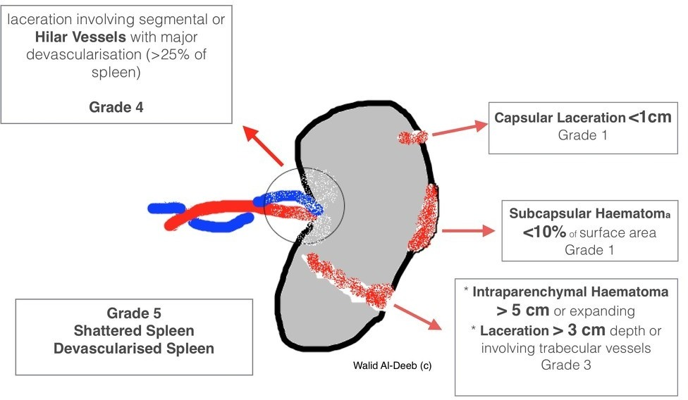
AAST splenic injury grading

Slide 15
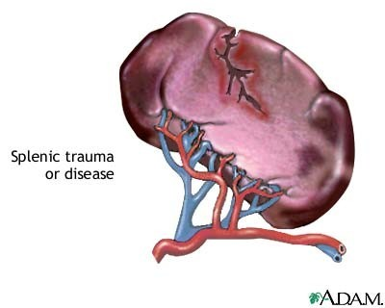
Nonoperative Management of Splenic Trauma
Indications for initial nonoperative management
hemodynamic stability
absence of peritonitis
CT scan
λ
λ
No contrast extravasation absence of other injuries
^{λ} Transfusions - >2 PRBC’s

Slide 16
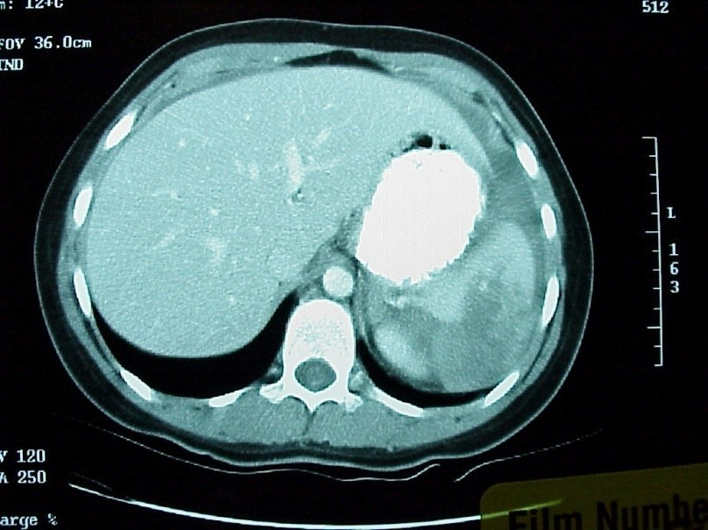
Protocol for Nonoperative Management
Grade I & II
λ
Awake + alert, isolated injury 2-3 days
λ
monitored observation
λ
λ
λ
serial abdominal exams
If remain stable and asymptomatic – D/C in 5 days F/U CT scan in 4 wks
λ
Avoid prophylactic and therapeutic heparinization
λ
Grade III, IV, & V
λ
λ
λ
λ
Monitored observation x5 days Repeat CT scan
Transfer to floor if stable
F/U CT scan in 6-8 wks after discharge

Slide 17
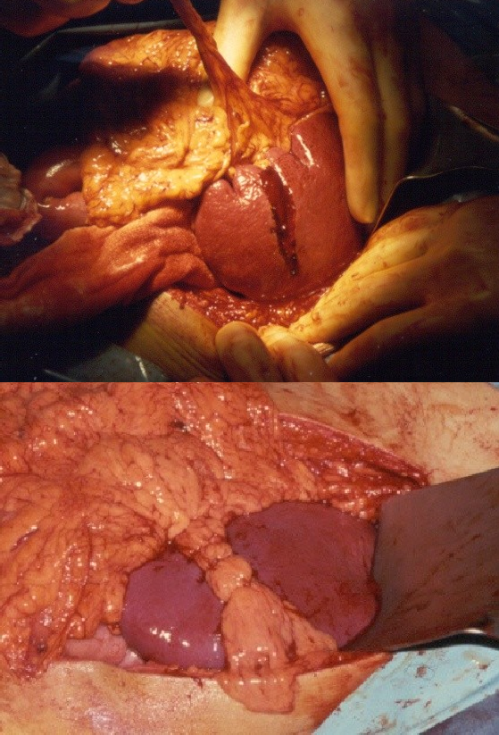
Splenorrhaphy
^{λ} Topical Hemostasis
λ
Small injuries (I & II)
λ
λ
λ
λ
λ
Bovie electrocautery Argon beam Gelfoam
Surgical Avitene
^{λ} Suture Repair & Partial Resection
λ
λ
Segmental blood supply Monofilament sutures
λ
Pledgeted horizontal mattress sutures

Slide 18
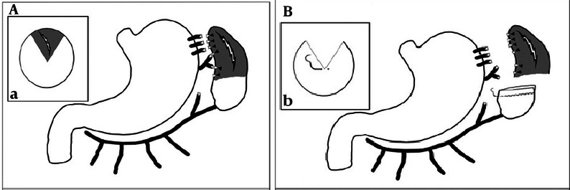
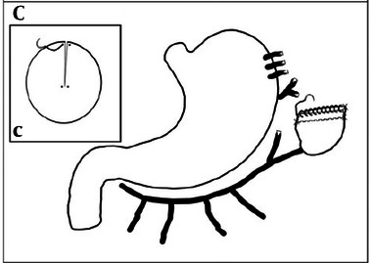
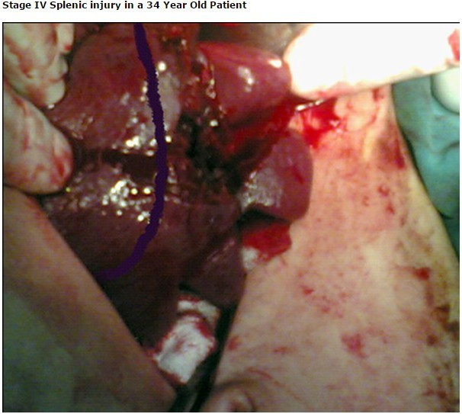
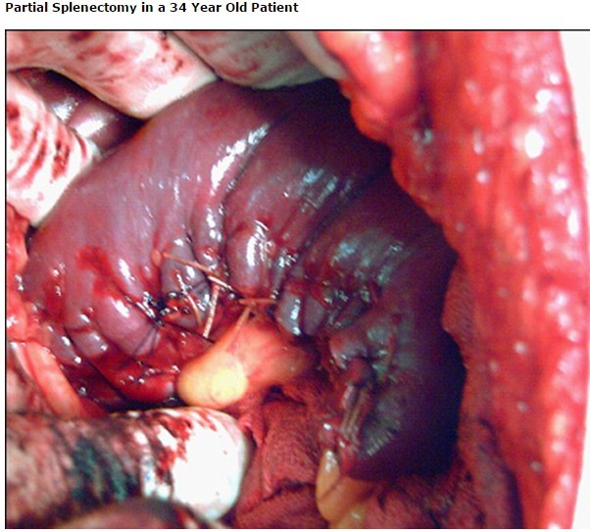
Splenorrhaphy

Slide 19
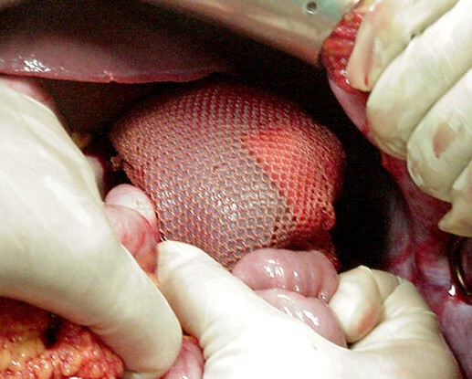
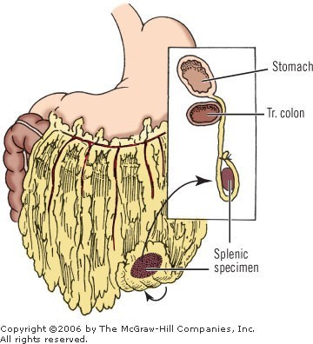
Splenorrhaphy
^{λ} Mesh Splenorrhaphy Autotransplantation

Slide 20
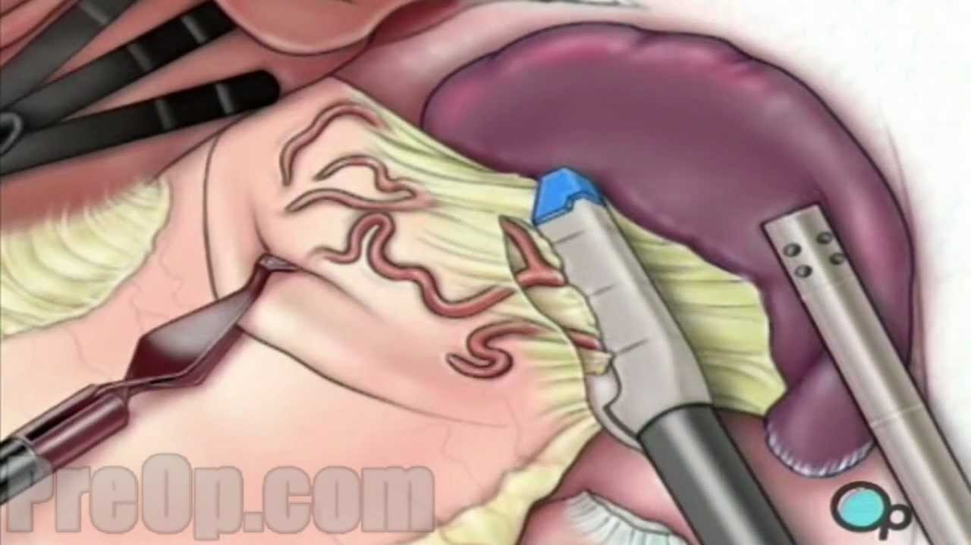
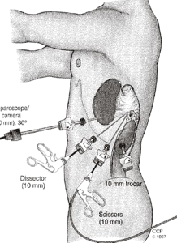
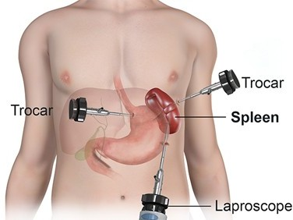
Laproscopic splenetomy

Slide 21
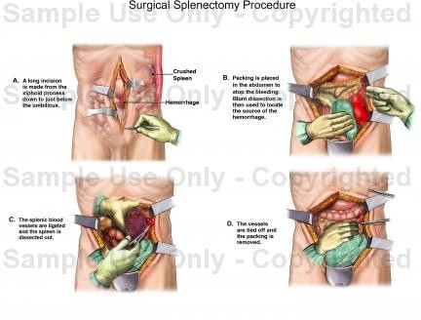
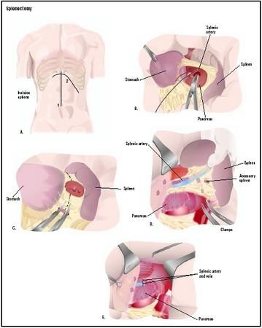
Open splenctomy

Slide 22
Splenectomy Complications
LLL atelectasis, pneumonia, effusion
Hemorrhage (mostly with laparoscopic)
Intraabdominal abscess (LUQ)
Pancreatitis or fistula formation
DVT & PVT
λ
Hemolytic anemia or myeloproliferative dz with splenomegaly
^{λ} OPSI : An overwhelming post-splenectomy infection is a rare but rapidly fatal infection occurring in individuals following removal of the spleen. The infections are typically characterized by either meningitis or sepsis, and are caused by encapsulated organisms including Streptococcus pneumoniae.

Slide 23
Splenectomy Complications
OPSI
λ
λ
Incidence ≈1% (up to 5%); 50% Mortality Risk factors
Children < 15 yrs old
Immunosupression
Hematologic dz (thalassemia, SCD, etc)
Highest within the first 2 yrs post splenectomy
Pnemococcus, H.influenza, meningococcus
λ
λ
vaccination 7-14 days prior to splenectomy
λ
λ
Pneumovax booster Q5yrs and annual H.influenza immunizations Abx prophylaxis for children x2 yrs post splenectomy

Slide 24
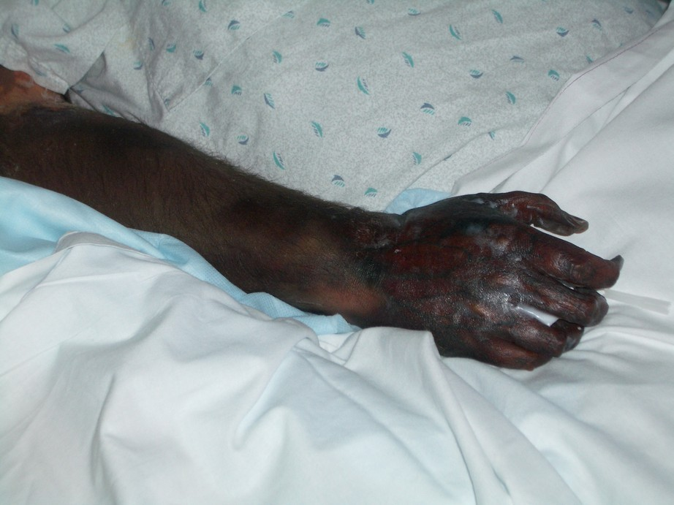

Slide 25
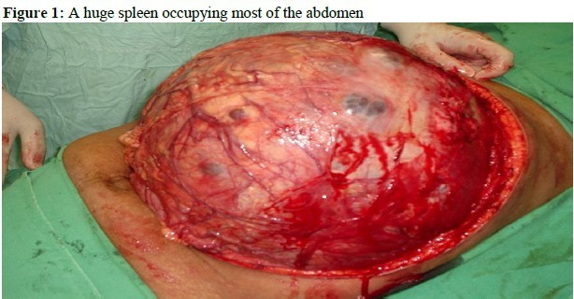
The End Thanks

