Slide 1
THUJA OCCIDENTALIS
Dr. C.R. KRISHNAKUMARI AMMA
PROF & HOD
DEPT OF MATERIA MEDICA

Slide 2
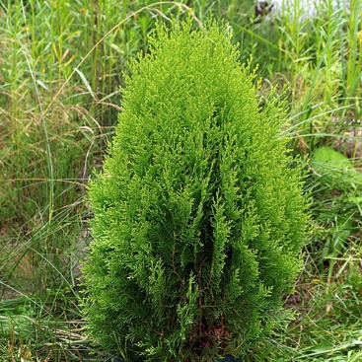

Slide 3
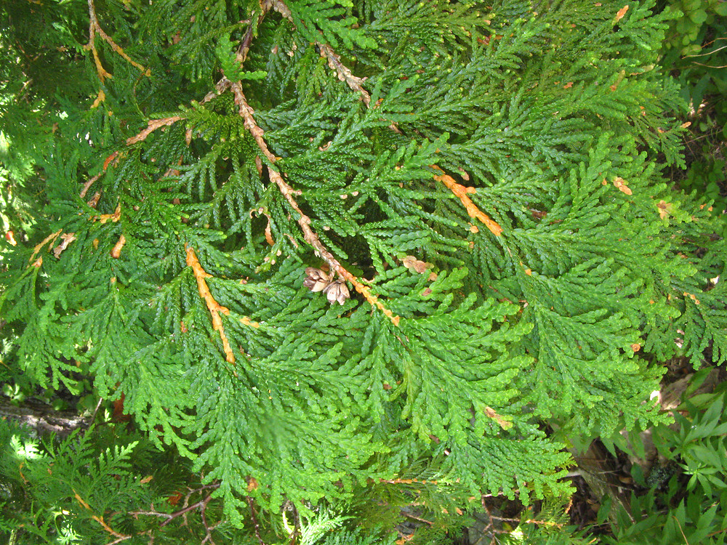

Slide 4
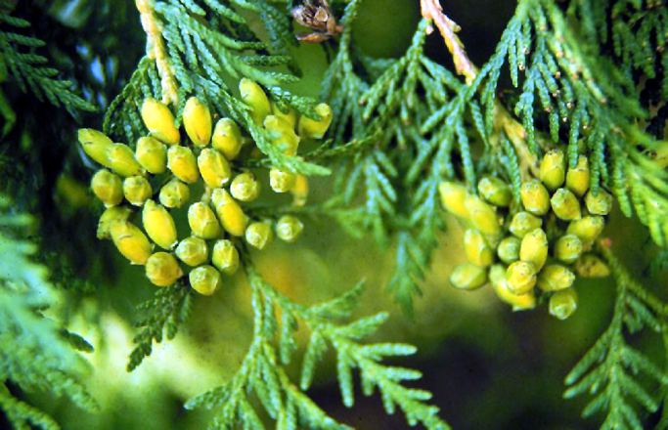
THUJA OCCIDENTALIS

Slide 5
THUJA OCCIDENTALIS
COMMON NAME: Tree of Life; White Cedar; Arbor Vitae.
FAMILY: Coniferae.
PROVED BY:Dr.Hahnemann

Slide 6
SPHERE OF ACTION
Mucous membranes: GENITO-
URINARY.
Intestines.
Mind
Nerves
Occiput
Glands. SKIN
Left side; ovary.

Slide 7
KEY POINTS
Sycosis of Hahnemann-fig warts.
Bad effects of vaccination.
Supression of gonorrhea.
Metastasis
Sweat.
Periodicity
Thermal: Chilly

Slide 8
AILMENTS FROM
From bad effects of vaccination.
From suppressed or maltreated gonorrhoea.

Slide 9
CONSTITUTION
Adapted to; Von Grauvogl’s hydrogenoid constitution.
Acts well in lymphatic temperament, in very fleshy persons, dark complexion, black hair, unhealthy skin.

Slide 10
MENTAL GENERALS
Fixed ideas.
Hasty and anxious; over trifles.
Sensation as if; an animal crying in abdomen, motion as if something alive, protrudes here and there like the arm of a foetus.

Slide 11
HEAD
Vertigo, when closing the eyes.
Headache : as if a nail had been driven into parietal bone; or as if a convex button were pressed on the part.
< from sexual excesses; overheating; from tea.
Chronic, or sycotic or syphilitic origin.

Slide 12
EYES
Ophthalmia neonatorum.
Large granulations, like warts or blisters.
Eyelids; agglutinated; styes and tarsal tumors.
Chalazion.

Slide 13
EAR SYMPTOMS
Chronic otitis media like putrid meat.
Condylomata; polyp bleeds easily.
Chronic catarrh of ears.

Slide 14
MOUTH
Tongue: White blisters on side close to root, painfully sore.
Teeth decay at the roots, crowns remain sound; crumble, turn yellow.
Toothache from tea drinking.
Ranula: bluish, or varicose veins on tongue or in mouth.

Slide 15
GASTRO-INTESTINAL SYMPTOMS
Loss of appetite.
Dyspepsia
Desire: Salt
Aversion: Fresh meat and potatoes.
Cannot eat onions.
Diarrhea: early morning; gurgling, as water from a bunghole.

Slide 16
Flatulence
Constipation: Stool recedes, after being partly expelled.
Anus fissured; painful, with warts.

Slide 17
URINARY SYMPTOMS
Paralysis of sphincter vesicae.
Desire sudden and urgent, but cannot be controlled.
Urinary stream split and small.
Sensation of trickling after urinating.

Slide 18
MALE
Balanitis and Balanoposthitis.
Gonorrhoeal rheumatism.
Chronic induration of testicles.
Prostatic enlargement.

Slide 19
FEMALE
Very sensitive vagina.
Warty excrescences on genitals.
Ovaritis; left side, at every menstrual period.
Profuse perspiration before menses.

Slide 20
EXTREMITIES
Muscular twitchings, weakness and trembling.
Tips of fingers swollen and red.
Cracking in joints.
Pain in heels and tendo-Achilles.
Brittle and ingrowing toe nail.
Pain better by drawing up the limb.

Slide 21
SKIN
Eruptions only on covered parts; worse on scratching.
Unhealthy skin.
Warts on any parts of the body; fig warts.
Herpetic eruptions.
Sarcoma; polypi.
Brown spots on hands and arms.

Slide 22
GENERAL MODALITIES
AGGRAVATION:
At night, from heat of bed.
At 3 a.m and 3 p.m.
Cold, damp air.
After breakfast.
Fat, coffee, narcotics.

Slide 23
AMELIORATION:
Left side, while drawing up a limb.
By movements.
Pressure.
Rubbing and scratching.

Slide 24
RELATIONSHIP
Complementary to: Med, Sab, Staph.
Complements: Ars, Nat-s, Sab, Sil, Med.
Follows well: after Med, Merc, Nit-ac.
Remedies follow well: Asaf, Calc, Ign, Kali-c, Lyc, Merc, Nit-ac, Puls, Sab, Sil, Sulph.
Antidotes: Camph, Cham, Cocc, Merc, Puls, Sulph, Staph.

