Slide 1
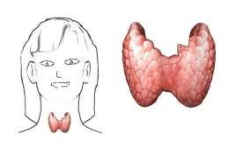
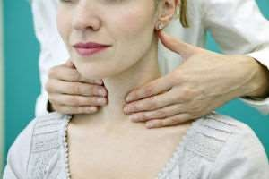
Thyroid Gland Examination
Dr. Varun. S
Dept.of . Surgery
Skhmc

Slide 2
Outlines
Anatomy
Physiology
Goiter
Presenting Complaint
Examination

Slide 3
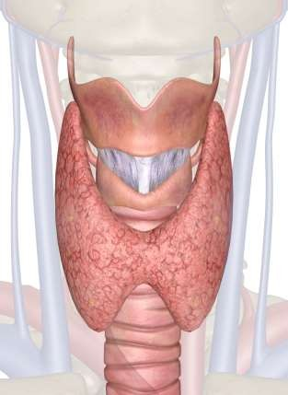
Anatomy
Site = In front of lower Part of neck/located in the cervical region anterior to the larynx consists of 2 lobes united by an isthmus. Right lobe is slightly larger than left lobe
Each lobe extends from middle of thyroid cartilage to fourth or fifth tracheal ring.
Isthmus extends from second to fourth tracheal ring
Shape = Butterfly

Slide 4
Physiology
Endocrine gland
The Thyroid secrete Hormones belonging to the Amine Group of Hormones, derived from the amino acid Tyrosine:
  Thyroxin (T4) • Tri-iodothyronine (T3)
Thyroid secretions are under influence of TSH (thyroid Stimulation Hormone) from pituitary gland.

Slide 5
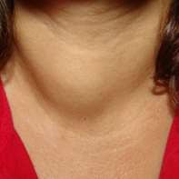
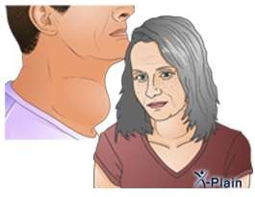
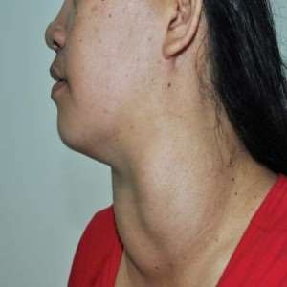
Goiter
A diffuse enlargement of thyroid gland.
Most common manifestation of thyroid diseases.
There is no direct correlation between size and function- a person with a goiter can be euthyroid, hypo- or hyperthyroid.

Slide 6
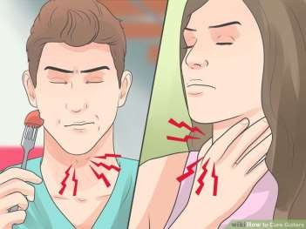
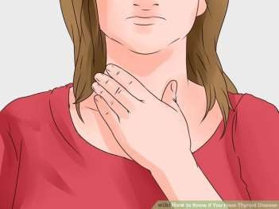
Presenting Complaint
A visible swelling at the base of your neck that may be particularly obvious when you shave or put on makeup
A tight feeling in your throat
Coughing
Hoarseness
Difficulty swallowing
Difficulty breathing

Slide 7
Examination
Before proceeding to the examination take a proper history.
Wash hands
Introduce yourself
Confirm patient details – name / DOB
Explain the examination
Gain consent
Position the patient – sitting on a chair

Slide 8
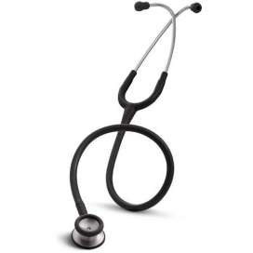
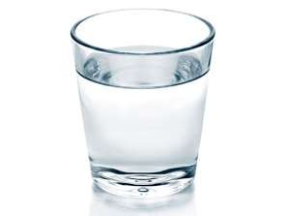
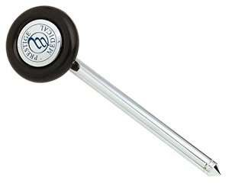

Gather equipment
Stethoscope
Glass of water
Tendon hammer
Piece of paper

Slide 9
Examination (cont.)
The examination consists of:
Inspection,
Palpation,
Percussion
Auscultation

Slide 10


Inspection
Anterior Approach
Lateral Approach

Slide 11
What to inspect??
Behaviour
Hands
Pulse
Face
Eyes
Thyroid

Slide 12

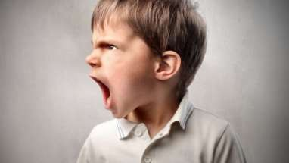
Behaviour
Does the patient appear hyperactive?
agitation / anxiety / fidgety (hyperthyroidism)
Does the patient appear hyporactive? – (hypothyroidism)

Slide 13
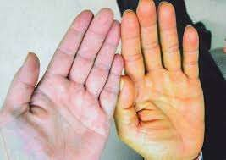
Hands
Inspect the patients hands for…
Dry skin (hypothyroid)
Increased sweating (hyperthyroid)
Thyroid acropachy – phalangeal bone overgrowth – Graves’ disease
Palmar erythema – reddening of the palms at the thenar / hypothenar eminences – hyperthyroidism

Slide 14
Hands (cont.)
Peripheral tremor
1. Ask the patient to place their arms straight out in front of them
2. Place a piece of paper across the backs of their hands
3. Observe for a tremor (the paper will quiver)
Peripheral tremor can be a sign of hyperthyroidism.

Slide 15
Pulse
Assess the radial pulse for…
Rate:
Tachycardia (hyperthyroidism)
Bradycardia (hypothyroidism)
Rhythm – irregular (AF) – thyrotoxicosis

Slide 16
Face
Inspect the face for…
Dry skin – hypothyroidism
Sweating – hyperthyroidism
Eyebrows– loss of the outer third (Queen Anne’s sign/ sign of Hertoghe) – hypothyroidism (rare)
Joffroy’s sign – Absent creases in the forehead on upward gaze
(hyperthyroidism)

Slide 17
Eyes
Exophthalmos (anterior displacement of the eye out of the orbit)
Inspect from the front, side and above
Note if the sclera is visible above the iris (lid retraction) – seen in Graves’
disease
Inspect for any redness / inflammation of the conjunctiva
Bilateral exophthalmos is associated with Graves’ disease, caused by abnormal connective tissue deposition in the orbit and extra-ocular muscles.

Slide 18
Eyes (cont.)
Eye movements
1. Ask the patient to keep their head still & follow your finger with their eyes
2. Move your finger through the various axis of eye movement (“H“ shape)
3. Observe for restriction of eye movements & ask the patient to report any double vision or pain
Eye movement can be restricted in Graves’ disease due to abnormal connective tissue
deposition in the orbit and extra-ocular muscles.

Slide 19
Eyes (cont.)
Lid lag
1. Hold your finger high & ask the patient to follow it with their eyes (head still)
2. Move your finger downwards
3. Observe the upper eyelid as the patient follows your finger downwards
If lid lag is present the upper eyelid will be observed lagging behind the eyes’ downward movement (the sclera will be visible above the iris). Lid lag occurs as a result of the anterior protrusion of the eye from the orbit (exophthalmos) which is associated with Graves’ disease.

Slide 20
Thyroid
Inspect the midline of the neck (in the region of the thyroid)
Any skin changes / erythema?
Any scars? – previous thyroidectomy scars can easily be missed

Slide 21
Thyroid (cont.)
Masses
Note any swelling / masses in the area – assess size & shape
The normal thyroid gland should not be visible.

Slide 22
Thyroid (cont.)
If a mass is noted on inspection…
1. Ask patient to swallow some water:
Observe the movement of the mass
Masses embedded in the thyroid gland will move with swallowing
Thyroglossal cysts will also move with swallowing
Lymph nodes will move very little

Slide 23
Thyroid (cont.)
2. Ask patient to protrude their tongue:
Thyroid gland masses / lymph nodes will not move
Thyroglossal cysts will move upwards noticeably

Slide 24
Palpation
Anterior Approach
Posterior Approach
Thyroid examination is best carried out from behind, with patient’s neck slightly extended.

Slide 25
Palpation
Stand behind the patient & ask them to slightly flex their neck (to relax the sternocleidomastoids).
Place your hands either side of the neck.
Ask if the patient has any pain in the neck before palpating.

Slide 26
Palpation (cont.) thyroid
When palpating the thyroid gland, assess the following:
Size – does it feel enlarged? – goitre
Symmetry – is one lobe significantly larger than the other?
Consistency – does the thyroid feel smooth or nodular? – e.g. multinodular goitre
Masses – are there any distinct masses within the thyroid gland’s tissue?
Palpable thrill – sometimes noted in thyrotoxicosis – due to increased vascularity

Slide 27
Palpation (cont.)
Procedure:
1. Place the 3 middle fingers of each hand along the midline of the neck below the chin
2. Locate the upper edge of the thyroid cartilage (“Adam’s apple”)
3. Move inferiorly until you reach the cricoid cartilage / ring
4. The first 2 rings of the trachea are located below the cricoid
cartilage and the thyroid isthmus overlies this area

Slide 28
Palpation (cont.)
5. Palpate the thyroid isthmus using the pads of your fingers(index finfers) (not the tips)
6. Palpate each lateral lobe of the thyroid including inferior border in
turn by moving your fingers down and slightly laterally from the isthmus
7. Ask the patient to swallow some water, whilst you feel for symmetrical elevation/superior movement of the thyroid lobes(asymmetrical elevation may suggest a unilateral thyroid mass)
8. Ask the patient to protrude their tongue once more (if a mass is a thyroglossal cyst, it will rise during tongue protrusion)

Slide 29
Palpation (cont.)
If a mass is noted…
Assess – position / shape / tenderness/ consistency / mobility

Slide 30
Palpation (cont.) Lymph nodes
Palpate for local lymphadenopathy:
Supraclavicular nodes
Anterior cervical chain
Posterior cervical chain
Submental nodes
Local lymphadenopathy may suggest metastatic spread of a primary thyroid malignancy.

Slide 31
Palpation (cont.) Trachea
Note any deviation of the trachea – may be caused by a large thyroid mass

Slide 32
Percussion
Percuss downwards from the sternal notch.
Retrosternal dullness may indicate a large thyroid mass, extending posterior to the manubrium.

Slide 33
Auscultation
Auscultate each lobe of the thyroid for a bruit.
A bruit would suggest increased vascularity, which occurs in Graves’ disease.

Slide 34
Special tests
Reflexes – e.g. Biceps – hyporeflexia is associated with hypothyroidism
Inspect for pre-tibial myxodema – associated with Graves’ disease
•
Proximal myopathy:
Ask patient to stand from a sitting position with arms crossed
An inability to do this suggests proximal muscle wasting
Proximal myopathy is associated with hyperthyroidism

Slide 35
To complete the examination
Thank patient
Wash hands
Summarize findings
Further assessments & investigations
Thyroid function tests (TSH / T4)
ECG – if irregular pulse noted
Further imaging – USS

Slide 36
Thanks

